Slide 1

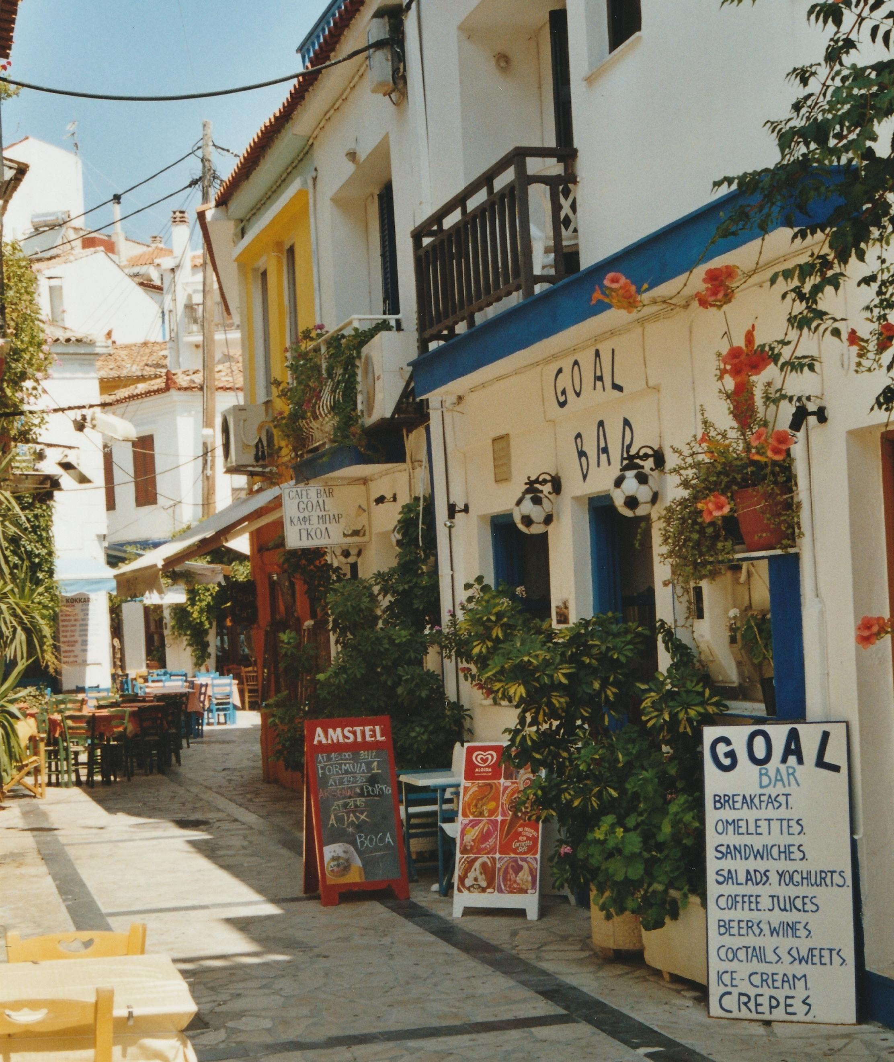
Greece Summer Program
Week 2

Slide 2
Today’s Class
Checklist
  Passport
  Health and Safety Quiz
  How were your finals?
Class Assignments Due Midnight
Introduce Kathy Ryan
My flight leaves to Thessaloniki (8am) June 13th
Airport Taxi Pick up 1:30pm & 6:30pm

Slide 3
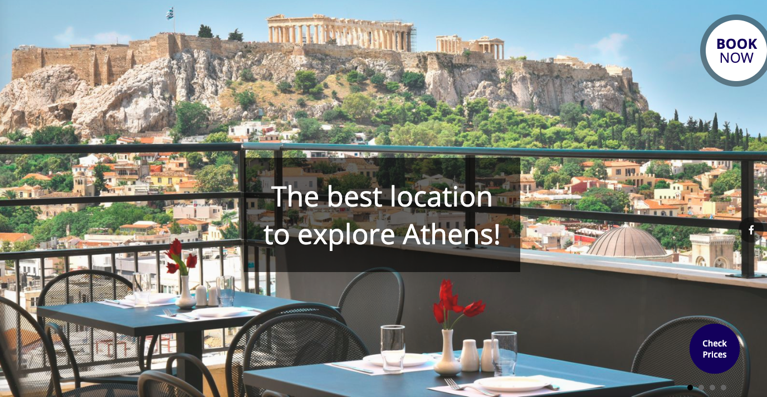
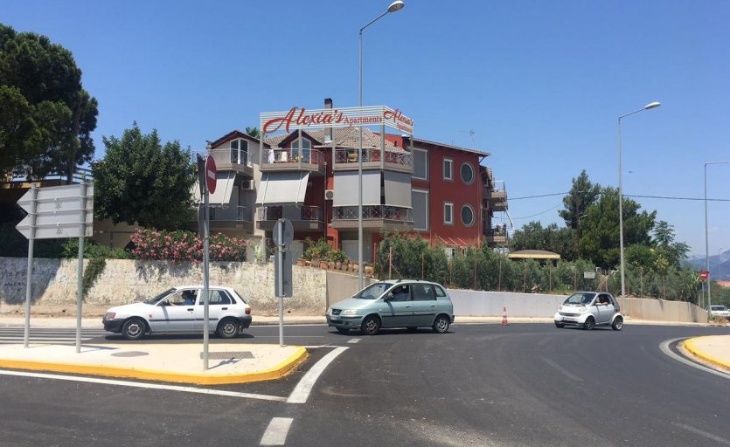
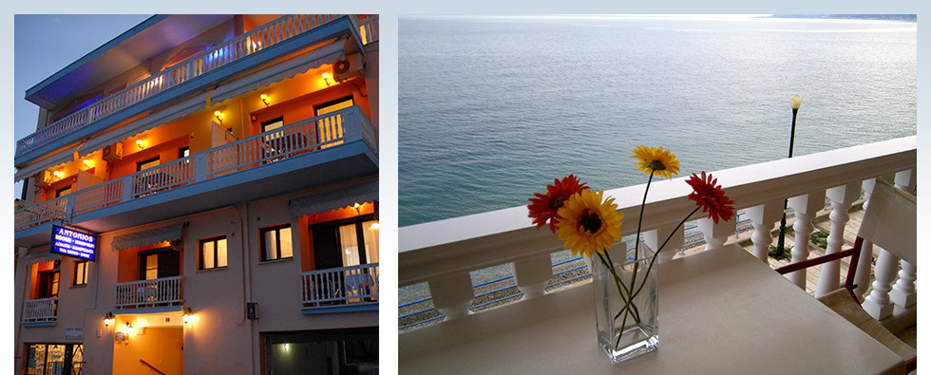
Hotels are Booked…Check them out!
June 1st -3rd : Astor Athens Central Hotel
June 3rd -8th : Alexia’s Apartments
June 8th – 10th : Antonio's Hotel Rooms
June 10th- 13th : Hostel Dioskouros

Slide 4
Covered by UIUC OIP:
  4 group dinner, 1 group brunch
    2 in Athens
    2 in Patras
    1 in Akrata
  Lodging + breakfast (all hotels haven’t confirmed with Alexia’s Apartments)
  Shuttle transportation between Athens, Patras, Akrata
  Bus tickets (for Patras)
  Some excursions
    Archaeology and national museum
    Possible tours in the small towns
    Preconference
  Snacks & water during domestic traveling

Slide 5
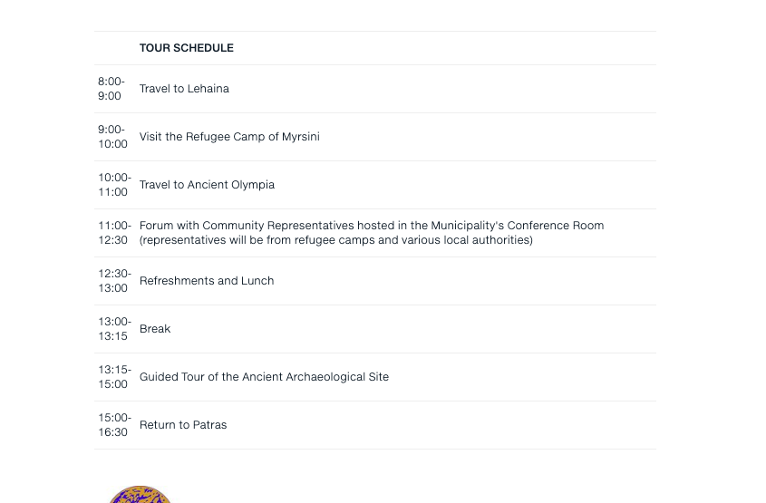
Activities and Excursions:
Museums tours in Athens (June 2nd)
American College of Greece Visit (June 3rd)
Pre-conference (June 4th )
Two School Observations in Patras
Conference Presentations
Going to Akrata
  Visiting Delphi (Nafpaktos, Arachova, Galaxidi) on the way

Slide 6
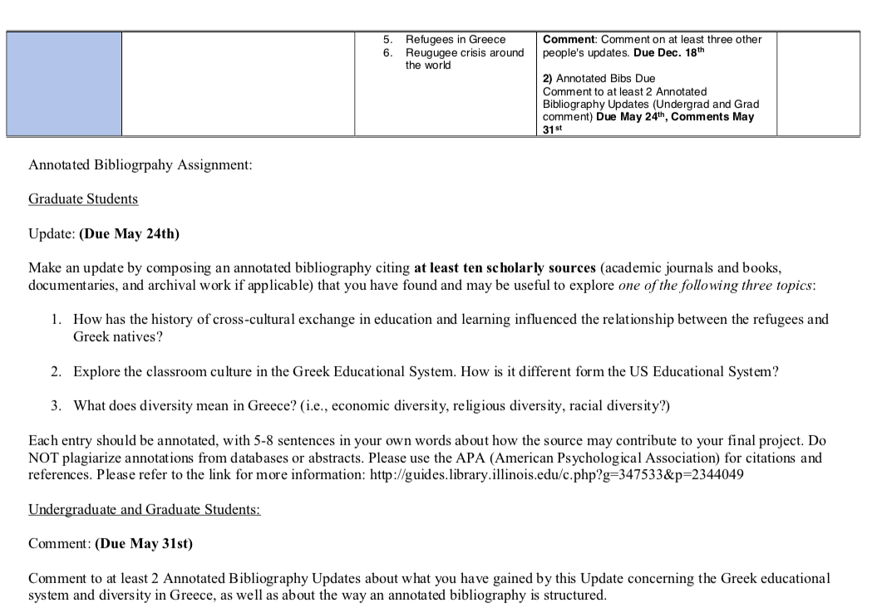

Slide 7
Room Arrangements: Astor Hotel
Family Rooms X3 (4 people to a Room)
One Classic Double (2 people)

Slide 8
Room Arrangement Akrata: Antonio's Hotel 7 Rm/2ppl
Complementary Coffee/Tea Croissant

Slide 9
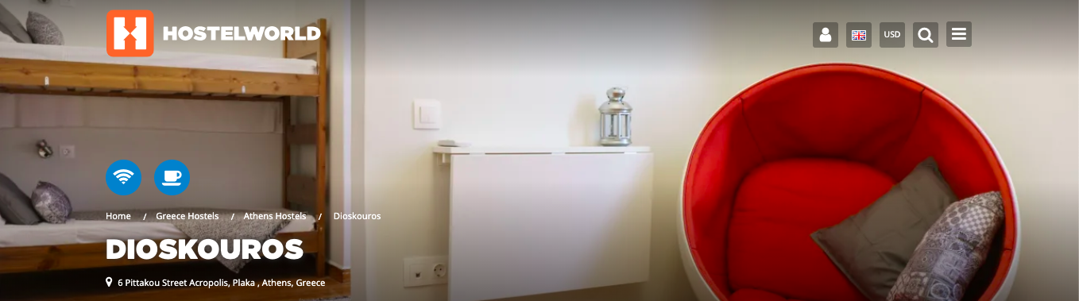
Dioskouros
1 Basic Twin= 2people
3 x 4 Basic Bed

Slide 10
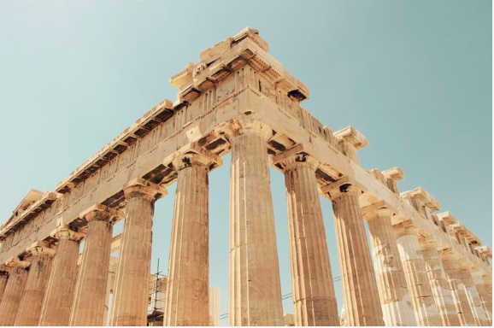
Greece has always been in interaction with other nations and people nearby throughout her history. How this interaction has influenced its culture, people's lifestyle and the way of dealing with important issues?
What are the main structures of the Greek education system? How does it compare to the education system in the United States?

