Slide 1
Week 5
A Linear Economy in a Resource Scarce World?
Context: Is it possible that Economists got their stories wrong? How did we start with the Economic problem of scarcity but ended up with the drive for endless economic growth?
Are there stronger models that reflect better the reality of the world we live in?
Are there things we should learn from nature in the movement called biomimicry?

Slide 2
What Does Linear Economy Mean? How does it relate to the GDP?

Slide 3
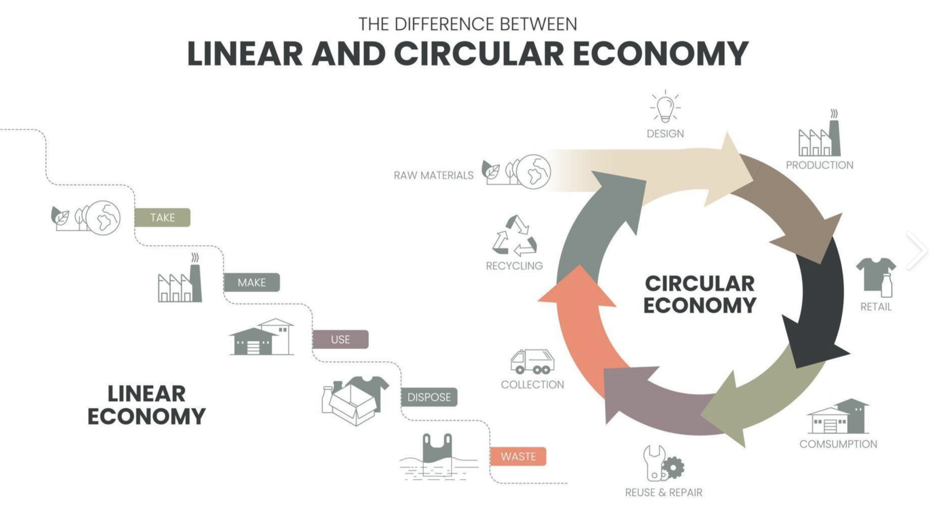
Source: The vector infographic diagram 9904075 Vector Art at Vecteezy
Is A Linear Economy with endless GDP growth possible?

Slide 4
Is Scarcity compatible with endless
Economic Growth?
Recall the Economic Problem?

Slide 5
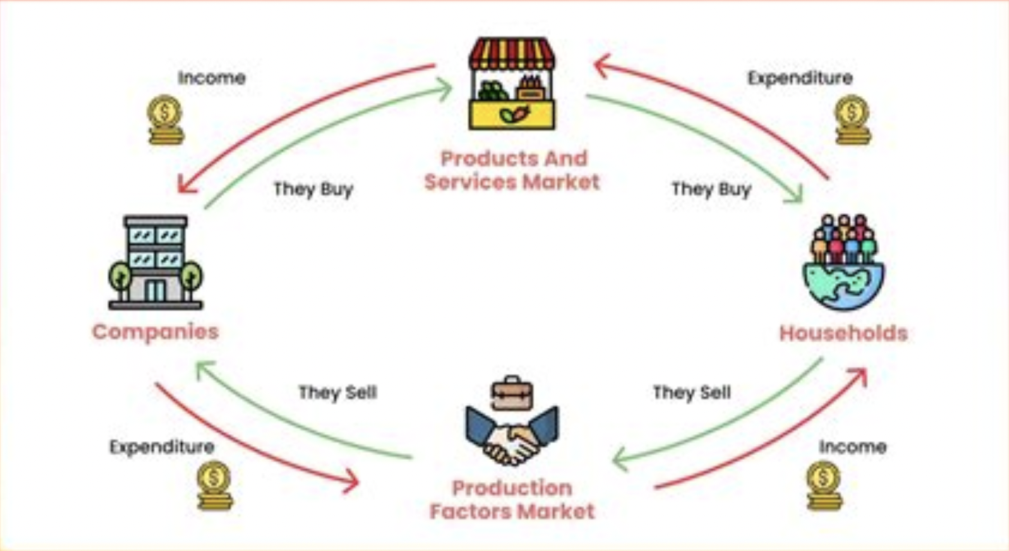
Where is the incoherence?

Slide 6
Is Circular Economy Possible?
Notes:
9 circular economy examples that are accelerating transition | World Economic Forum (weforum.org)

Slide 7
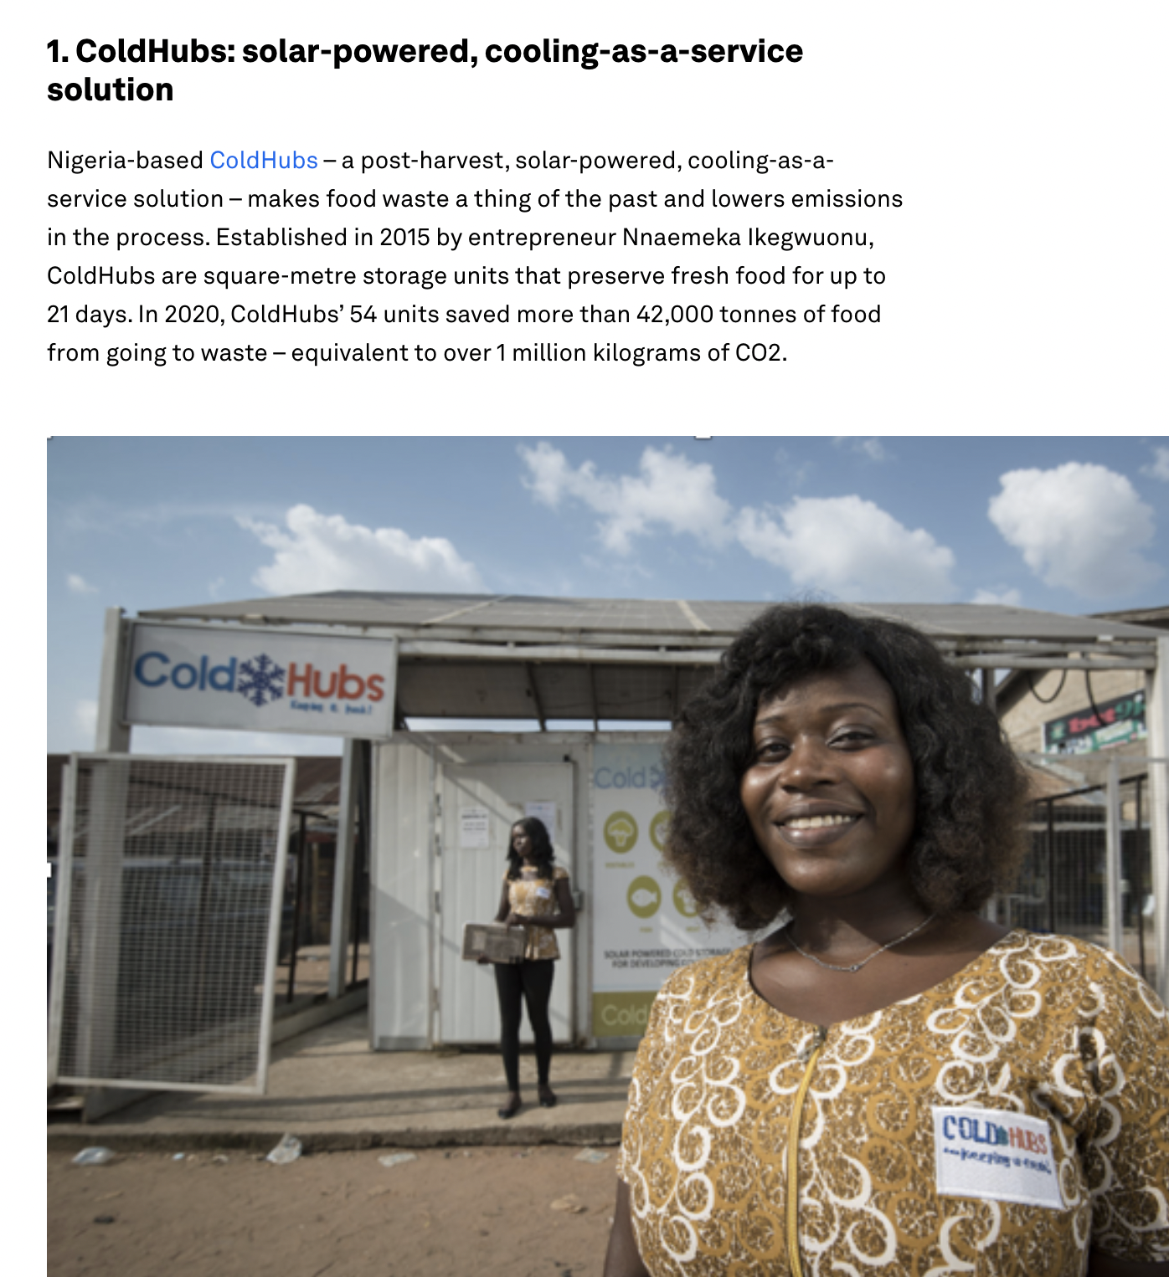
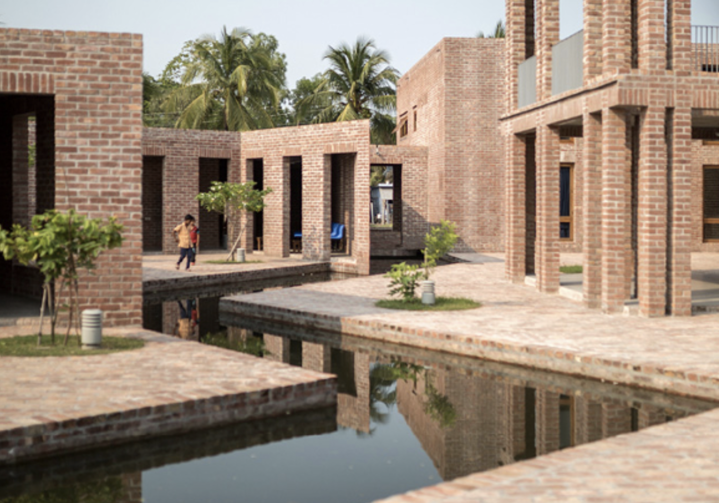
9 circular economy examples that are accelerating transition | World Economic Forum (weforum.org)

Slide 8
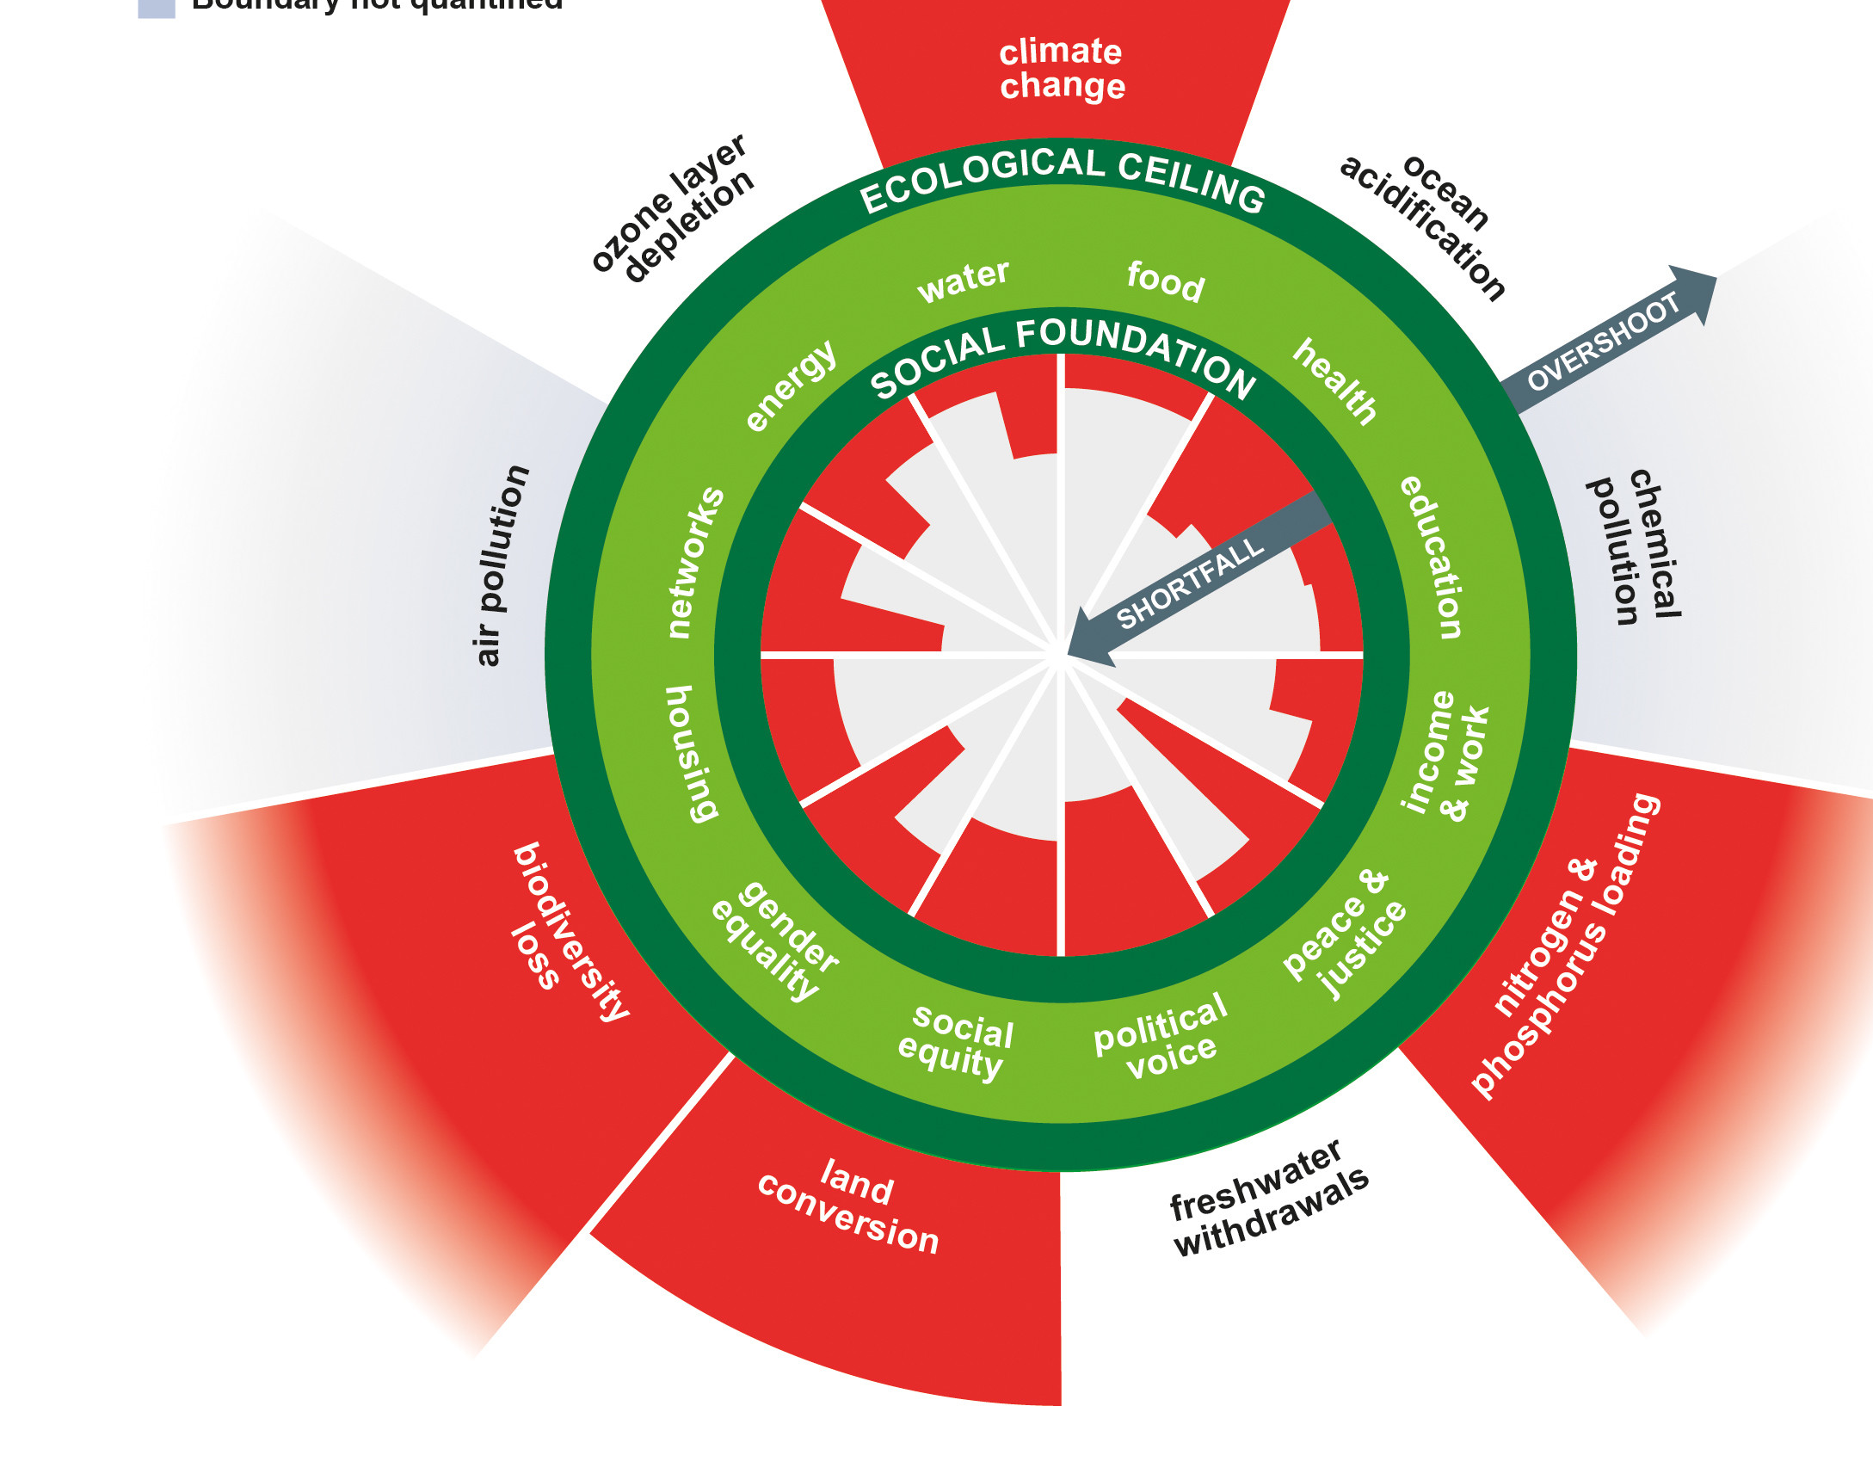
Explain the Doughnut
Doughnut Economy by Country (doughnut-economy-fxs7576.netlify.app)

Slide 10
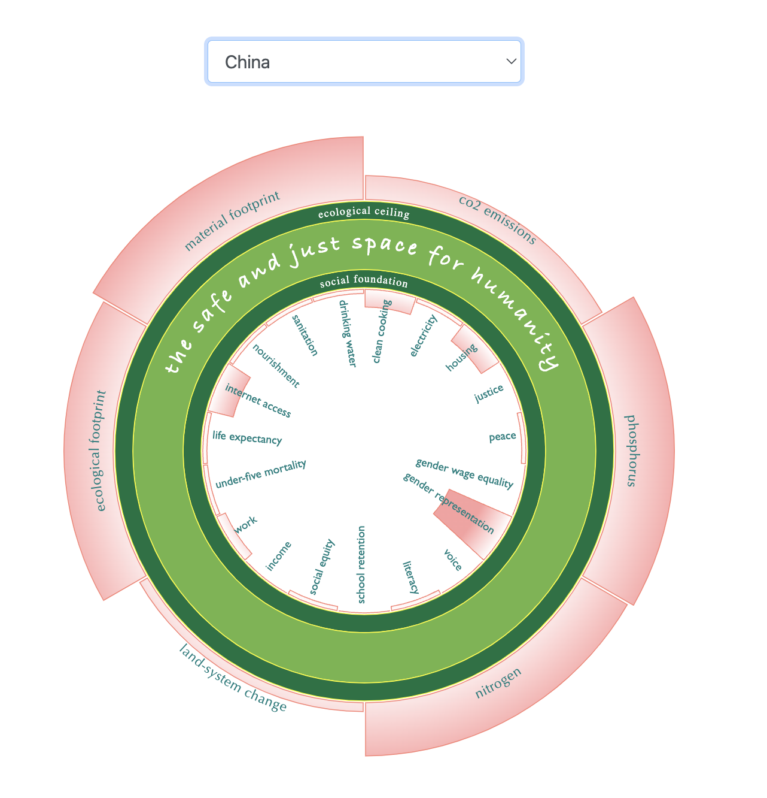
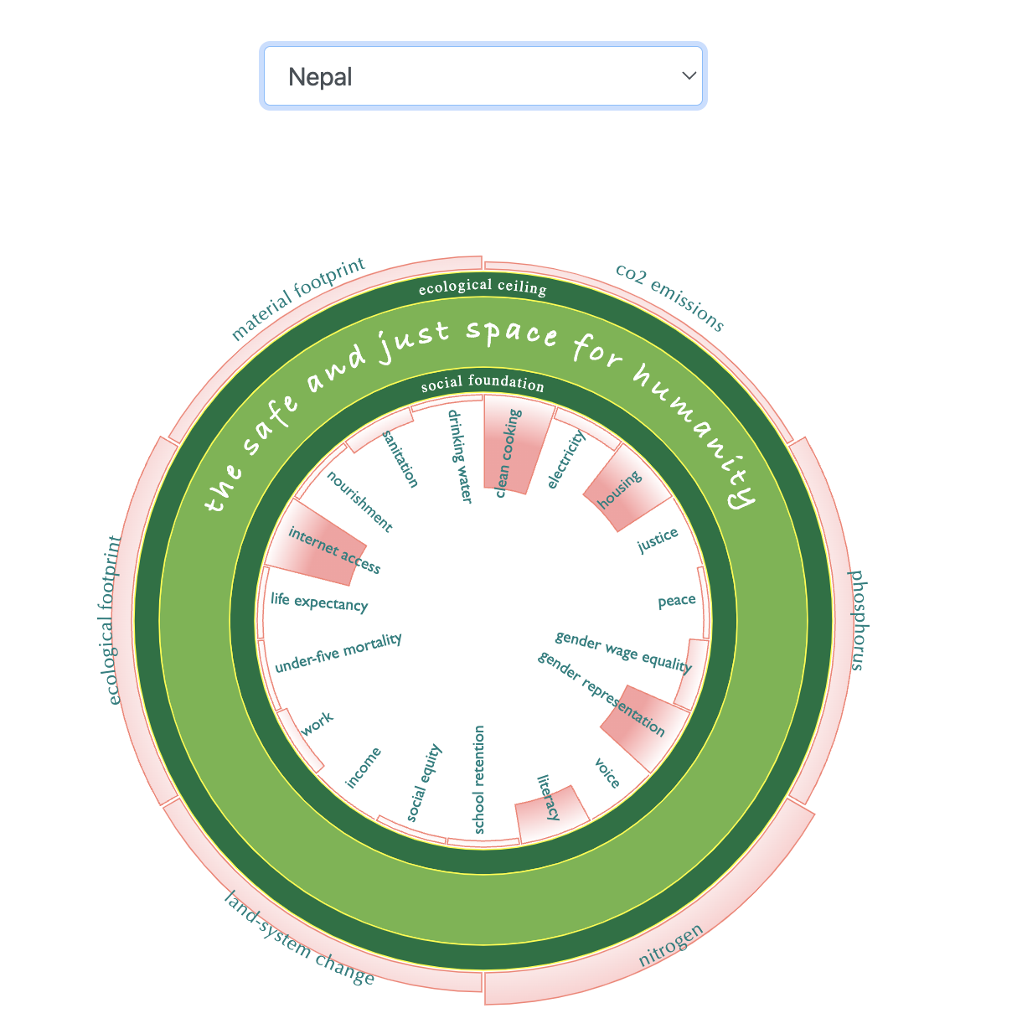
Doughnut Economy by Country (doughnut-economy-fxs7576.netlify.app)

Slide 11
More
than just idealism
Source: NewsHour, P. (2021). Amsterdam’s ‘doughnut economy’ puts climate ahead of GDP [Video]. In YouTube. https://www.youtube.com/watch?v=5bw5TewCD0M

Slide 12
a. Investigate the definition b. Question assumptions that lie behind economic model c. Consider what problem was being solved d. Consider what unintended consequences can arise e. Consider if there a “silver bullet” (uncomplicated solution) or composite approach f. Question if the economic policy is truly ”positive” or value-free g. Scrutinize for internal incoherence
CEL Means…

Slide 13
Your Wonderings…

Slide 14
Week 5 Update/Reflection Prompt:
“Economists have gotten their own story wrong…can you think of an incoherence in your own subject field and what implications this has or can have? (even better if there’s economic incoherence eg.art as expression of beauty/truth but how its expressions are being commodified and falsified?” (150-200 words)

Slide 15
Unit Plan includes:
1. Learning objectives
2. At least 3 Learning activities over a week (consider different modality - text, video, audio, image)
3. At least 1 piece of evidence of learning/ understanding created by students (singly or collaboratively)
4. Contrasted with unit plan version 1
5. Commentary on how CEL is being embedded in the unit to help promote Critical Global Citizenship Education
CEL PAR: Next Week – What is Refutation?

Slide 16
Week 5
A Linear Economy in a Resource Scarce World?
Context: Is it possible that Economists got their stories wrong? How did we start with the Economic problem of scarcity but ended up with the drive for endless economic growth?
Are there stronger models that reflect better the reality of the world we live in?
Are there things we should learn from nature in the movement called biomimicry?

