Slide 1

Week 7
The Iron Cage of Neoliberalism and the need for Alternate Criticality
Context:
Neoliberalism can be understood as a modern form of the “iron cage". The attendant rise of global crises and inequality render many teachers at a loss as to ways to question the Economics that has built and maintained this “iron cage”. This is why there is a need for an “alternate criticality”

Slide 2
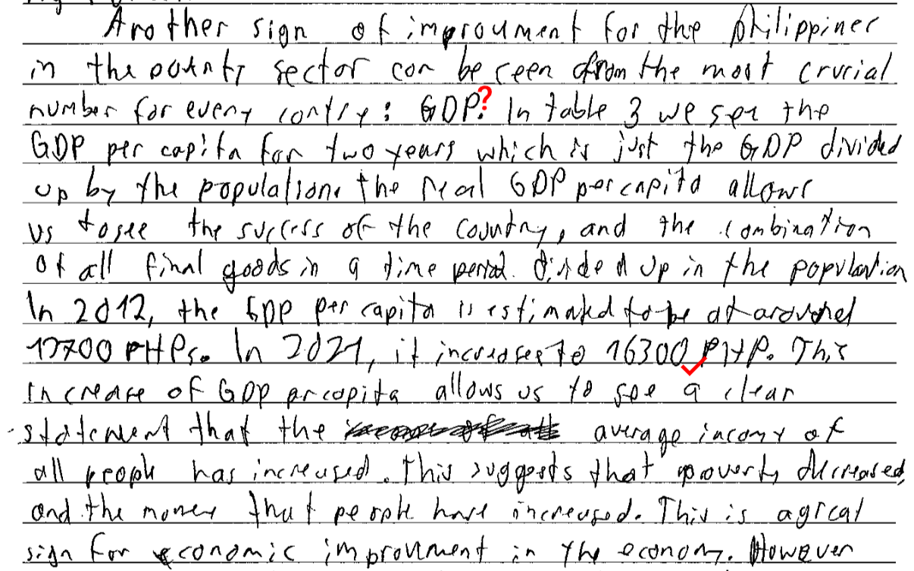
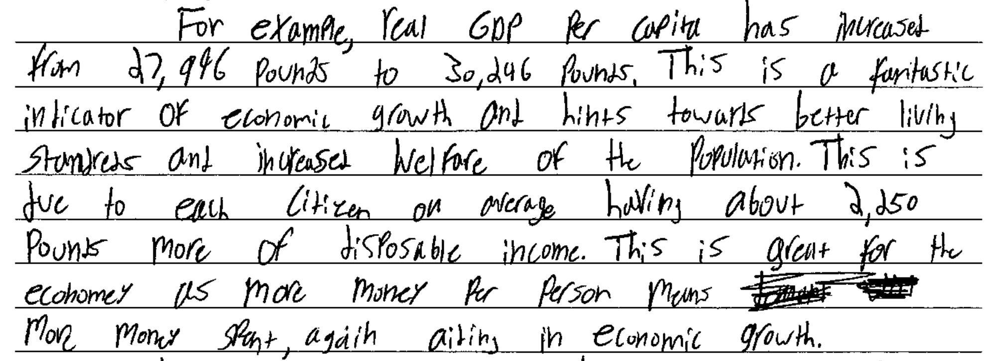
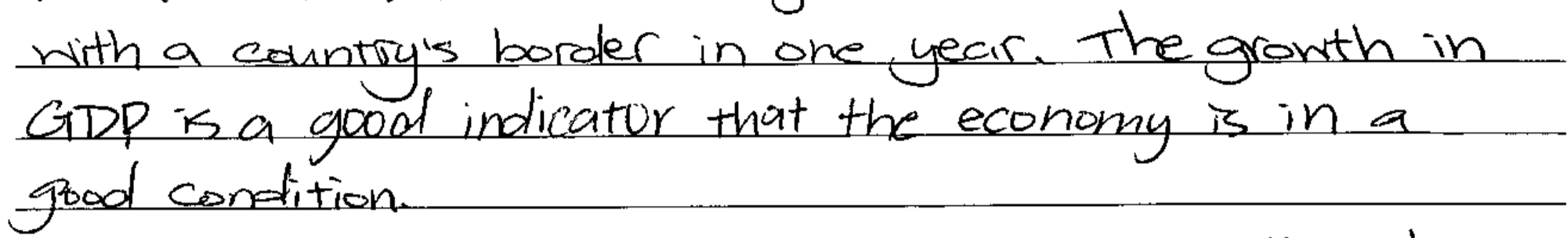
IB Econ Student Exam Response: What thoughts come to mind?

Slide 3
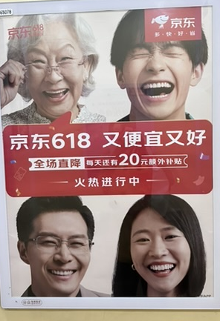


Let’s Play “Spot the Error” with our CEL lens
You have 30 seconds
You will be shown an image, jot down as many ideas as you can on what you have learned
these weeks that are applicable to this image. Person with most (and justifiable) ideas win!

Slide 4

What is the message? What CEL can be applied?

Slide 5
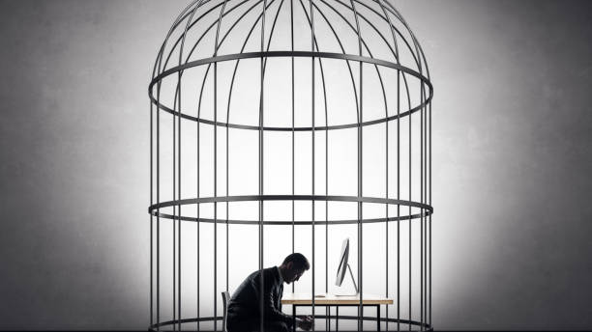
How is Neoliberalism an Iron Cage?

Slide 6
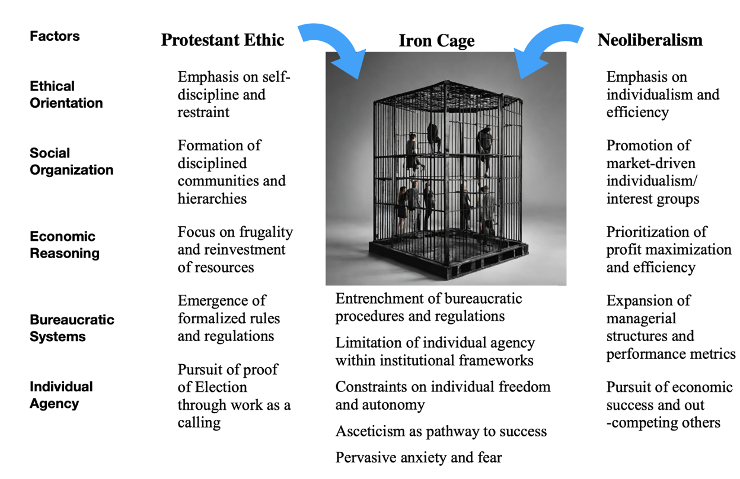

Slide 7

How Would you Mindmap the
Connections?
How are we trapped in this iron cage?
How do we perpetuate the iron cage?
What is the relationship between the iron cage and socially sanctioned ignorance?
Why is good critical thinking not adequate in dismantling the iron cage?
What is the relationship between CEL and Critical GCE?

Slide 8
a. Investigate the definition b. Question assumptions that lie behind economic model c. Ask what problem is being solved d. Consider what unintended consequences can arise e. Examine if there a “silver bullet” (uncomplicated solution) or composite approach f. Interrogate if the economic policy is truly ”positive” or value-free g. Scrutinize for internal incoherence h. Refute economic theories that are no longer relevant to changed contexts…adopt new ones that are more appropriate
CEL Means…

Slide 9
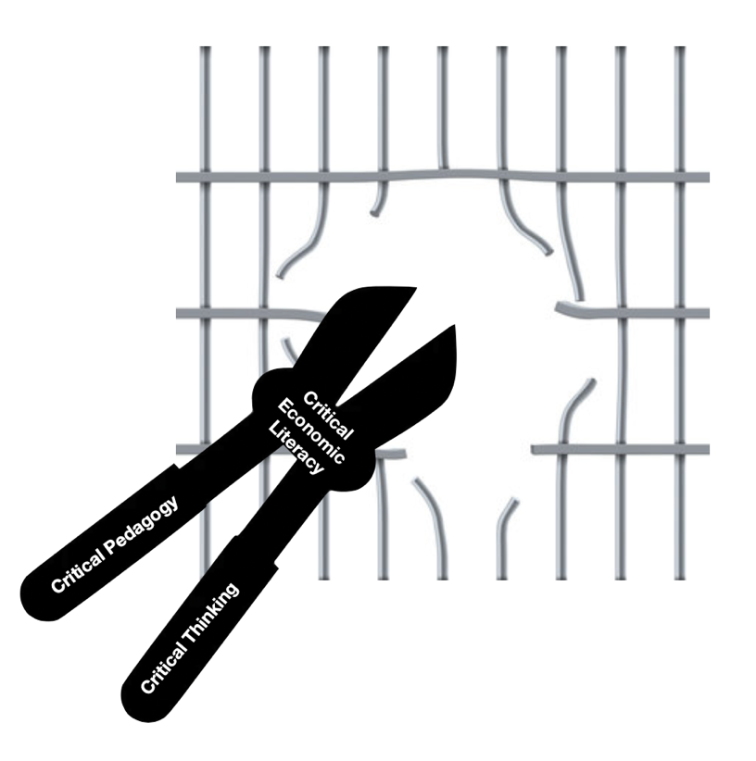
To what extent can
Critical Economic Literacy
dismantle the iron cage?
Dismantling the iron cage of neoliberalism
with CP, CT and CEL

Slide 10

Can we reinvent the form of retirement as we have now?
Do we all always have to build enough financial wealth to retire?
Are we finding it hard to just dismantle our own iron cage?
Will we be considered as irresponsible for adopting the lying flat lifestyle? What would happen in the long term if the new generation of lying flat is working against the protestant ethics and testing out the current economic system?
Perhaps there is something we can learn from Bhutan?
Your Wonderings…

Slide 11

Week 7 Update/Reflection Prompt:
Reflect:
What is the role of education and educators in promoting Critical GCE?
(150 – 200 words).

Slide 12
Wonderings
Weekly Updates/Comments
Revision of Unit Plans
Feedback on Unit Plans
Pre and Post-PAR Survey
1 on 1 Interview
Data Collation and Analysis – Discourse Analysis

Slide 13
Please do the following in preparation for our final session –
Take the feedback received and put together your unit plan (PPT)
You have 10 mins – this includes sharing the lesson & feedback
Complete the final reflection
Complete the post-PAR survey
Set up an appointment for 1 on 1 interview with Cat
Next Week – Unit Plan Presentations!

