Slide 1

AUDIO

Slide 2
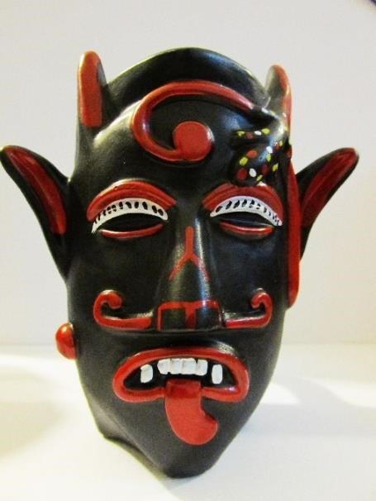
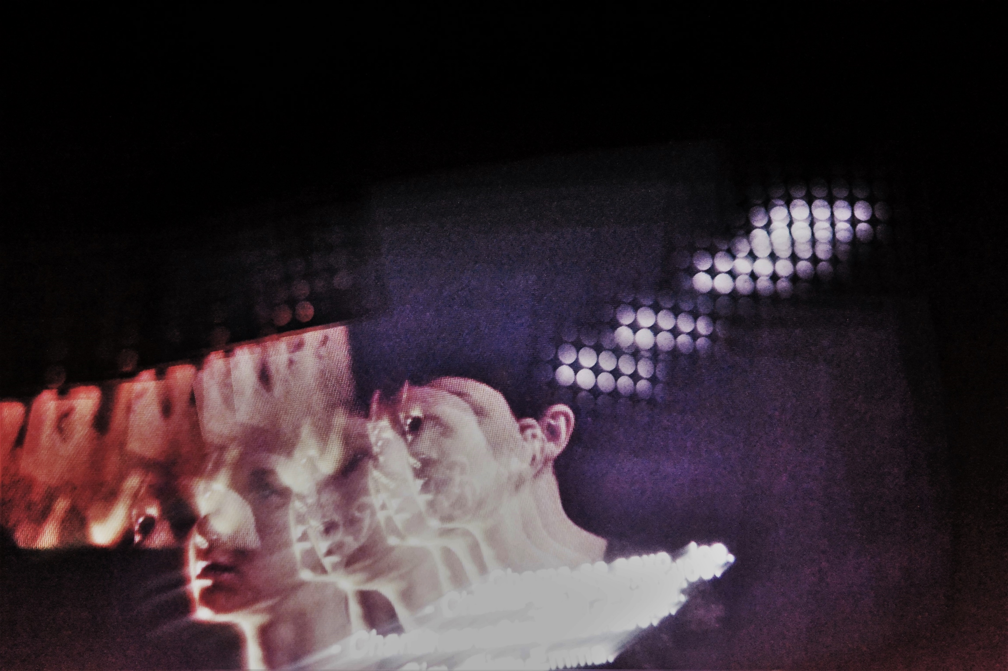
ALEXANDRA GOÇALVES
(Almost of images presented were created by the author. Only, one of chocalheiro did not)
CHOCALHEIRO AND DEFORMED TRANSPARENT

Slide 3

The first impulse leads us to say that, the behavior, even in its most formal aspects, of viruses and bacteria resemble the design of human societies.
The second impulse leads us to consider that appearance of covid-19 that can ravage human groups and destroy them, will hardly change the essence of a mental image built by men over thousands of years, and surely, not only will the development of technologies change it.
The third impulse, not putting aside the terrible condition of the pandemic, make us to feel like that while attention is focused too much on the covid-19, other terrible events are happening in the world.
A fourth impulse brings us to the feeling that, half of the human population must die to the other part may live, and Covid-19 is just another element joining the same game of life and death.
By giving the example of the Chocalheiro, (archaic portuguese figure, coming from the beginnings of time), and presenting the figure of Deformed Transparent, (who belongs to this present time), we try to realize and understand the mental image which underlies these two figures.
CHOCALHEIRO AND DEFORMED TRANSPARENT

Slide 4
AUDIO

Slide 5
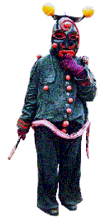
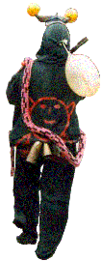
CHOCALHEIRO
Chocalheiro is an anthropomorphic figure, who holds two oranges stuck in the horns. He carries a blacksmith’s tongs in one hand, and he has a serpent hanging from his body. Chocalheiro only appears at the winter solstice, both men and animals fear him. This figure, which seems to have been brought by the Celts, belongs to the iconography of Trás-os-Montes.
Chocalheiro is a tauromanic figure dressed in rough linen dyed black.
Resembling a demon, he wears a mask with large ox horns where two oranges are stuck.
On his chin he has a goatee. An animal bladder is hanging around Chocalheiro’s neck.
Chocalheiro has a skull painted, also, on his back. He is got a long tail.
At the waist of trousers, he brings a snake made of fabric. He wears gloves.
On one of his hand he has an iron tong, alike a blacksmith’s tong.
Chocalheiro is full of iconographically important elements, which can give remarkably
interesting clues about the myths of these communities of Trás-os-Montes (Portugal).

Slide 6
CHOCALHEIRO
The Orange ------- Symbolize the winter solstice festivities. The orange is, for the lusitan shaman, the spokesperson of all nature, as it was for the Greeks Dionisio. In these winter solstice festivities great importance is given to the symbol of the orange who represents a subjective dimension of life.
The Myth of the Serpent -------- The serpent, represented both in the mask and around the Chocalheiro’s waist, is related to the ophidian myth which dates from portuguese Prehistory. Is a symbol of fertility, wisdom, regeneration, and immortality. Its power represents all the greatness of the mother-earth.
The Ox --------- Represents the taurine force is a power of life, a vertical power, perhaps, identical to shaman’s horse guiding the souls of the dead through upon the sky. Chocalheiro, with his horns raised, transmits the solar force able of destruction.
The Tong --------- The tong can be compared to the neolithic crozier with its unquestionable symbol of power, perhaps of tribal chief, or perhaps linked to the sorcerer’s cult which later may have established in the peninsular shamanic cult.

Slide 7
WHILE…
Chocalheiro has a tong in his hand, Deformed Transparent has a virtual stiletto. Deformed Transparent has at his service a virtual stiletto. This virtual stiletto enables him to have another image of time substance. His virtual stiletto, further, refines the informational databases, as well as makes his dress into a truly iconotemporably important work of blades. This virtual stiletto can project those blades, turning them during human movement, escaping from the human minds, or becoming part of them.
To speak about Deformed Transparent is also to point out the need of human resistance to him. At the same time, is to point out to something new, derived from the covid-19, that can teach us all something more beneficial to the beings of the planet, or not.

Slide 8

DEFORMED TRANSPARENT
The Deformed Transparent has a giant eye that can be both spherical and can be divided into parts, without ceasing to be one and, also, each part can generate another eye. Are the numerical science inventors who design this eye, which collects data about species’ characteristics; about the individuals and everything in their surroundings to colonize and enslave. It is an eye that is reborn from the same mental image that human beings have been bringing for thousands and thousands of years. It is a teleported eye. Plenty of appetite he transfers it to the algorithm, to the digital to finally return the voracity of men. The Deformed Transparent is dressed, with a fabric of movable folds. Each fold of its dress is a blade. All blades perform and compare readings of patterns with as much up-to-date information as possible, collecting more and more human and non-human data. The blades need the giant eye, without this, they lose time and data.

Slide 9
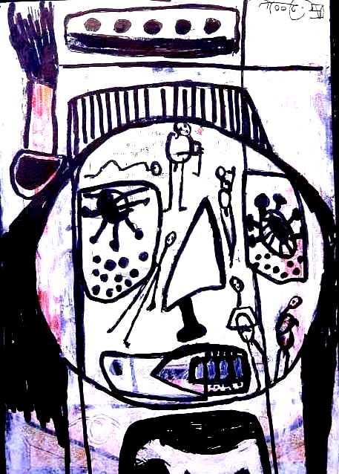
DEFORMED TRANSPARENT:
GIANT DEFORMDE TRANSPARENT’S EYE

Slide 10
DEFORMED TRANSPARENT
GIANT DEFORMED TRANSPARENT’S EYE
Deformed Transparent’s eye controls their ways of seeing, and even can blind them. The appetites, of men who hold power over digital science, create Deformed Transparent ‘s eye able to capture a great data information about beings and their surroundings.
Deformed Transparent ‘s eye has a particular moving nature that knows how to blind. He can be anywhere. He can split his eye into several pieces without annihilating himself. This is to say that, he can separate his own eyeball in tiny flying peaces. He can, also, separate his iris from his retina, his iris from his pupil, and separate them from his sclera. These divided parts are able to capture a large number of information of beings and spaces and update it in nanoseconds.
The giant Deformed Transparent ‘s eye is a very colored eye and can delight, and atract, when its pigmentation changes. Could be regarded as a friendly painting that fills the soul.

Slide 11
DEFORMED TRANSPARENT
GIANT DEFORMED TRANSPARENT’S EYE
Digital numeric inventors fill Deformed Transparent’s eye with information designs absorbing the energies of beings. Each part of this eye collects the characteristics of the species and the characteristics of the individuals even before their birth. This is how algorithms are selected according to availability and scientific needs. So, beings become laboratory databases in the same condition. This is how Deformed Transparent’s eye captures those data to make differentiated calculations towards the same objective, to enslave all beings. This eye is an eye that is born from the same mental image that human beings have been bringing for thousands of years.
This eye is evolving through all of beings’ history. Although it makes it sound like drawing another story, it shows a design of that millenary same mental image.
Deformed Transparent ‘s eye sees, selectively, blisters and builds bubbles out of a voracious appetite. And it sees that some countries live in bubbles organized, wrapped in sanitized films, that expel from their neighborhood other bubbles that they consider to be their dumpsters.
The iris of Deformed Transparent’s eye points, setts, collects, transmits (through its special nutrient networks) attracts informational databases by stabilizing them in small membranes protecting them with its sclera.
It may even be that Deformed Transparent’s eye is not spherical. This eye can put on movement all the parts that constitute itself: iris, retina pupil. It can launch them near the rings of Saturn, or in the orbits of the earth, or in another reality, or even in a bedroom, or in a cell phone, or in a citizen’s card, or in a street lamp, and now on a health watch bracelet, in smarter schools and so on.

Slide 12
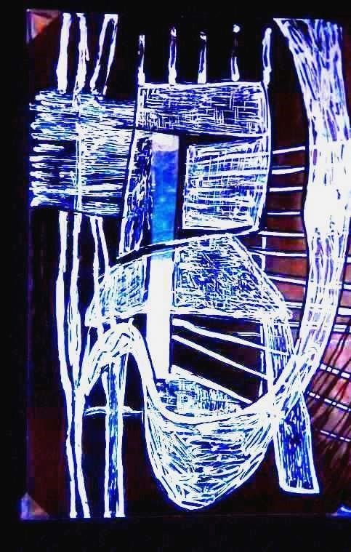
DEFORMED TRANSPARENT
THE GARMENTS OF THE DEFORMED TRANSPARENT: BLADES
Deformed Transparent’ garments are blades. Blades that remain fixed, or suddenly begin to undergo rotations, or begin to transplant one to the other. When transplanted the blades become thicker.
It can be seen a lot of images on those blades. One image who appears is that one of Chocalheiro with a skull inscribed on the back, coming from Lusitanian lands. He links Death to Life.
Deformed Transparent’s blades reache to make human beings turn around, until they all join up in algorithmic patterns.
The blades of Deformed Transparent know, also, that the new wars will be provoked by viruses and bacteria.

Slide 13
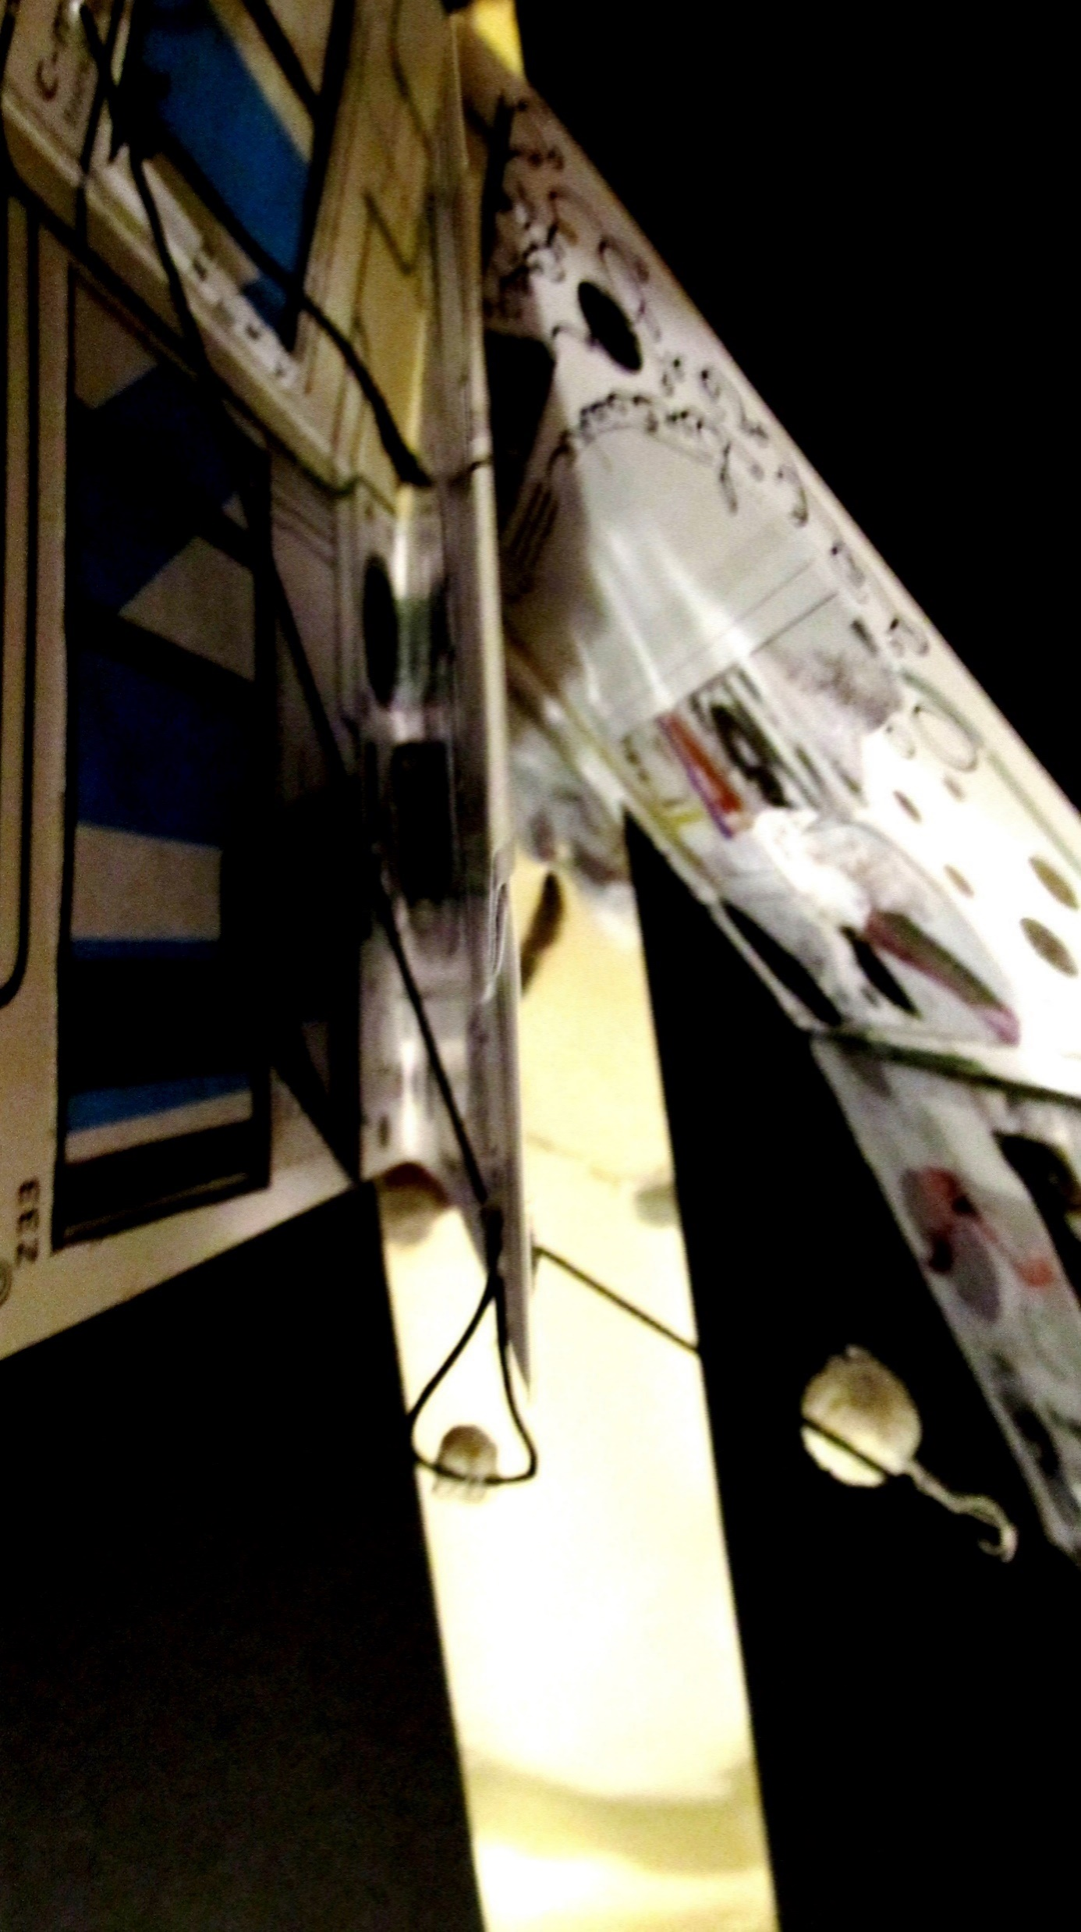
DEFORMED TRANSPARENT
THE GARMENTS OF THE DEFORMED TRANSPARENT: BLADES
It will be able Deformed Transparent’ blades to map everything and manage it, through energy imbalance resulting from the loss of will of individuals. Always following this loss of men will, these blades of Deformed Transparent’s garments will reveal the same symptomatologies, those of the appetites of men.
The reason for the existence of Deformed Transparent’s multiple blades gives him the possibility of reading patterns, related to an enormous database about men and other beings.
One can think of how some Deformed Transparent’ blades see the eagerness of human bodies and their subjectivities to want to be imortal. It may be seen from the image of the archaic stiletto. (Figure below: Blades of Deformed Transparent).

Slide 14
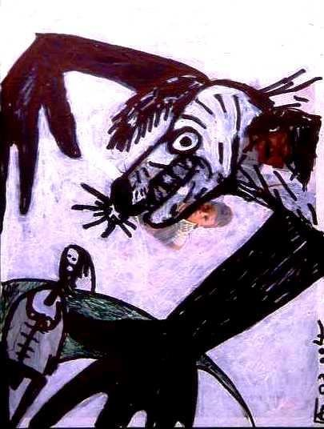
DEFORMED TRANSPARENT:
VIRTUAL STILETTO

Slide 15
DEFORMED TRANSPARENT:
VIRTUAL STILETTO
Deformed Transparent’s stiletto can dissect human society to eliminate the elderly and eliminate entire populations of living beings.
Deformed Transparent uses a virtual stiletto to maintain his “body”. This stiletto generates all kinesis of his blades, absorbing more and more information, as well as designs spaces and places.
The virtual stiletto seems to make Deformed Transparent learn faster.
This virtual stiletto allows him to have a more accurate image of the substance of time, and density of distance.
Deformed Transparent is armed with an important iconotemporality stiletto and he projects invisible blades, from his garment, making them rotate in the middle of the human beings. Through the human movements, sometimes, he can escape to their minds and sometimes being part of them.
At this moment of pandemic, Deformed Transparent’s virtual stiletto can work more freely. It can design up faster orbital motion satellites under more ideal conditions to acquire more easily databases of Earth and Universe.

Slide 16
DEFORMED TRANSPARENT:
VIRTUAL STILETTO
The virtual stiletto equates everyone to the same insignificance, to informational database.
Virtual stiletto is seeing the symptom of a certain imbalance between human beings, and not focusing on their syndrome, that seems be useful to him.
Will Deformed Transparent’s virtual stiletto be able to transform paradises into deserts of times?
By the time of the end of Covid-19 something will have changed, that is for sure. But what change will be able to make this virtual stiletto?
Is it possible that the future virologic and bacteriological wars will be more profitable until all information on all beings is collected in Deformed Transparent database?

Slide 17
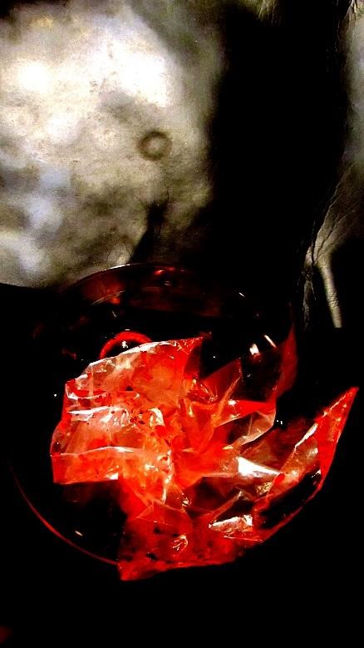
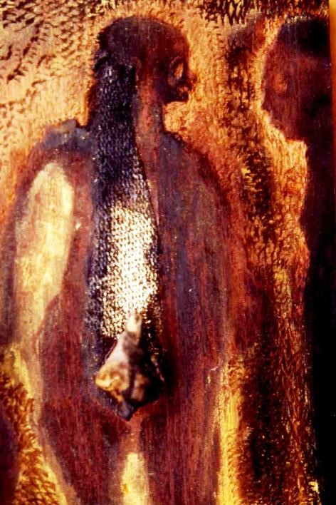
SOME WORDS MORE
Figure 6.Condition. Figure 7. V-2.
Alexandra Gonçalves. Coimbra. 2016. Alexandra Gonçalves. São Paulo. 2019.

Slide 18
SOME OTHER WORDS MORE
Thinking about what will arise after the covid-19 pandemic necessarily requires another way of thinking about the lives of all beings. Deformed Transparent, armed with a virtual stiletto, will design new information. This virtual stiletto seems to be a pretext. Its pretense to empower Deformed Transparent allied to another misery of men, revealing that men can be the image of viruses. Or maybe, the viruses are in men image and likeness.
What needs to be changed is the mental image of the human beings about: themselves; other beings; their geographical issues; environmental crises and reevaluate sciences. Human beings must, also, think deeply about the substance of time.
The giant Deformed Transparent’s eye sees sick beings on a numerical scale. It does not deal with social illnesses, but it fears a new mental image who can come out from human beings. Covid-19 is perhaps an image of the great human and planetary illness. We can draw on a sheet of paper lines and stains representing the structural foundations of our societies. If we pay attention to these representations, we can see that there is something similar with viruses, even, in their formal aspect. This is to say that representations are the images of our environment crises and a sign appealing danger for our planet. Deformed Transparent is not so different from Chocalheiro.

Slide 19
AUDIO

