Slide 1
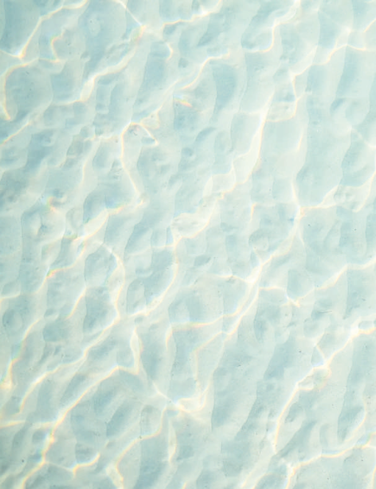
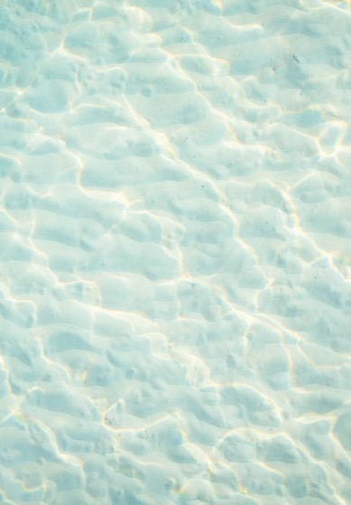

23rd International Conference New Directions in the Humanities, 2025: OCEANIC JOURNEYS: MULTICULTURAL APPROACHES IN THE HUMANITIES
University of HAWAII, HILO
SALTWATER /Interconnectivity: a group exhibition co-curated by Katharine Atafu – Mayo and Giles Peterson, for Tautai Contemporary Pacific Arts Trust
https://www.tautai.org/saltwater-interconnectivity
New Directions in the Humanities
Session details: Thursday, Jun3 25 – 27, 2025
1:15 PM - 2:00 PM
University of Hawaii, Hilo
Presenting author:
Giles Peterson, Curator and educator,
Whitecliffe College of Arts and Design
SALTWATER /
Interconnectivity
TAUTAI GALLERY
300 TE KARANGAHAPE ROAD, NEWTON, AUCKLAND, AOTEAROA New Zealand 16 OCT - 30 JAN
https://www.tautai.org/saltwater-interconnectivity
Peterson, Giles & Atafu – Mayo, Katharine. [Curators]. ‘SALTWATER/ Interconnectivity’ Tautai Gallery, Auckland, October 16– 2020 to January 30, 2021. Exhibition catalogue: SALTWATER/Interconnectivity, 2020.Publishers: Tautai Contemporary Pacific Arts Trust. Image: Katharine Atafu – Mayo. Feso’oata’iatu, 2020. Digital video projection (filmed by Beni Timu), sound, saltwater, 20 x 100cm including projection. SALTWATER /Interconnectivity, Tautai Gallery – Level 3, 300 Te Karangahape Road, Newton, Auckland. Catalogue Design: Niko Meredith, NO SIX.
Notes:
THIS PRESENTATION examines the recent group exhibition SALTWATER / Interconnectivity co-curated by Katharine Losi Atafu-Mayo and Giles Peterson at the Tautai Gallery in Auckland, Aotearoa New Zealand (October 16, 2020 to January 30, 2021), including its public exhibition talks, forums, and performance activations. The exhibition was intended to embody the Moana worldview and explore questions of justice, equity, identity, and ecology through newly commissioned work by six multimedia Indigenous artists and designers from the Moana-Solwara (Oceania region): Katharine Losi Atafu-Mayo, Peter Elavera, Te Ara Minhinnick, Shawnee Tekki, Telly Tuita, and Gutiŋjarra Yunipiŋju.
Keywords: Moana, Solwara, Pasifika, contemporary art, Indigenous art, Oceania, saltwater, salt water, ecology

Slide 2
ABSTRACT:
This presentation explores SALTWATER / Interconnectivity (Tautai Gallery, Aotearoa, 2020–21) as a case study in Indigenous-led curating, where talanoa, performance, and activism amplified the voices of young Pasifika artists.
Co-curated by Katharine Losi Atafu-Mayo and Giles Peterson, the exhibition embodied the relational, fluid nature of the Moana -Solwara ( or – the Moananuiākea in the native Hawaiian languages to describe (the great expansive ocean), also known as the Pacific Ocean today, which represents thousands of islands and is ancestral homelands to generations of indigenous Pasifik peoples who have made these islands their home, over thousands of millenia, and which covers one-third of the earth's surface.
SALTWATER /INTERCONNECTIVITY is a wonderful exhibition and curatorial community collaborative project to explore within the themes of this conference: OCEANIC JOURNEYS – MULTICULTURAL APPROACHES IN THE HUMANITIES, Being held here in the beautiful University of Hawaii, Hilo and environs.
SALTWATER INTERCONNECTIVITY is an exhibition and curatorial project – dear to my heart that was developed over a year of covid19 lockdowns with the intent to bring healing and our diverse dynamic indigenous Moana and Solwara Communities together. Its focus on justice, Ecology, Climate Change, Youth and intergenerational transmission of knowledge, Kustom, guardian ship, ancestral histories of indigenous peoples, Black and Brown Lives Matter, identity, and resilience through new works by contemporary new-generation indigenous Pacific islander artists. More than a static exhibition, SALTWATER extended into the Auckland Writers Festival (2021), where performance became a platform for storytelling, knowledge exchange, and resistance—addressing climate change, diaspora displacement, and colonial impacts.
This project exemplifies niu ecologies, emergent frameworks in Moana curatorial practice that foreground Indigenous futurisms and activism, empowering young Pasifika communities to shape Oceania’s contemporary narrative. Drawing from my work as a curator, co –curator and educator, I examine how exhibitions like SALTWATER function as models for community-centered curating—transforming spaces of art into spaces of gathering and healing.
By examining curatorial methodologies rooted in niu ecologies, I discuss how they challenge institutional frameworks and reimagine Pacific arts, fostering deeper connections to ancestral knowledge, ecosystems, and people-place relationships. This paper invites scholars, artists, and educators to reflect on how curatorial practice affirms Indigenous Pacific sovereignty, resilience, and social justice. How do youth-led indigenous Pasifika artists, and creative movements sustain cultural and ecological resilience in the Oceania Pacific?
This study explores contemporary Pasifika art as a powerful tool for niu ecologies, cultural survival, decolonial Indigenous resistance, social and design activism, community building, resilience, hope, intergenerational knowledge, protest, and renewal. https://www.tautai.org/saltwater-interconnectivity.... Giles Peterson, 2025
SALTWATER /
Interconnectivity
TAUTAI GALLERY
300 TE KARANGAHAPE ROAD, NEWTON, AUCKLAND, AOTEAROA New Zealand 16 OCT - 30 JAN 2020 - 21
https://www.tautai.org/saltwater-interconnectivity
Peterson, Giles & Atafu – Mayo, Katharine. [Curators]. ‘SALTWATER/ Interconnectivity’ Tautai Gallery, Auckland, October 16– 2020 to January 30, 2021. Exhibition catalogue: SALTWATER/Interconnectivity, 2020.Publishers: Tautai Contemporary Pacific Arts Trust. Image: Katharine Atafu – Mayo. Feso’oata’iatu, 2020. Digital video projection (filmed by Beni Timu), sound, saltwater, 20 x 100cm including projection. SALTWATER /Interconnectivity, Tautai Gallery – Level 3, 300 Te Karangahape Road, Newton, Auckland. Catalogue Design: Niko Meredith, NO SIX.
Notes:
THIS PRESENTATION examines the recent group exhibition SALTWATER / Interconnectivity co-curated by Katharine Losi Atafu-Mayo and Giles Peterson at the Tautai Gallery in Auckland, Aotearoa New Zealand (October 16, 2020 to January 30, 2021), including its public exhibition talks, forums, and performance activations. The exhibition was intended to embody the Moana worldview and explore questions of justice, equity, identity, and ecology through newly commissioned work by six multimedia Indigenous artists and designers from the Moana-Solwara (Oceania region): Katharine Losi Atafu-Mayo, Peter Elavera, Te Ara Minhinnick, Shawnee Tekki, Telly Tuita, and Gutiŋjarra Yunipiŋju.
Keywords: Moana, Solwara, Pasifika, contemporary art, Indigenous art, Oceania, saltwater, salt water, ecology

Slide 3
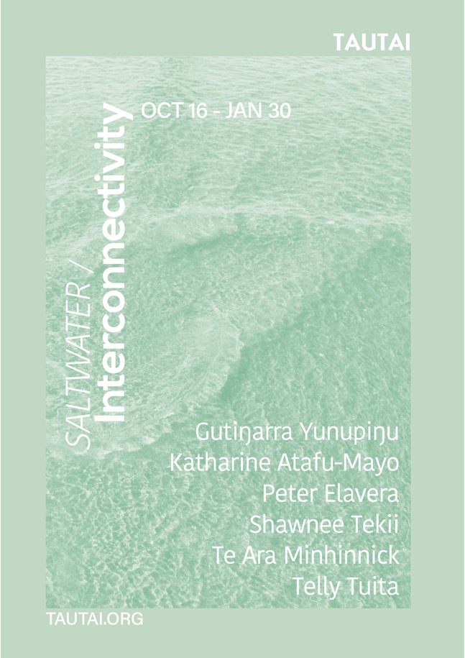
We sweat and cry salt water, so we know that the ocean is really in our Blood-
—Teresia Teaiwa – the great I –Kiribati Pacific Scholar and Educator and community leader ( quote used with
Permission from Tere’s family. Tere was a close personal friend and supporter, As is Sean Mallon).
~Ka mua, ka muri (Walking backwards into the future). —Whakataukī (Maori Proverb).
(Motu –Koitabu assembly, South Coast : Papua Niugini - Ieni Sivarai – …. It’s Story……
This presentation examines the group exhibition - SALTWATER / Interconnectivity co-curated by Katharine Losi Atafu-Mayo and Giles Peterson at the Tautai Gallery in Auckland, Aotearoa New Zealand (October 16, 2020 to January 30, 2021).
The exhibition was intended to embody the Moana Solwara worldview and explore questions of justice, equity, identity, and ecology through newly commissioned work by six multimedia Indigenous artists and designers from the Moana-Solwara - Moananuiākea (Oceania region):
Katharine Losi Atafu-Mayo: <Samoa >
Peter Elavera <Papua New Guinea >
Te Ara Minhinnick. < Aotearoa >
Shawnee Tekki. < Cook Islands >
Telly Tuita. < Tonga >
Gutiŋjarra Yunipiŋju. < Aboriginal Australia – Torres Strait Islands]
In the presentation I will discuss the exhibition and its Kaupapa(intent)- - the public program - exhibition talks, forums, and performance activations which were part of Auckland Art Week, and the interconnected community participation, impact and reach of the project which is still reverberating, meaningful and felt. Given that the project drew from the dazzling talent of rangatahi artists, curator, activists and community leaders from across Te Moana –Nui – a –Kiwa - The Pacific rim.
I will also briefly discuss the SALTWATER PEOPLE’s event which took place at the Auckland Writers Festival in May 2021 which featured Sistar Spakifik aka Rosanna Raymond (Pacific Sisters, SaVAge K’lub); Katharine Losi Atafu – Mayo ( the newest and youngest member of Pacific Sisters); Amber Esau (Writer and Poet); James Waititi (Fafswag, SaVAge Klu’b) in a collective Mana Moana talanoa response to the artwork of the SALTWATER /INTERCONNECTIVITY Exhibition at Tautai Gallery and its community engagements/events/projects..
Notes:
We sweat and cry salt water, so we know that the ocean is really in our Blood-
—Teresia Teaiwa – the great I –Kiribati Pacific Scholar and Educator and community leader ( quote used with
Permission from Tere’s family. Tere was a close personal friend and supporter, As is Sean Mallon).
~Ka mua, ka muri (Walking backwards into the future). —Whakataukī (Maori Proverb).
(Motu –Koitabu assembly, South Coast : Papua Niugini - Ieni Sivarai – …. It’s Story……
This presentation examines the group exhibition - SALTWATER / Interconnectivity co-curated by Katharine Losi Atafu-Mayo and Giles Peterson at the Tautai Gallery in Auckland, Aotearoa New Zealand (October 16, 2020 to January 30, 2021).
The exhibition was intended to embody the Moana Solwara worldview and explore questions of justice, equity, identity, and ecology through newly commissioned work by six multimedia Indigenous artists and designers from the Moana-Solwara - Moananuiākea (Oceania region):
Katharine Losi Atafu-Mayo: <Samoa >
Peter Elavera <Papua New Guinea >
Te Ara Minhinnick. < Aotearoa >
Shawnee Tekki. < Cook Islands >
Telly Tuita. < Tonga >
Gutiŋjarra Yunipiŋju. < Aboriginal Australia – Torres Strait Islands]
In the presentation I will discuss the exhibition and its Kaupapa(intent)- - the public program - exhibition talks, forums, and performance activations which were part of Auckland Art Week, and the interconnected community participation, impact and reach of the project which is still reverberating, meaningful and felt. Given that the project drew from the dazzling talent of rangatahi artists, curator, activists and community leaders from across Te Moana –Nui – a –Kiwa - The Pacific rim.
I will also briefly discuss the SALTWATER PEOPLE’s event which took place at the Auckland Writers Festival in May 2021 which featured Sistar Spakifik aka Rosanna Raymond (Pacific Sisters, SaVAge K’lub); Katharine Losi Atafu – Mayo ( the newest and youngest member of Pacific Sisters); Amber Esau (Writer and Poet); James Waititi (Fafswag, SaVAge Klu’b) in a collective Mana Moana talanoa response to the artwork of the SALTWATER /INTERCONNECTIVITY Exhibition at Tautai Gallery and its community engagements/events/projects..
THIS PRESENTATION examines the recent group exhibition SALTWATER / Interconnectivity co-curated by Katharine Losi Atafu-Mayo and Giles Peterson at the Tautai Gallery in Auckland, Aotearoa New Zealand (October 16, 2020 to January 30, 2021), including its public exhibition talks, forums, and performance activations. The exhibition was intended to embody the Moana worldview and explore questions of justice, equity, identity, and ecology through newly commissioned work by six multimedia Indigenous artists and designers from the Moana-Solwara (Oceania region): Katharine Losi Atafu-Mayo, Peter Elavera, Te Ara Minhinnick, Shawnee Tekki, Telly Tuita, and Gutiŋjarra Yunipiŋju.
The exhibition was intended to embody the Moana Solwara worldview and explore questions of justice, equity, identity, and ecology through newly commissioned work by six multimedia Indigenous artists and designers from the Moana-Solwara - Moananuiākea (Oceania region):
Katharine Losi Atafu-Mayo: <Samoa >
Peter Elavera <Papua New Guinea >
Te Ara Minhinnick. < Aotearoa >
Shawnee Tekki. < Cook Islands >
Telly Tuita. < Tonga >
Gutiŋjarra Yunipiŋju. < Aboriginal Australia – Torres Strait Islands]
In the presentation I will discuss the exhibition and its Kaupapa - the public program - exhibition talks, forums, and performance activations which were part of Auckland Art Week, and the interconnected community participation, impact and reach of the project which is still reverberating, meaningful and felt. Given that the project drew from the dazzling talent of rangatahi artists, curator, activists and community leaders from across Te Moana –Nui – a –Kiwa - The Pacific rim.
I will also briefly discuss the SALTWATER PEOPLE’s event which took place at the Auckland Writers Festival in May 2021 which featured Sistar Spakifik aka Rosanna Raymond (Pacific Sisters, SaVAge K’lub); Katharine Losi Atafu – Mayo ( the newest and youngest member of Pacific Sisters); Amber Esau (Writer and Poet); James Waititi (Fafswag, SaVAge Klu’b) in a collective Mana Moana talanoa response to the artwork of the SALTWATER /INTERCONNECTIVITY Exhibition at Tautai Gallery and its community engagements/events/projects..
Keywords: Moana, Solwara, Pasifika, contemporary art, Indigenous art, Oceania, saltwater, salt water, ecology.

Slide 4
0.1: Mihi:
nga waka, e nga reo Greetings all People​
​
E nga mana, e nga hau e wha All Languages from the Four Winds​
​
Tena kotou, tena kotou, Greetings to you all​
tena kotou katoa​
​
Ehara taku toa I te toa My strength is not that of the ​
Takitahi Engari he of the individual but that of the many​
Toa takitini​
No reira, kia ora tatou katoa Greetings once again
Mauri Ora ! ​
Adorahi Namona - Hiri Motu for good afternoon :)
E kore au e ngaro, he kākano i ruia mai i Rangiātea. I will never be lost, for I am a seed sown in Rangiātea* (Pacific ancestral homelands). The metaphorical "seed" represents growth, development, and self-realization.. Rangiātea is closely related to and located within, the ancestral homeland of Hawaiki.
Notes:
0.1: Mihi:
nga waka, e nga reo Greetings all People​
​
E nga mana, e nga hau e wha All Languages from the Four Winds​
​
Tena kotou, tena kotou, Greetings to you all​
tena kotou katoa​
​
Ehara taku toa I te toa My strength is not that of the ​
Takitahi Engari he of the individual but that of the many​
Toa takitini​
No reira, kia ora tatou katoa Greetings once again
Mauri Ora ! ​
Adorahi Namona - Hiri Motu for good afternoon :)
E kore au e ngaro, he kākano i ruia mai i Rangiātea. I will never be lost, for I am a seed sown in Rangiātea* (Pacific ancestral homelands). The metaphorical "seed" represents growth, development, and self-realization.. Rangiātea is closely related to and located within, the ancestral homeland of Hawaiki.

Slide 5
Mihi
Katharine Losi Atafu-Mayo (Sāmoa, Aotearoa, Scotland, England) was born in Auckland in 1995 and is a devoted daughter, sister, and godmother with a beautiful vessel that houses her resilient soul, powerful heart, and unshakable spirit. She is a multidisciplinary artist, curator, creative and well-being director, and world builder. Her social art practice is an evolving ecosystem of Moana healing methodologies, spirituality, and community engagement grounded in unconditional love to create alternative ways of living in the everyday. Her artworks include installations, workshops, moving image, and poetry. She is best known for ceremonial rituals based on intuitive activation.
Giles Peterson was born in Port Moresby, Papua New Guinea in 1969 and is a lecturer at Whitecliffe College of Arts and Design (Auckland, Aotearoa - NZ), where he teaches courses in New Zealand/Pacific art and design history, contemporary art, fashion theory, and arts management. He was a founding member of the Tautai Contemporary Pacific Arts Trust and has mentored three generations of Tautai artists. He is also an independent curator whose most recent exhibitions include Tīaho: Photography from Oceania (2010) and Garden of Memories: Extending Quilt Making Traditions from around the Pacific (2019).
Notes:
Mihi
Katharine Losi Atafu-Mayo (Sāmoa, Aotearoa, Scotland, England) was born in Auckland in 1995 and is a devoted daughter, sister, and godmother with a beautiful vessel that houses her resilient soul, powerful heart, and unshakable spirit. She is a multidisciplinary artist, curator, creative and well-being director, and world builder. Her social art practice is an evolving ecosystem of Moana healing methodologies, spirituality, and community engagement grounded in unconditional love to create alternative ways of living in the everyday. Her artworks include installations, workshops, moving image, and poetry. She is best known for ceremonial rituals based on intuitive activation.
Giles Peterson was born in Port Moresby, Papua New Guinea in 1969 and is a lecturer at Whitecliffe College of Arts and Design (Auckland, Aotearoa - NZ), where he teaches courses in New Zealand/Pacific art and design history, contemporary art, fashion theory, and arts management. He was a founding member of the Tautai Contemporary Pacific Arts Trust and has mentored three generations of Tautai artists. He is also an independent curator whose most recent exhibitions include Tīaho: Photography from Oceania (2010) and Garden of Memories: Extending Quilt Making Traditions from around the Pacific (2019

Slide 6
PRESS RELEASE SALTWATER/Interconnectivity TAUTAI GALLERY OCT 16 – JAN 30
For Katharine Losi Atafu-Mayo curating her first major exhibition alongside Giles Peterson with ‘SALTWATER/Interconnectivity’ is an opportunity to give back to the community.
The upcoming show at Tautai Gallery endured all the disruptions of Covid19 and its launch next month is something to celebrate, says Atafu-Mayo. An alumni of Whitecliffe, the young artist graduated last year as the top student in her Bachelor of Fine Arts degree. Tautua (service), Manaakitanga (hospitality) and Healing are major influences into her practice as both performance artist and curator.
‘I’ve already learnt so much about my curatorial practice; including how I work alongside people and how I can weave my cultural values into the details of the project.’ She said her relationship with co-curator Giles Peterson made the show even more special, having been taught by Peterson during her years at university and now working alongside one another as peers.
Atafu-Mayo says dispelling assumptions was important as a curator with the exhibition bringing artists to the fore who are a testament to this. ‘It was absolutely vital that within this project we displayed a range of lived experiences, seeing as Moana/Solwara people we are versatile, vast, and multifaceted’ referring to artist Gutiŋarra Yunupiŋu, whose homeland is Buymarr, east of Darwin, Australia. Born deaf he is a filmmaker and digital artist and signs in the Yolŋu sign language.
Drawing from Aotearoa and across Te Moana Nui a Kiwa; SALTWATER/Interconnectivity includes the works of Peter Elavera, Katharine Atafu-Mayo, Te Ara Minhinnick, Shawnee Tekii, Telly Tuita and Gutiŋarra Yunupiŋu. Their lived experiences magnified through the largeness of the exhibition.
The exhibition uses a grand scale to highlight its focus and both curators are excited the show’s narratives around social justice, equity, gender and sexuality identity, climate change, language diaspora and ancestral knowledge are viewed uniquely through a Moana worldview.
WHAT: SALTWATER/Interconnectivity
WHEN: October 16 – January 30
WHERE: TAUTAI GALLERY Level 1, 300 Karangahape Road, CBD
http://www.tautai.org.
Notes:
PRESS RELEASE SALTWATER/Interconnectivity TAUTAI GALLERY OCT 16 – JAN 30
For Katharine Losi Atafu-Mayo curating her first major exhibition alongside Giles Peterson with ‘SALTWATER/Interconnectivity’ is an opportunity to give back to the community.
The upcoming show at Tautai Gallery endured all the disruptions of Covid19 and its launch next month is something to celebrate, says Atafu-Mayo. An alumni of Whitecliffe, the young artist graduated last year as the top student in her Bachelor of Fine Arts degree. Tautua (service), Manaakitanga (hospitality) and Healing are major influences into her practice as both performance artist and curator.
‘I’ve already learnt so much about my curatorial practice; including how I work alongside people and how I can weave my cultural values into the details of the project.’ She said her relationship with co-curator Giles Peterson made the show even more special, having been taught by Peterson during her years at university and now working alongside one another as peers.
Atafu-Mayo says dispelling assumptions was important as a curator with the exhibition bringing artists to the fore who are a testament to this. ‘It was absolutely vital that within this project we displayed a range of lived experiences, seeing as Moana/Solwara people we are versatile, vast, and multifaceted’ referring to artist Gutiŋarra Yunupiŋu, whose homeland is Buymarr, east of Darwin, Australia. Born deaf he is a filmmaker and digital artist and signs in the Yolŋu sign language.
Drawing from Aotearoa and across Te Moana Nui a Kiwa; SALTWATER/Interconnectivity includes the works of Peter Elavera, Katharine Atafu-Mayo, Te Ara Minhinnick, Shawnee Tekii, Telly Tuita and Gutiŋarra Yunupiŋu. Their lived experiences magnified through the largeness of the exhibition.
The exhibition uses a grand scale to highlight its focus and both curators are excited the show’s narratives around social justice, equity, gender and sexuality identity, climate change, language diaspora and ancestral knowledge are viewed uniquely through a Moana worldview.
WHAT: SALTWATER/Interconnectivity
WHEN: October 16 – January 30
WHERE: TAUTAI GALLERY Level 1, 300 Karangahape Road, CBD
http://www.tautai.org.

Slide 7
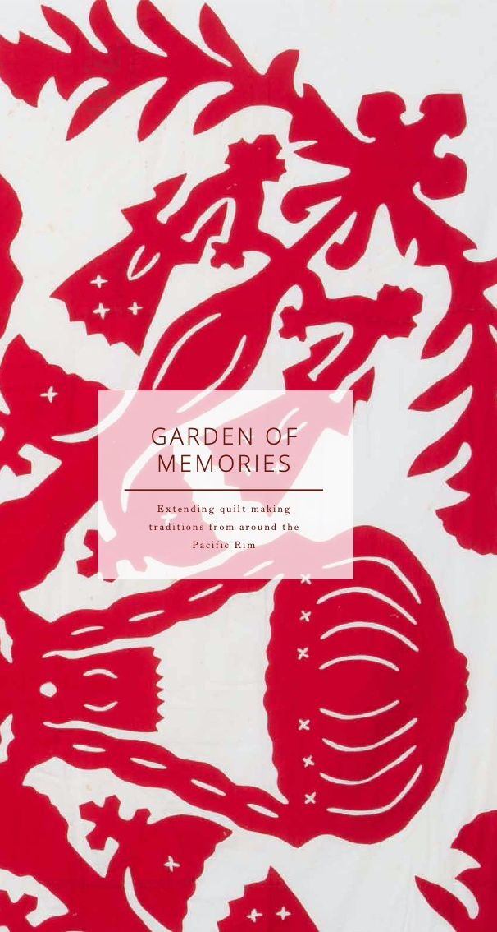
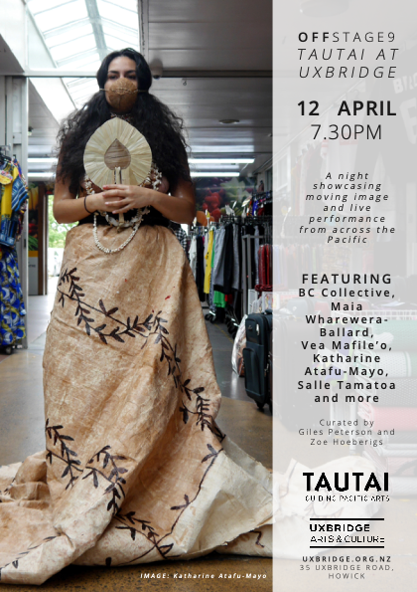
Saltwater interconnectivity Exhibition's: Whakapapa /GAFA:
SOLWARA = Tok Pisin for
Salt Water, Ocean, Sol - Wara
: salted water, also salt tears = crying
. My mother died in February
2019 a month before these events shown on this screen. Katharine
along with several of my amazing students
was really there for me at this time, as was
Courtney Sina Meredith – the then director of
Tautai and her family. The family of artists and community ive known
And loved called Tautai – Championing Pacific Creativity.
My teaching and curatorial practice is always within an educational space and
Is always relational – but everything in the Moana World view is relational - and always personal – interconnected like textiles - but also outreaching, community building, collaborative and collective. My teaching and curatorial practice are informed by a life lived working with young artists and designers and their indigenous Pacific communities to build something strong, together, uplifting and empowering. Mana Moana - Pacific fanau - Pacific families = Pacific way.
"without love, I am nothing " 1 Corinthians 13 1
Offstage 9
Tautai at >>>
Uxbridge
12 April 2019
Garden of Memories 2019
Malcolm Smith Gallery
<<March to May 2019

Slide 8
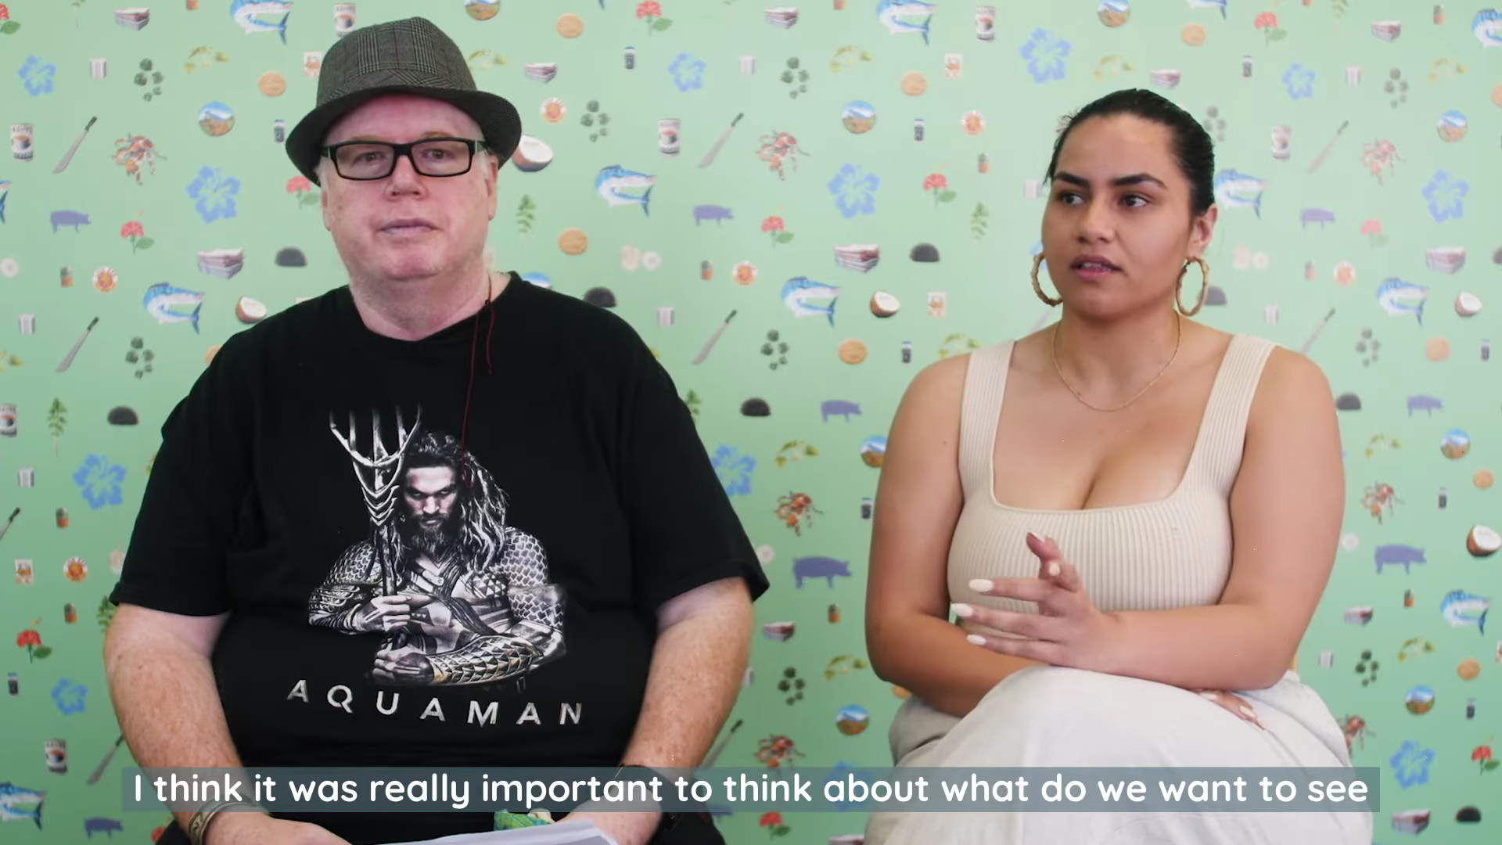

Slide 9
As change-agents, the exhibition’s artists are a collective voice of the urban Moana-Solwara - weaving the past with the present to inform the future as they draw upon their own lived realities to investigate old and adapted systems of spirituality, social justice, equity, gender, sexuality, climate change, technology, economic uncertainty, language diaspora, and the revitalisation of ancestral knowledge.
SALTWATER / Interconnectivity was a moment to come together amid an ever- changing landscape. A space to talanoa (dialogue), celebrate, and critique our ways of life. A place to share our experiences within an ecosystem of relationships that informs who we are as saltwater people.
Our communities face hostility towards Indigenous peoples of colour and incredible social hardship, especially among our most vulnerable, our elderly and our rangatahi (youth) who are often hardest hit by global crises such as the COVID-19 pandemic, worldwide recessions and job losses, climate change, and more.
SALTWATER / Interconnectivity was a rallying cry and a celebration of the resilience of Moana Solwara indigenous people. The exhibition was a call to revel in dazzling beauty and artistry and honour the strength and resilience of Pasifika peoples through the creative talent of its young people as they weather storms of massive social change and survive colonisation and adversity.
Keywords: Moana, Solwara, Pasifik(a), contemporary art, Indigenous art, Oceania
Notes:
As change-agents, the exhibition’s artists are a collective voice of the urban Moana-Solwara - weaving the past with the present to inform the future as they draw upon their own lived realities to investigate old and adapted systems of spirituality, social justice, equity, gender, sexuality, climate change, technology, economic uncertainty, language diaspora, and the revitalisation of ancestral knowledge.
SALTWATER / Interconnectivity was a moment to come together amid an ever- changing landscape. A space to talanoa (dialogue), celebrate, and critique our ways of life. A place to share our experiences within an ecosystem of relationships that informs who we are as saltwater people.
Our communities face hostility towards Indigenous peoples of colour and incredible social hardship, especially among our most vulnerable, our elderly and our rangatahi (youth) who are often hardest hit by global crises such as the COVID-19 pandemic, worldwide recessions and job losses, climate change, and more.
SALTWATER / Interconnectivity was a rallying cry and a celebration of the resilience of Moana Solwara indigenous people. The exhibition was a call to revel in dazzling beauty and artistry and honour the strength and resilience of Pasifika peoples through the creative talent of its young people as they weather storms of massive social change and survive colonisation and adversity.
Keywords: Moana, Solwara, Pasifik(a), contemporary art, Indigenous art, Oceania

Slide 10
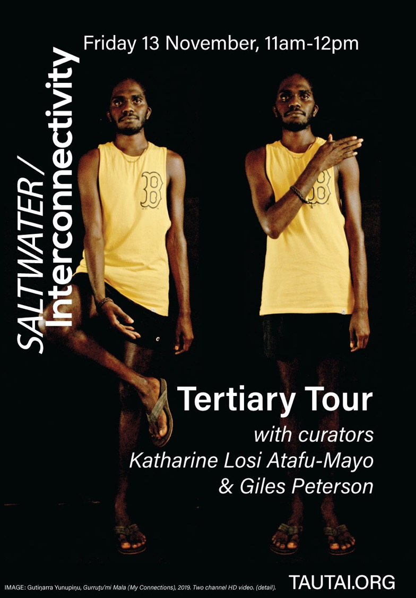
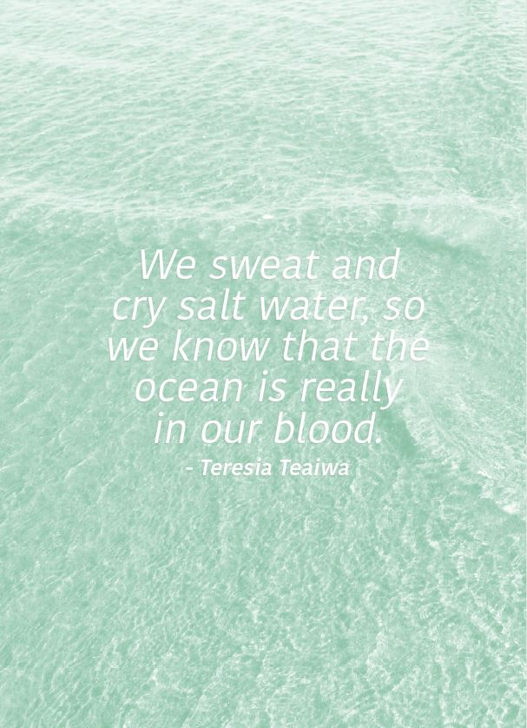
<<Teresia was a personal friend of mine. I approached Sean and also Katairaina, Tere's sister for permission for us to use this quote.
Artwork:>>>>>>
Guti Yunupinju
-Courtesy of the Mulka
Arts Centre, Yirkala, Australia
Graphic Design:
Gloriana Meyers:
Tautai
Graphic design: Niko Meredith, No Six.
in SALTWATER / Interconnectivity, ed. Katharine Losi Atafu-Mayo and Giles Peterson (Auckland: Tautai, 2019), 2

Slide 11
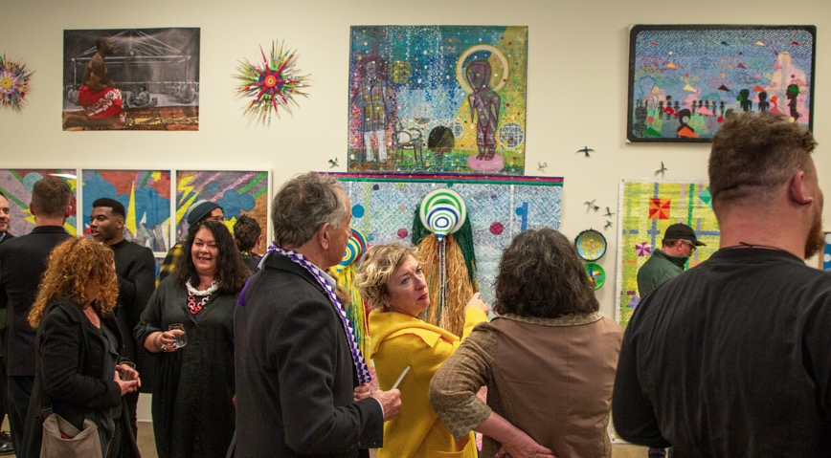
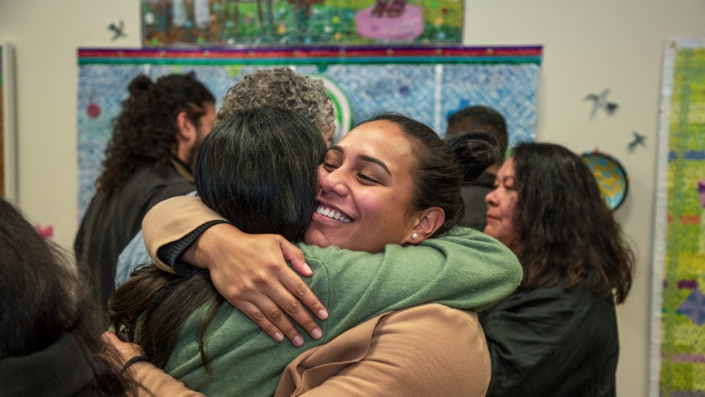
Figure 1. Community engagement at the opening of SALTWATER / Interconnectivity, October 15, 2020. Photograph by Isoa Kavakimotu. Courtesy of Tautai Gallery

Slide 12
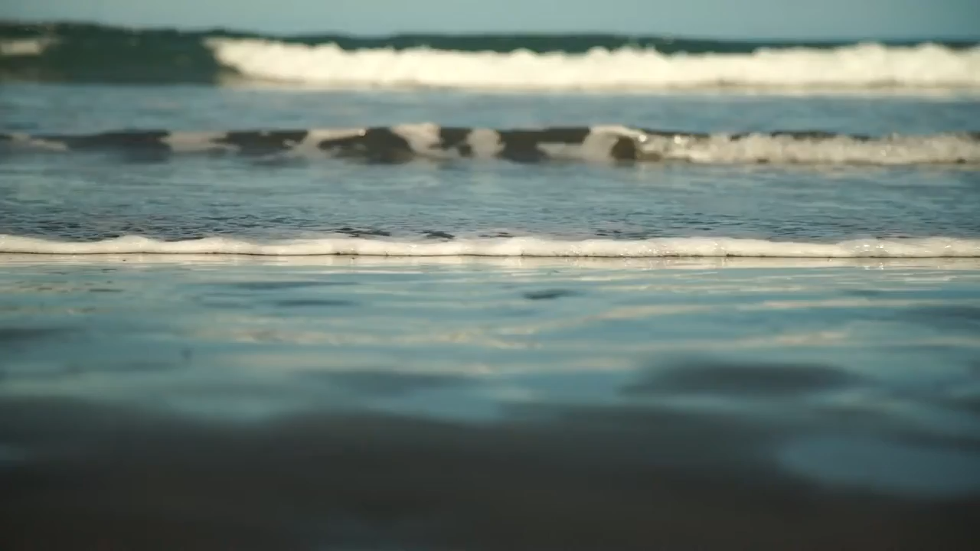
SPOTLIGHT VIDEO- MEET THE CURATORS – KATHARINE ATAFU – MAYO & GILES PETERSON. Video: Niko
Meredith, No Six. 2020. Tautai – Championing Pacific Creativity

Slide 13
Curators
SALTWATER /
Interconnectivity
Katharine Losi Atafu-Mayo & Giles Peterson
We sweat and cry salt water, so we know that the ocean is really in our blood. - Teresia Teaiwa
Saltwater is the key ingredient for the building blocks of life. It is also the essence of who we are as Solwara and Moana peoples of Oceania.
This living and breathing heartbeat knows no bounds; an entity that acts as a highway we continue to navigate which connects, separates, sustains, threatens, heals and purifies. The exhibition has been shaped to reference these traits which reflect the critical relationships, worldviews and shared histories of Indigenous Solwara and Moana peoples.
As change-agents, the artists are a collective voice of the urban Moana and Solwara, weaving the past with the present to inform the future as they draw upon their own lived realities to investigate old and adapted systems of spirituality, social justice, equity, gender, sexuality, language diaspora, and ancestral knowledge.
SALTWATER/Interconnectivity is a point in time to come together amid an ever-changing landscape. A space to talanoa, celebrate, and critique our ways of life. A place to share our experiences within an ecosystem of complexities that inform who we are as saltwater people.
“Ka mua, ka muri” (walking backwards into the future)
- whakatauki.
po, po, po
po, po, po
²Telly Tuita, Future Nostagia,2020
Graphic design: Niko Meredith, No Six.
in SALTWATER / Interconnectivity, ed. Katharine Losi Atafu-Mayo and Giles Peterson (Auckland: Tautai, 2019), 4
Notes:
We sweat and cry salt water, so we know that the ocean is really in our blood—Teresia Teaiwa
Ka mua, ka muri (Walking backwards into the future).
—Whakataukī (Maori Proverb)
“We sweat and cry salt water, so we know that the ocean is really in our blood,” said the late scholar, poet, and i-Kiribati activist Teresia Teaiwa. These evocative words became a reference point for Tautai Gallery’s recent exhibition SALTWATER / Interconnectivity. As co-curators, we aimed to transform the gallery into an embodiment of the Moana worldview and explore questions of justice, equity, identity, and ecology.¹ This essay describes some of the issues explored by the group exhibition—held in Auckland, Aotearoa New Zealand from October 16, 2020 to January 30, 2021—including through its public exhibition talks, forums, and performance activations. The exhibition showed newly commissioned work by six multimedia Indigenous artists and designers of the Moana-Solwara (Oceania region): Katharine Losi Atafu-Mayo, Peter Elavera, Te Ara Minhinnick, Shawnee Tekki, Telly Tuita, and Gutiŋjarra Yunipiŋju.
Several concepts guided the curation of the exhibition and its conscious engagement with local communities. Salt water is referred to as solwara in Tok Pisin and Melanesian Island language groups, as well as Moana, a pan-Polynesian term for the Pacific Ocean and its island peoples. Salt water is the key ingredient for the building blocks of life. It is also the essence of who we are as Solwara and Moana peoples of Oceania. This living and breathing heartbeat knows no bounds; it is an entity that acts as a highway that connects, separates, sustains, threatens, heals, and purifies as we continually navigate through it. We shaped the exhibition to reference these traits and reflect the critical relationships, worldviews, and shared histories of Indigenous Moana-Solwara peoples.² As change-agents, the exhibition’s artists are a collective voice of the urban Moana-Solwara, weaving the past with the present to inform the future as they draw upon their own lived realities to investigate old and adapted systems of spirituality, social justice, equity, gender, sexuality, language, diaspora, and ancestral knowledge. SALTWATER / Interconnectivity was a moment to come together amid an ever­changing landscape. A space to talanoa (dialogue), celebrate, and critique our ways of life. A place to share our experiences within an ecosystem of relationships that informs who we are as saltwater people.

Slide 14
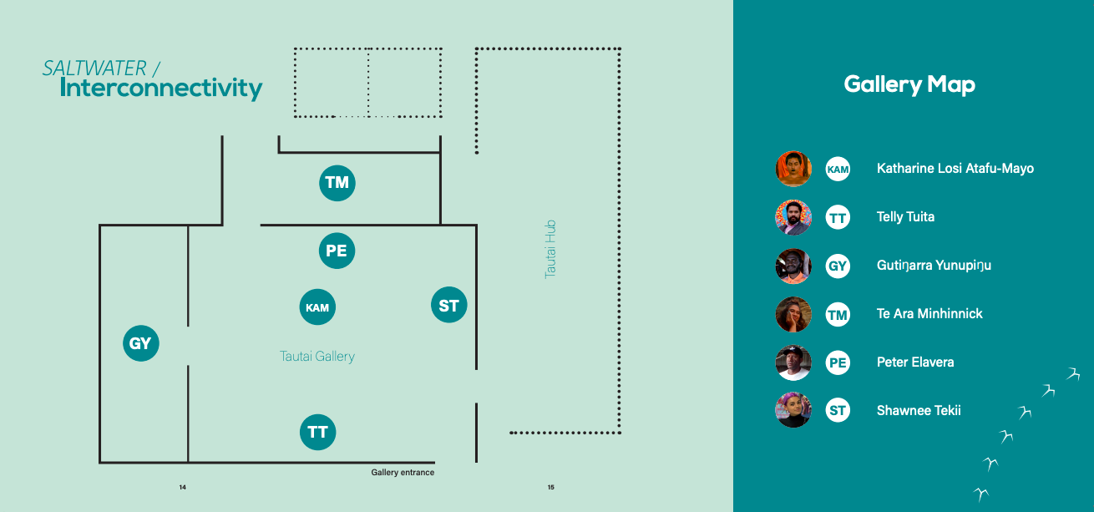
Graphic design: Niko Meredith. Graphic design: Niko Meredith, No Six.
in SALTWATER / Interconnectivity, ed. Katharine Losi Atafu-Mayo and Giles Peterson (Auckland: Tautai, 2019), 7
Notes:
“Interconnectivity” in the exhibition’s title refers to the connections that unite and connect Tangata o le Moana (Pacific Island peoples). Tautua is the Sāmoan word for service to community. Tautai is the Sāmoan word for navigator, one who leads and shows the way. We centred the exhibition on Indigenous ways of being, knowing, and wayfinding, as well as the navigation of ancestral, intergenerational, and spiritual bloodlines and pathways. Tautai Gallery is a recently established (2020), Pasifika-driven space that builds on the Tautai Pacific Arts Trust’s thirty-five-year legacy of championing contemporary Pacific creativity. The gallery is located on Te Karangahape Road, which sits above the ancient Te Wai Horotiu waterway, a freshwater stream of importance to Māori culture that flows from the Karangahape Road ridge, down the Queen Street Valley, and eventually to the Pacific Ocean. We referred to connections to ancient waterways of Moana peoples, the concept of katiakitanga (guardianship of waterways), and the role of waterways as a place of gathering and sustenance throughout the exhibition: in the scenography, curatorial texts presented in Te Reo Māori (Māori language) and English, and the artworks. References to the importance of the Moana as a source of life, sustenance, healing, awe, respect, and community survival were present throughout the exhibition space and in the works addressing climate change and ecological disaster.

Slide 15
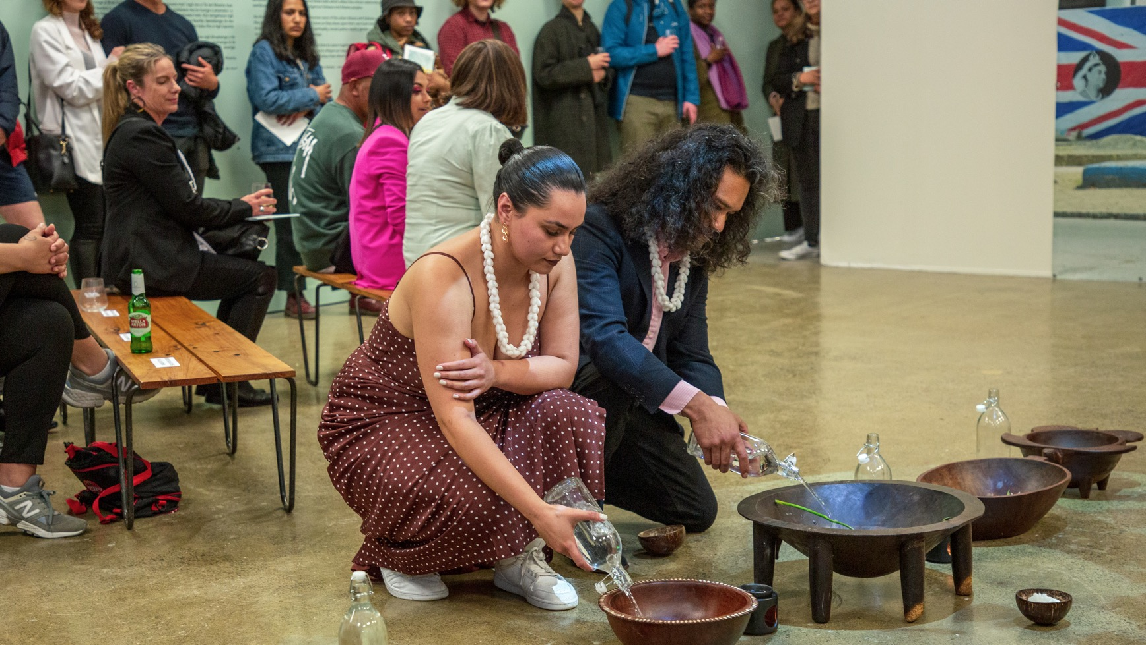
Figure 2. Co-curator and artist Katharine Losi Atafu-Mayo with artist Telly Tuita at the opening performance activation featuring Atafu-Mayo’s Feso’ota’i atu (Connection). SALTWATER / Interconnectivity, Tautai Gallery, Auckland, Aotearoa New Zealand, October 15, 2020. Photograph by Isoa Kavakimotu. Courtesy of Tautai Gallery
Notes:
Performance and Participation
As curators, we intended the exhibition and its related programming to visually, bodily, kinesthetically, emotionally, and spiritually engage Moana-Solwara communities in Aotearoa. Focusing on performance enabled us to do this, as Moana-Solwara cultures are strongly performative. We included spoken word poetry, dance, moving image, performative photography, time-based collaborations, participatory art, and digital storytelling. Performance and audience participation empower viewers who directly witness the talent, beauty, and bravery of their youth, artists, and teachers (and themselves) in the artwork and public programs. Katharine Losi Atafu-Mayo’s opening performance articulated these ideas about participation and empowerment in space and time. She collected salt water from the Pacific Ocean and ritually poured it into five kava bowls from different parts of Oceania that were set in a line on the floor of the gallery (Fig. 2). Atafu- Mayo’s simple, powerful performance activated the bowls, their contents, and the cultures they represented. The space of the gallery was likewise transformed into a charged, ceremonial Pasifika space, in part through notebooks the artist had provided for audience members to draw and write in as they engaged with the piece (Fig. 3).³ In the performance, Atafu-Mayo wanted people to exchange with the Moana. Bringing the ocean water into the gallery transposed it from its usual context and allowed people to value it differently. In designing the work, she thought about Indigenous worldviews and the ways her community celebrates, performs rituals, grieves, and forgives.⁴ She connected these ideas to her performance, stating: Kava is a ritual that allows connection, authentic talanoa, and a space for vulnerability and transparency. Presenting saltwater, in the place of kava, in these bowls speaks to the spatial separation and diaspora that we find ourselves in, as well as our spiritual con­nection by a powerful multifaceted entity and God.⁵

Slide 16
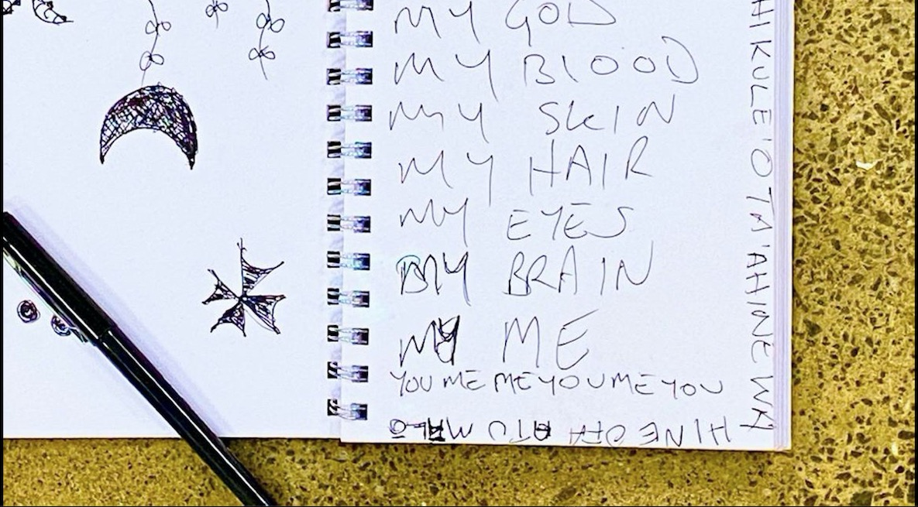
Figure 3. Katharine Losi Atafu-Mayo’s notebook included in Fesoʻotaʻi atu (Connection) for audiences to draw and write in as they engaged with the piece, 2020. SALTWATER / Interconnectivity, Tautai Gallery, Auckland, Aotearoa New Zealand. Photograph by Giles Peterson. Courtesy of Tautai Gallery

Slide 17
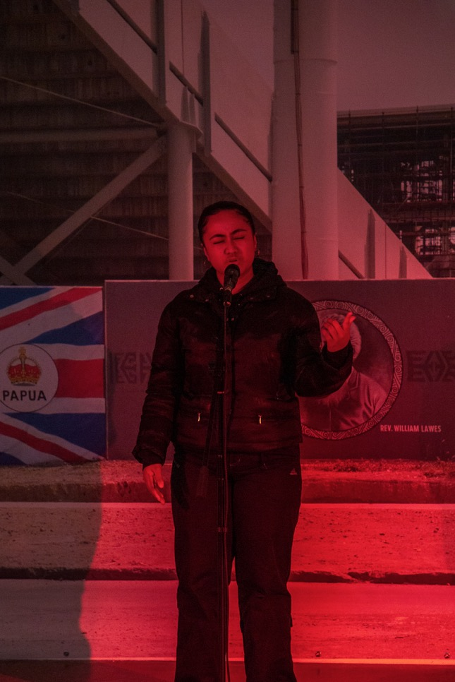
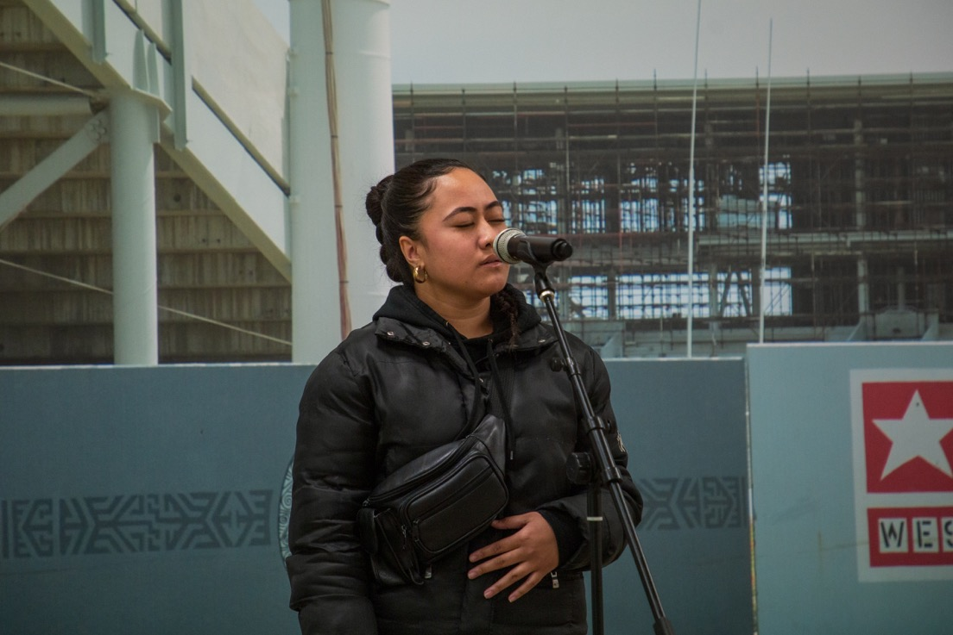
Figure 4. Spoken word perfor­mance by Aigagalefili Fepuleaʻi- Tapuaʻi of 4TK (4 Tha Kulture) at the opening of SALTWATER / Interconnectivity, Tautai Gal­lery, Auckland, Aotearoa New Zealand, October 15, 2020. Photograph by Isoah Kava- kimotu. Courtesy of 4TK and Tautai Gallery
Notes:
Other programming included three performances on the opening night of the exhibition on October 15, 2020, as part of Auckland Artweek.⁶ The first of these was a powerful spoken word poem and oratory by Aigagalefili Fepuleaʻi Tapuaʻi of 4TK (4 Tha Kulture), a South Auckland-based Indigenous environmentalist youth group committed to advocating against climate change through a lens of the perspectives and experiences of rangatahi (youth) (Fig. 4).

Slide 18
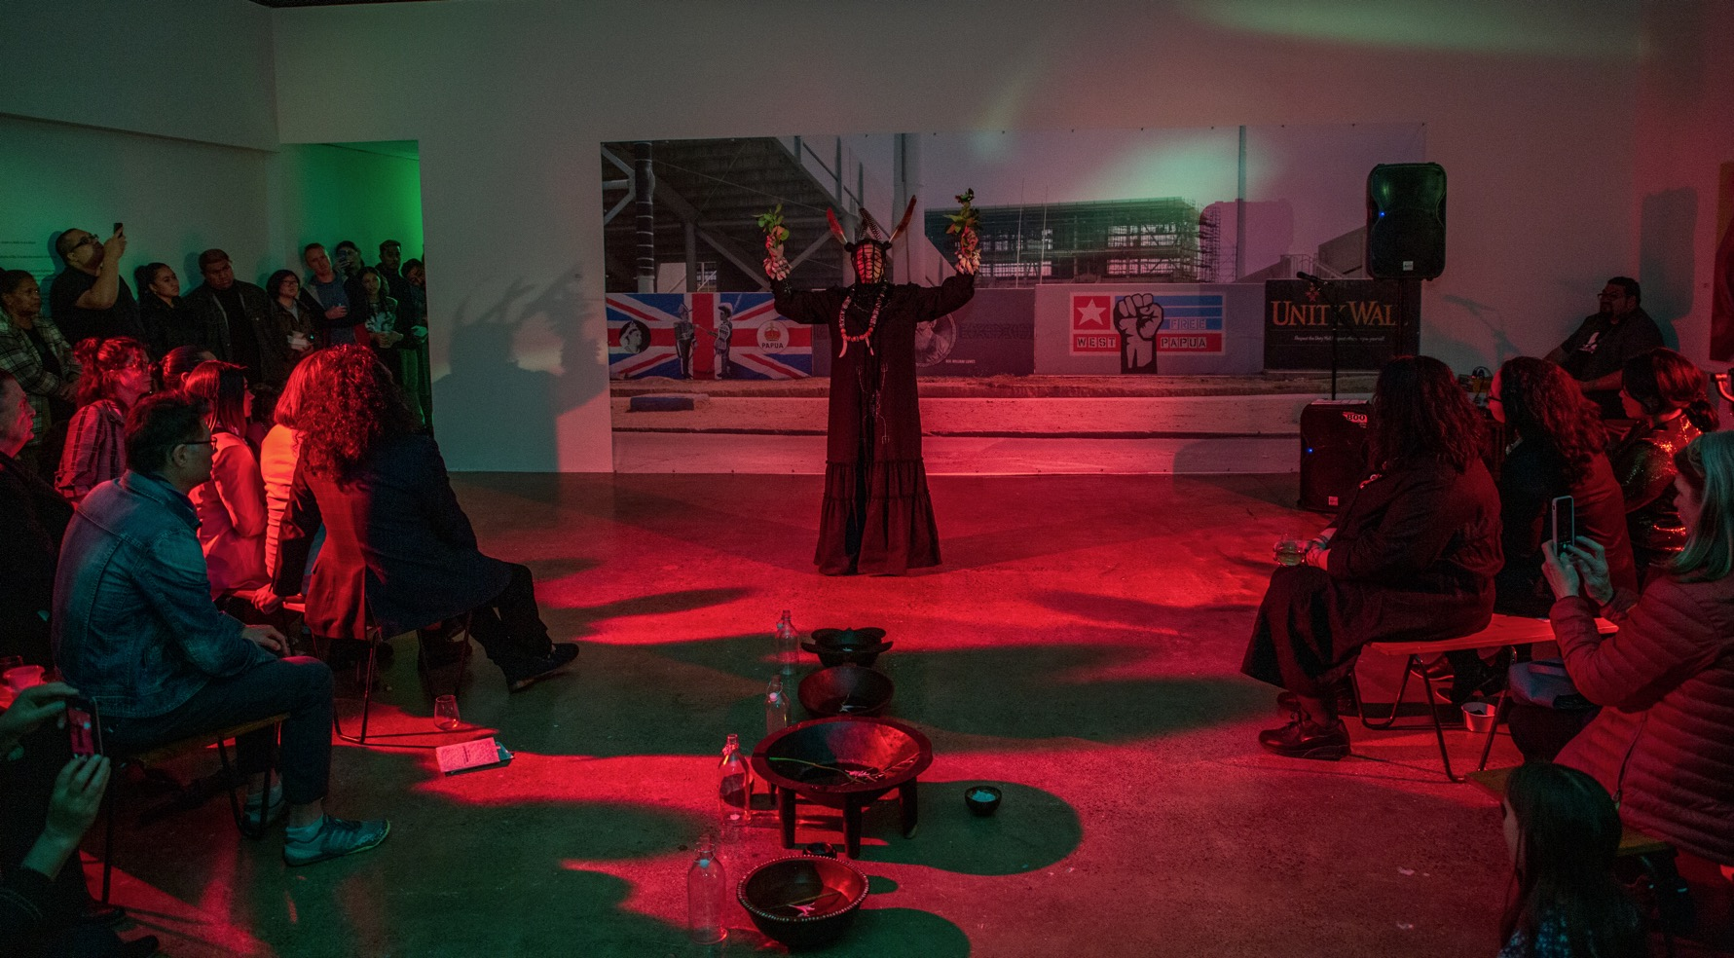
Figure 5. Sistar S’pacific (aka Rosanna Raymond), Acti.VĀ.tion, 2020. Performance at the opening of SALTWATER / Interconnectivity, Tautai Gallery, Auckland, Aotearoa New Zealand, October 15, 2020. Photograph by Issoh Kavakimotu. Courtesy of the artist and Tautai Gallery
Notes:
Rosanna Raymond—an innovator in the contemporary Pasifika art scene, long-standing member of the Pacific Sisters art collective, and founding member of the SaVAge K`lub—also contributed a performance piece. Her practice engages people, spaces, and objects to “acti.VĀ.te” dynamic relationships and to realise and reshape the tā-vā (time-space) duality.⁷ She uses performance, Pasifika ceremony, chant, storytelling, spoken word poetry, costume, and adornment as ways to transform the physical world into a sacred space and make sense of the world from an Indigenous Moana-Solwara worldview.
At the exhibition opening, Raymond appeared as Sistar S’pacific in a kaitiaki ceremonial role (Fig. 5). Kaitiaki is a New Zealand Māori term for the concept of guardianship for the sky, the sea, and the land. A kaitiaki is a guardian, and the process and practices of protecting and looking after the environment are referred to as kaitiakitanga. In a practice embedded within Moana world views, values, oratory, ritual chant, and movement, Raymond blessed and activated the community space and exhibition. She honoured the Indigenous custodians of the land; the spiritual power of our Moana-Solwara peoples; the great teachers and healers who have gone before, and their struggles and sacrifices that gave new generations a better way of life; and the bravery of the artists and their mahi (work) Raymond’s performance celebrated the exhibition as a powerful expression of the Pacific family and the Pacific way, uniting our communities through the healing and transformative power of art. Sistar S’pacific heralded new beginnings and called on tautai—the navigators in us all—to come together, celebrate, exchange, and be ever-vigilant in supporting Pasifika peoples’ struggles for self-determination, equity, social justice, and freedom from oppression, systemic racism, and neocolonialism.

Slide 19
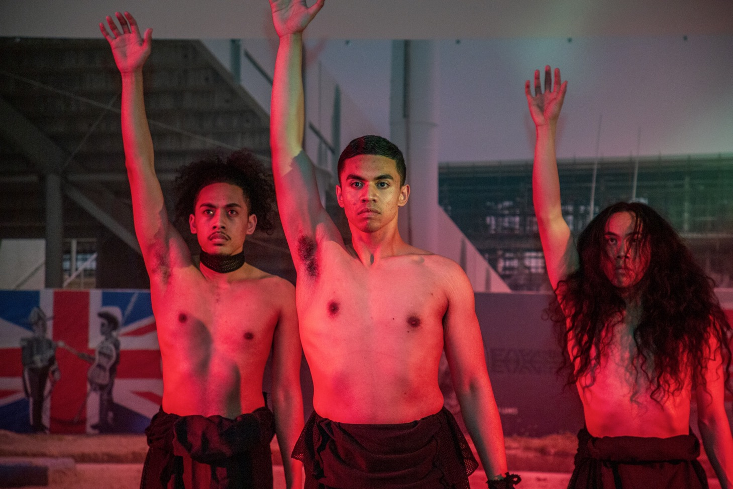
Figure 6. Performance by LALO (Ankaramy (Anks) Fepuleai, Jireh Lalotoa, Jay Lisimoni, Christian Segi, and Kardia Ah Kiau) at the opening of SALTWATER / Interconnectivity, Tautai Gallery, Auckland, Aotearoa New Zealand, October 15, 2020. Photograph by Isoa Kavakimotu. Courtesy of LALO and Tautai Gallery
Notes:
The exhibition opening event also featured contemporary dance by choreographer Ankaramy Fepuleai and four male dancers—who performed Fepuleai’s epic dance work LALO—direct from the Pacific Dance Festival. LALO, which means “below,” guided viewers through ifoga, the Sāmoan custom of seeking forgiveness. This involves delivering a formal apology to another person, while bowing down and humbling oneself. The offender appears covered in an ʻie toga (fine mat) and the only way forgiveness is granted is if the victim lifts the ʻie toga from the offender (Fig. 6).⁸

Slide 20
in SALTWATER / Interconnectivity, ed. Katharine Losi Atafu-Mayo and Giles Peterson (Auckland: Tautai, 2019), 7. Graphic design: Niko Meredith, No six.

Slide 21
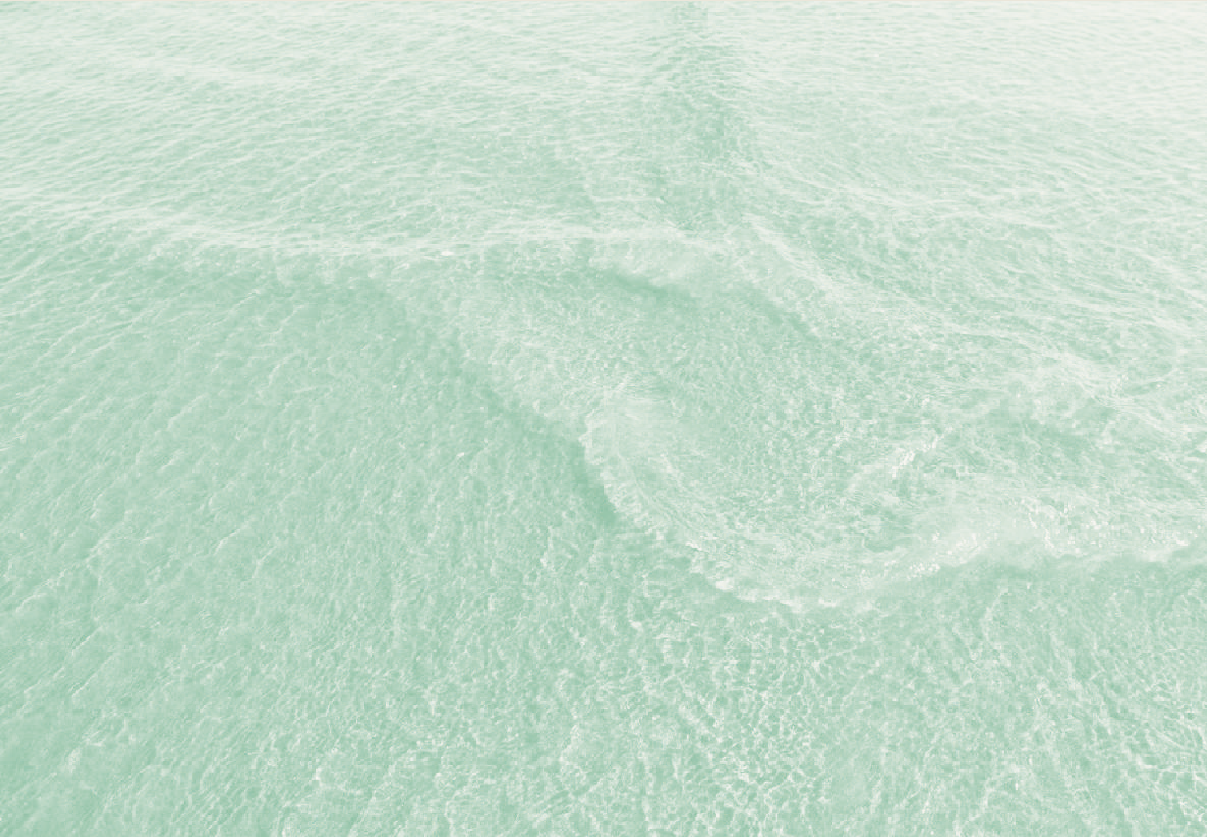
Resilience
8 9
Graphic design: Niko Meredith, No Six.
in SALTWATER / Interconnectivity, ed. Katharine Losi Atafu-Mayo and Giles Peterson (Auckland: Tautai, 2019), 9
Notes:
Resilience
It was important to us as curators to think about what we wanted to see in this uncertain time and in this ever-changing landscape. What does our community want to experience when they come into this gallery?⁹ We had several major themes related to resilience in mind for the exhibition: feminine energy; community; intergenerational storytelling; activation, social justice, and protest based on “Black and Brown Lives Matter”; and climate change and ecology. These are issues that affect not only the families and communities in our own neighbourhoods and across Aotearoa and the Moana-Solwara, but every person on the planet. Our communities face hostility towards Indigenous peoples of colour and incredible social hardship, especially among our most vulnerable, our elderly and our rangatahi (youth) who are often hardest hit by global crises such as the COVID-19 pandemic, worldwide recessions and job losses, climate change, and more.
SALTWATER / Interconnectivity was a rallying cry and a celebration of the resilience of Pasifika people. The exhibition was a call to revel in dazzling beauty and artistry and honour the strength and resilience of Pasifika peoples through the creative talent of its young people as they weather storms of massive social change and survive colonisation and adversity.

Slide 22
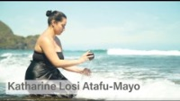
ARTIST SPOTLIGHT – KATHARINE ATAFU – MAYO . Video- Niko Meredith, No Six. 2020

Slide 23
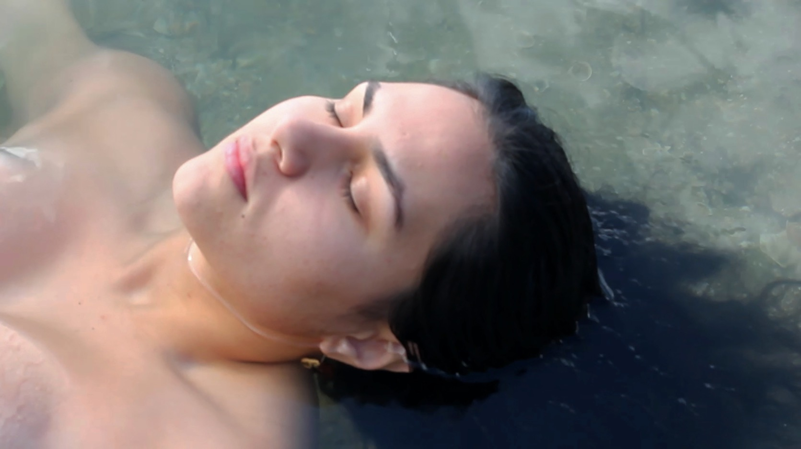
Katharine Losi Atafu-Mayo, Fesoʻotaʻi atu, 2020. Digital video projection – film, sound, saltwater ocean, 250 x 100 cm, including projection. SALTWATER / Interconnectivity, Tautai Gallery, Auckland, Aotearoa New Zealand.
Notes:
Fesoʻotaʻi atu, Katharine Losi Atafu-Mayo
Katharine Losi Atafu-Mayo (Sāmoa, Aotearoa, Scotland, England) is a devoted daughter, sister, and godmother whose social art practice is an evolving ecosystem of Moana healing methodologies, spirituality, and community engagement grounded in unconditional love. By confronting cultural norms, societal expectations, and systematic oppressions, Atafu-Mayo uses her lived experiences to create an alternative way of operating in our everyday lives.
Atafu-Mayo’s multimedia activation/moving image installation was titled Fesoʻotaʻi atu, which means “connection” in the Sāmoan language. A video depicted Atafu-Mayo, who appeared as an unidentified Polynesian woman, collecting water from the Pacific Ocean. The water was stored in glass bottles to be used in the artist’s opening performance, as described above. The five kava bowls featured in the opening ceremony, lined in a row in the main gallery space, accompanied the video projection (Fig. 7). Atafu-Mayo borrowed these bowls from personal collections representing different parts of Oceania

Slide 24
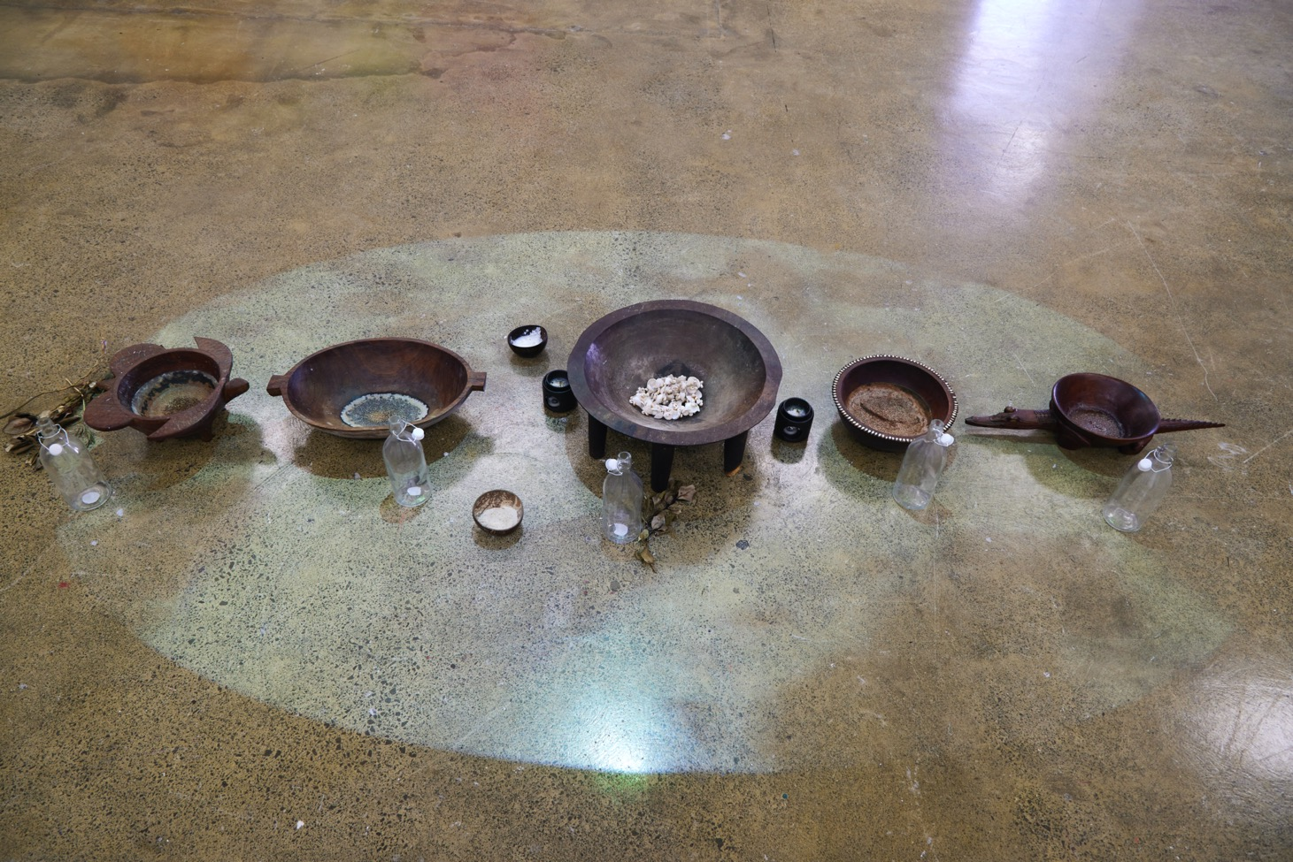
Figure 7. Katharine Losi Atafu-Mayo, Fesoʻotaʻi atu, 2020. Digital video projection (filmed by Benji Timu), sound, saltwater, Pasifika tanoa (kava bowls), wood, mother of pearl, coconut drinking cups, 250 x 100 cm, including projection. SALTWATER / Interconnectivity, Tautai Gallery, Auckland, Aotearoa New Zealand. Photograph by Ralph Brown. Courtesy of the artist and Tautai Gallery
Notes:
Giles Peterson loaned two bowls: one from the Sepik region of Papua New Guinea that his father had brought to Aotearoa New Zealand—underscoring the intergenerational connections that ran throughout the exhibition—and another that was gifted to him in 2009 by Papua New Guinean artist Martin Morububuna. Atafu-Mayo and Rosanna Raymond contributed two Sāmoan ava bowls, and a colleague of Peterson’s loaned a Fijian bowl. In advance of the installation, Atafu-Mayo oiled each bowl to protect them from the salt water that she and other participating artists ritually poured into them during the opening performance. The bowls were filled with salt water for the duration of the exhibition and remained lined up on the floor of the gallery, while a video was projected down onto the bowls from the ceiling. Like rays of sunlight, the footage of waves lapping against the shore immersed the bowls and viewers in a saltwater world.

Slide 25
Katharine Losi - Atafu-Mayo
Feso’ota’i atu
po, po, po, manava i totonu;
may this space light the fire within you that has been extinguished, may your peace that’s been disrupted find harmony in all living things, may your tino, mafaufau, and agaga feel held,
I invite you to just be in this space of interconnectedness; remember, navigate, reflect, meditate, thank,
manava i totonu;
exchange your love, your rage, your energy, your joy, your distaste, your healing; share what you must with the Moana.
They will be returned with what you pour into them.
we are connected, we are profound, we are resilient, we are powerful, manava i totonu;
po, po, po.
Notes:
Atafu-Mayo included the following original poem, “Po, po, po (night), Manava i totonu (breath in),” as part of her artist statement for the exhibition:
po, po, po
manava i totonu:
may this space light the fire within you that has been extinguished, may your peace that’s been disrupted find harmony in all living things, may your tino, mafaufau and agaga feel held,
I invite you to just be in this space of interconnectedness;
remember, navigate, reflect, meditate, thank,
manava i totonu:
exchange your love, your rage, your energy, your joy, your distaste, your healing;
share what you must with the Moana.
They will be returned with what you pour into them.
we are connected, we are profound, we are resilient, we are powerful, manava i totonu;
po, po, po.

Slide 26
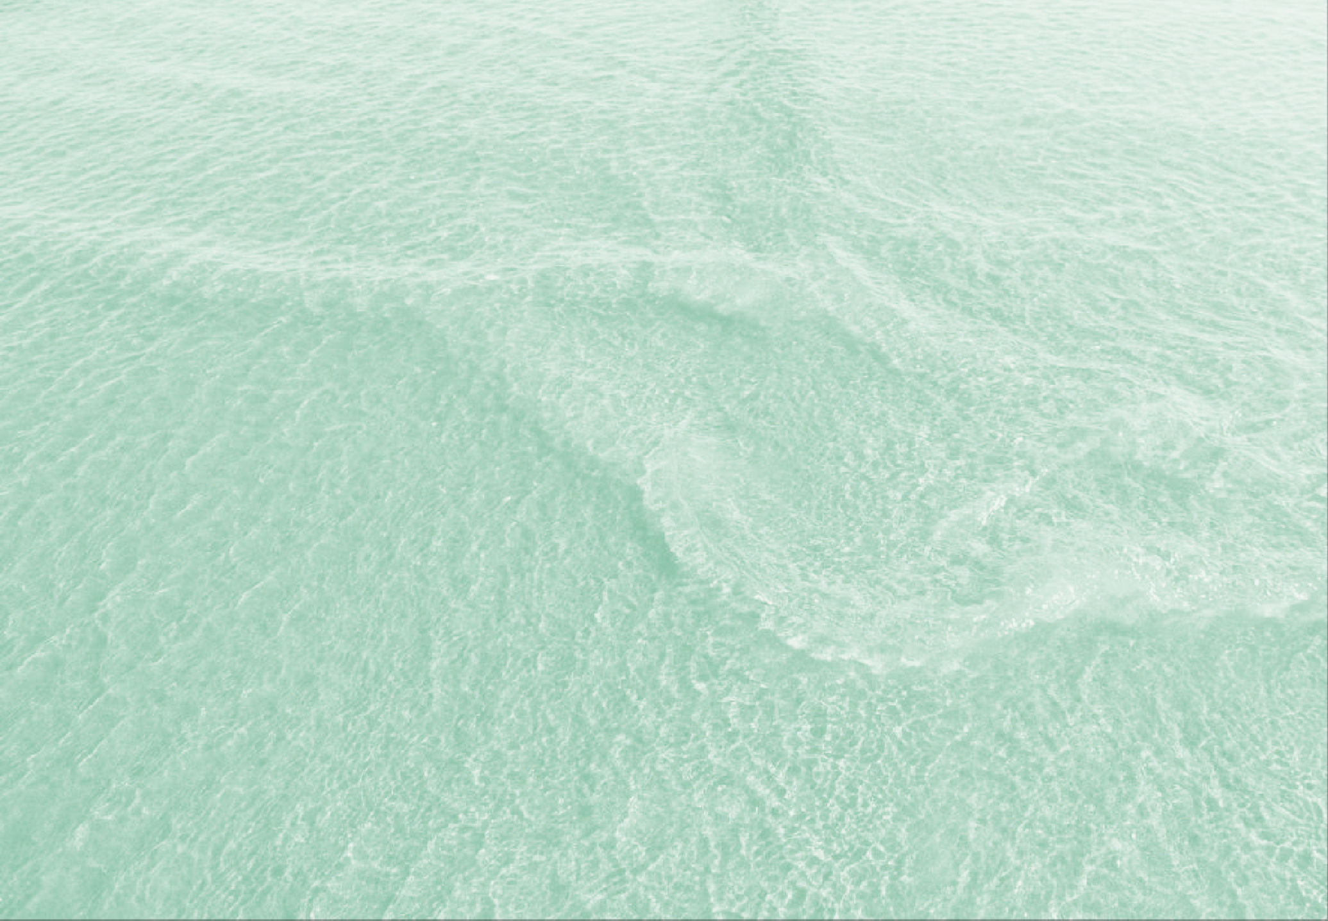
Healing
14
13
Graphic design: TAUTAI, SALTWATER INTERCONNECTIVITY Exhibition Catalogue: Niko Meredith, No Six.
in SALTWATER / Interconnectivity, ed. Katharine Losi Atafu-Mayo and Giles Peterson (Auckland: Tautai, 2019), 26
Notes:
I Left My Heart in Tongpop, Telly Tuita
Telly Tuita’s¹⁰ installation I Left My Heart in Tongpop consisted of paintings, sculptural assemblages, performative self-portraits, adornments, and found objects that transformed the exhibition space into a kaleidoscopic place of energy, vibrancy, beauty, living history, and arohanui (love) (Fig. 8). The piece consisted of about ten years of art production and testified to Tuita’s experience of leaving Tonga as a child, growing up in Australia, and finally moving to Aotearoa New Zealand

Slide 27
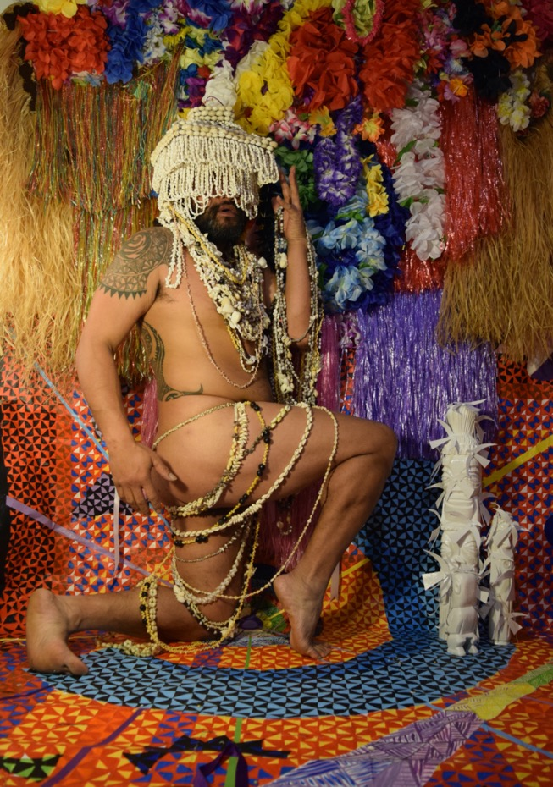
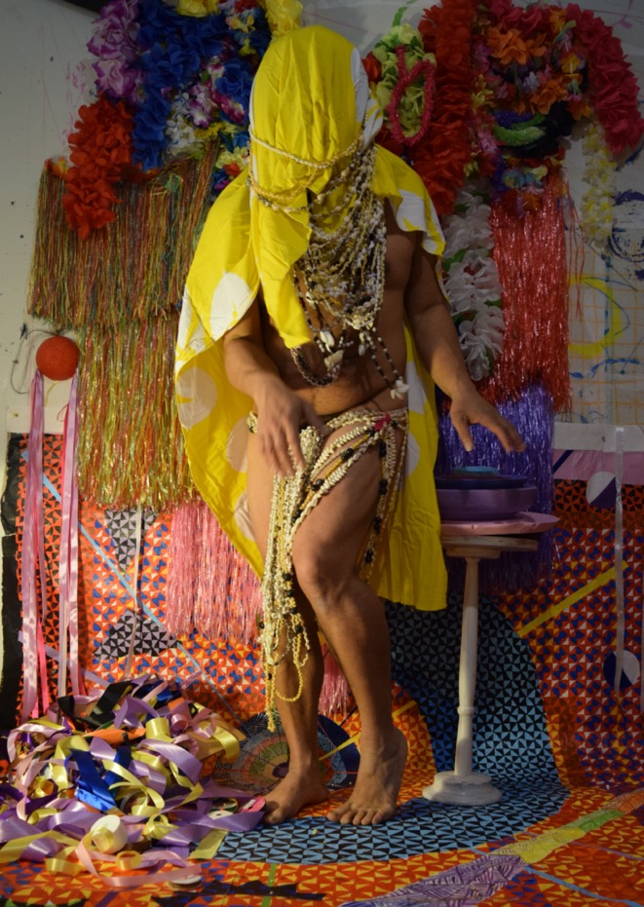
TELLY TUITA
TONG POP WANGA 2
Digital Print
100 x 96 cm, 2020. SALTWATER /Interconnectivity
TELLY TUITA
TONG – POP WANGA 1
Digital Print
100 x 96 cm, 2020 Tautai Gallery

Slide 28
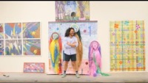
ARTIST SPOTLIGHT: TELLY TUITA – I LEFT MY HEART IN TONGPOP – SALTWATER/INTERCONNECTIVITY
TAUTAI GALLERY, : interview: Giles Peterson, curator: Video: Niko Meredith, No Six.

Slide 29
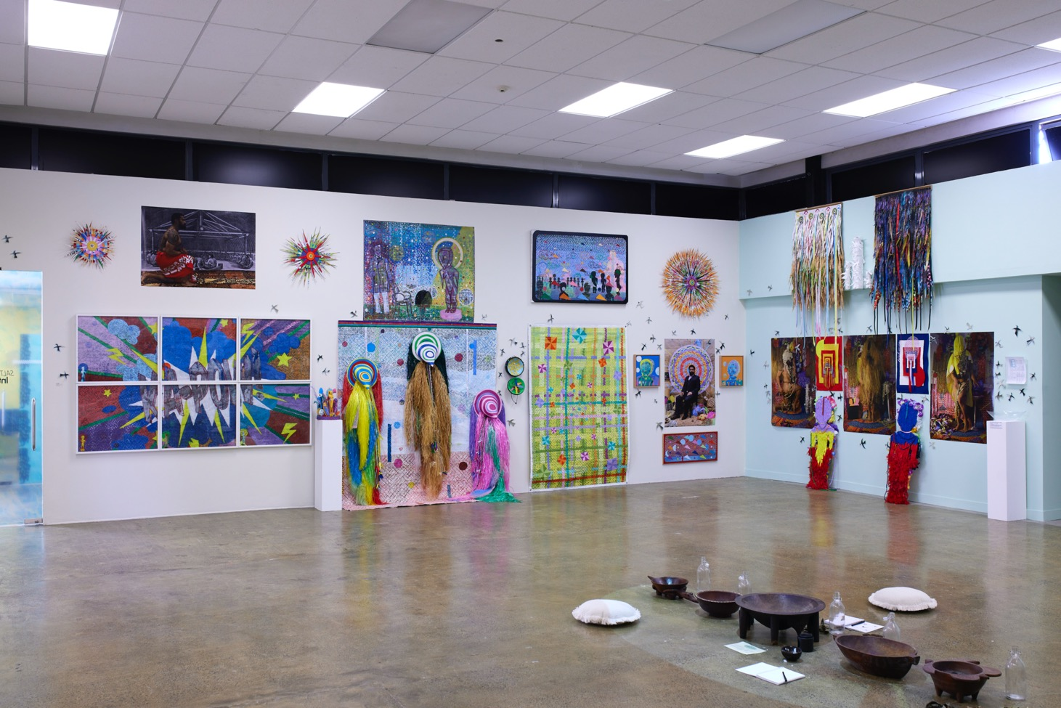
Figure 8. Telly Tuita, I Left My Heart in Tongpop, 2020. Multimedia installation. SALTWATER / Interconnectivity, Tautai Gallery, Auckland, Aotearoa New Zealand. Photograph by Ralph Brown. Courtesy of the artist and Tautai Gallery

Slide 30
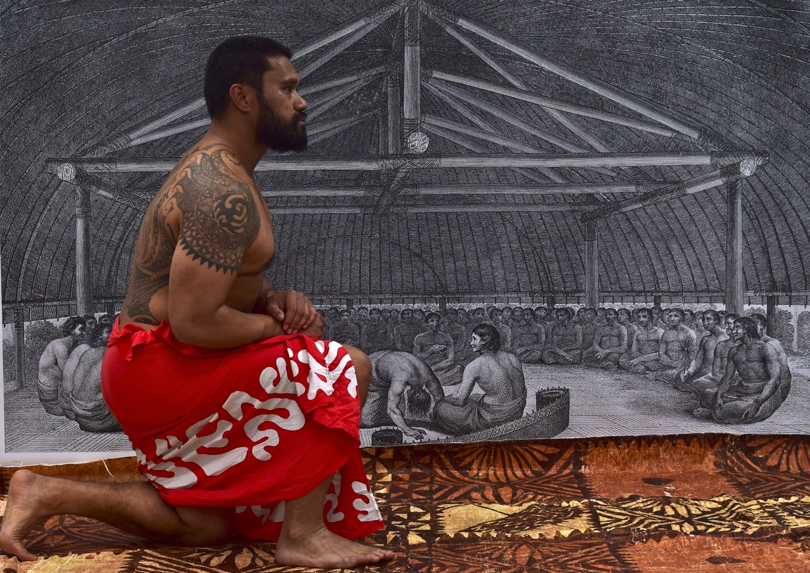
Figure 9. Telly Tuita, Romancing History, 2015. Digital print installed as part of I Left My Heart in Tongpop, 2020. SALTWATER / Interconnectivity, Tautai Gallery, Auckland, Aotearoa New Zealand. Courtesy of the artist and Tautai Gallery
Notes:
Three self-portraits, interspersed throughout the installation, documented the artistʻs grown and coming to terms with his Tongan––and more broadly, his Oceanic—heritage. The first, Romancing History (2015) was an image of the artist kneeling in front of a black-and-white reproduction of a 1784 engraving titled Poulaho, King of the Friendly Isles Drinking Kava (Fig. 9).¹¹ Dressed in a tupenu (Tongan waist garment), Tuita appears to be at once a part of the group depicted in the engraving while also showing reverence for those who came before him. The other two, Professional Brown Man (2018) (Fig. 10) and Tongpop 1–3 (2019) showed the artist in increasingly elaborate costumes and surrounded by numerous objects that evoke his relationship to Oceanic cultures, including woven mats and baskets, plastic lei, and Pasifika imagery on upcycled materials.

Slide 31
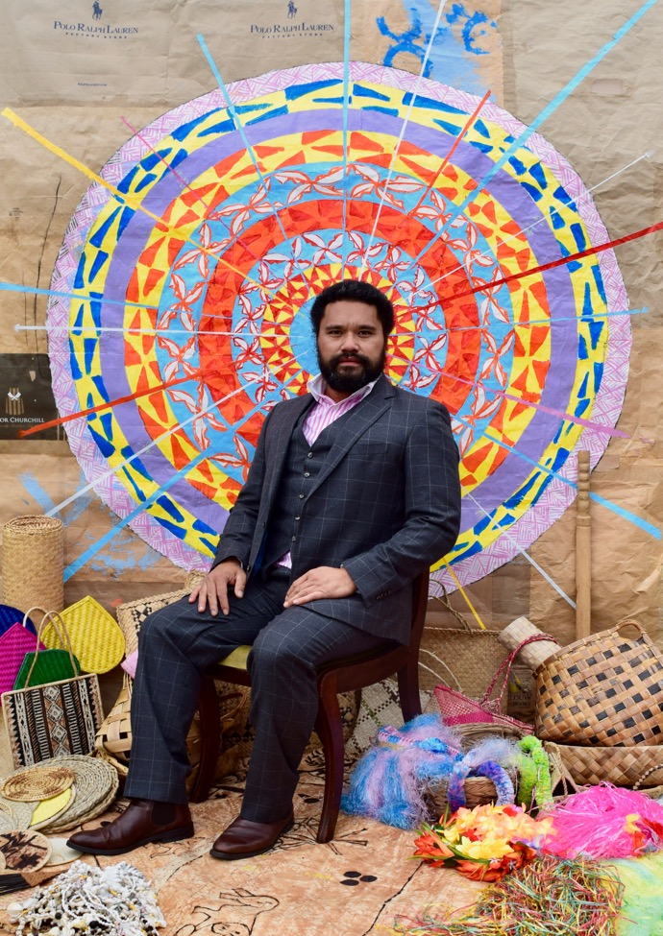
Figure 10. Telly Tuita, A Professional Brown Man, 2018. Digital print installed as part of I Left My Heart in Tongpop, 2020. SALTWATER / Interconnectivity, Tautai Gallery, Auckland, Aotearoa New Zealand. Courtesy of the artist and Tautai Gallery
Notes:
Tuita’s photographs traced the evolution of his performance practice by showing how Tongan visual and material culture has become more and more central to his identity. The installation underscored the importance of art and culture in keeping the artist’s connections with Tonga and Australia alive.¹² Tuita described the installation in this way:
How does one maintain connectivity when ties are broken? Through objects, through images, through stories, through my body. Like marks left from scars, like marks left on the earth we are always reminded of our interconnectivity to the past, present and future. The good and the bad.
I Left My Heart in Tongpop showcases ten years of a body of work that carries the spirit of Oceania. Not as a place but a Being/Spirit/God/Mother. Able to evolve and thrive in any time, any place.
Scouring second-hand shops and dollar stores, art history volumes, and visual histories, I collect items and iconography that connect with personal narratives and idealised views of places from the past. I ritualistically gather and process my bounty, layering and repurposing to create a cacophony of colour, shape, and motif which I have ascribed as TONGPOP—A hybrid aesthetic borne from broken ties and healed scars.¹³
Although Tongpop is a fictional place, Tuita notes that it has its roots in Tonga. He sees unique aspects of Oceanic cultures, histories, iconographies, materials, and art processes embodied in Moana-Solwara people who sustain a living and dynamic interconnectivity.

Slide 32
Notes:
Healing
Atafu-Mayo’s curatorial and artistic practice centres on Indigenous healing and well-being—a foundational theme for the exhibition––and is grounded in manaakitanga (respect, kindness, honesty), tautua (service), hospitality, and awhi (support). With this curatorial approach in mind, the exhibition’s artworks metaphorically opened up the gallery space to foster healing through togetherness, warmth, resilience, survival, and joy. The exhibition was organised during the lockdown caused by the COVID-19 pandemic, which is still wreaking havoc on communities around the world at the time of this writing. Having a safe and positive exhibition that united different-but-connected Indigenous Pacific ways of knowing and being was very important to her.
Healing is the restoration of that which has been wounded or broken. When connections break, we experience loss and hurt persists. The opportunity for young Indigenous artists to tell their stories and histories creates new spaces and opportunities for renewal and healing. Relationships, community, people, land, can all be recovered through healing.
SALTWATER / Interconnectivity’s focus on Indigenous knowledges was linked to the strong emphasis in the exhibition on decolonising methodologies. The artists drew on Indigenous Moana-Solwara worldviews to create accessible, dynamic, and visually exciting artworks that spoke to the manawa (heart) of people. They sought to connect spiritually and emotionally with the diverse communities coming to engage with the healing energy of the artwork.

Slide 33
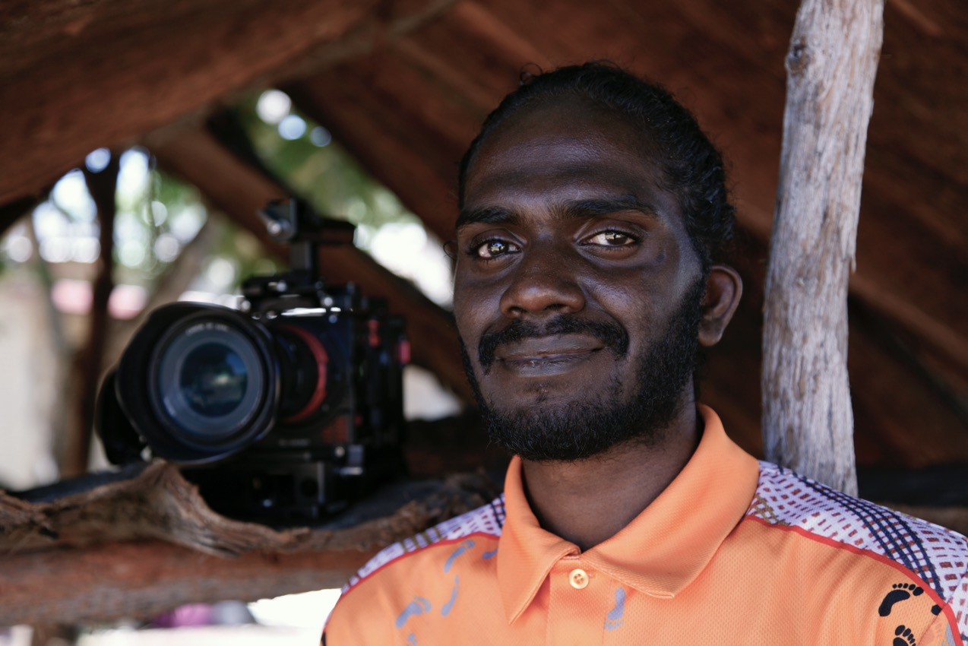
Gurruṯuʻmi Mala (My Connections). Gutiŋarra Yunupiŋu- artist and film-maker
Photo: Mulka Project, Mulka Arts Centre, Yirkala, Northern Territory, Australia, 2019
SALTWATER /Interconnectivity, TAUTAI GALLERY, AOTEAROA NEW ZEALAND, 2020 -21
Notes:
Gurruṯuʻmi Mala (My Connections), Gutiŋarra Yunupiŋu
Gutiŋarra Yunupiŋu is a First Nations artist of the Gumatj clan, Yirritja moiety, and Buymarr homeland who lives and works in Yirrkala, Northern Territory, Australia, utilising film and digital media to capture the stories of his kin. Despite being deaf since birth, he has managed to overcome many barriers. Since 2015 he has worked at The Mulka Project, a Yolŋu cultural knowledge preservation project in Yirrkala. As a project officer and filmmaker, Yunupiŋu often travels to Yolŋu homelands where he regularly films cultural ceremonies and events.¹⁴ Viewers bear witness to the power of healing, family, and community across oceans from the perspective and triumphs of this young artist who is recording the living histories and culture of his elders and community, as well as forging the pathway forward for future generations of Indigenous youth.

Slide 34
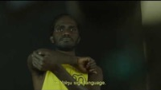
Tarnanthi 2019 - Gutiŋarra Yunupiŋu:
Tarnanthi: Contemporary Aboriginal & Torres Strait Islander Art 18 October 2019 - 27 January 2020 Art Gallery of South Australia, Adelaide agsa.sa.gov.au/tarnanthi

Slide 35
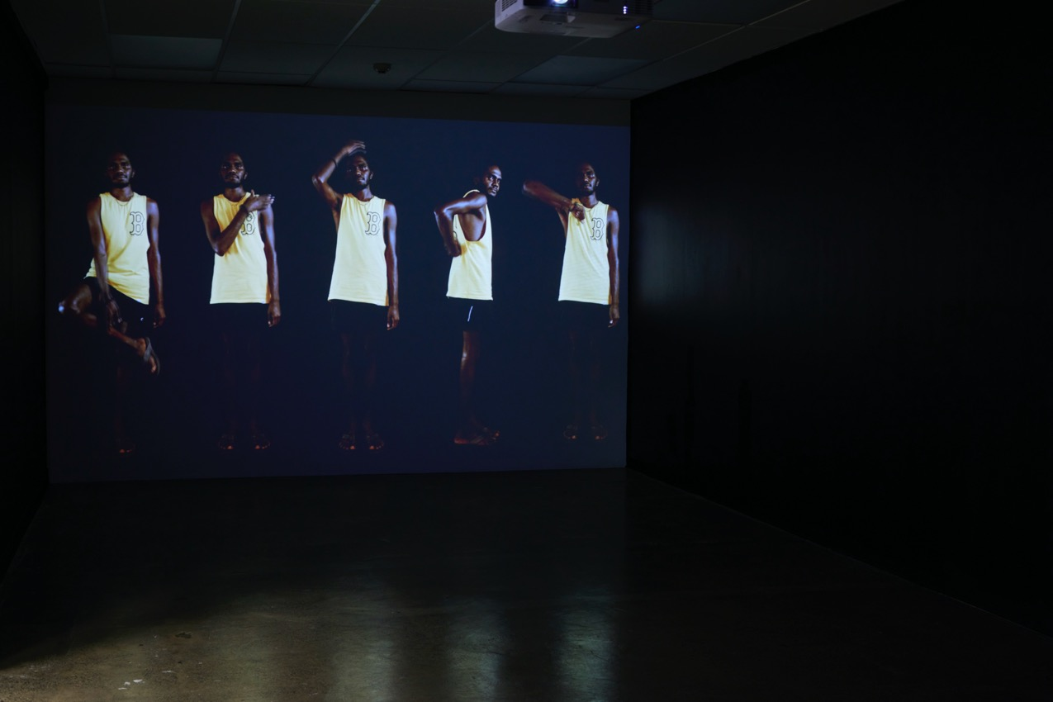
Figure 11. Gutiŋjarra Yunupiŋu, Gurrutuʻmi Mala (My Connections), 2019. Film installation. HD two-channel digital video, 4K. SALTWATER / Interconnectivity, Tautai Gallery, Auckland, Aotearoa New Zealand. Photograph by Ralph Brown, Tautai Gallery, Auckland. Courtesy of the artist, Buku- Larrŋgay Mulka Centre, and Tautai Gallery
Notes:
In the powerful 4K film installation Gurruṯu`mi Mala (My Connections), the artist situates himself in the world of gurruṯu (translated as “kinship system”) and articulates his connections to family, community, and beyond (Fig. 11). Chris Matthews (Quandamooka people of Minjerribah) describes gurruṯu as “a sophisticated system that defines interconnected relationships between all the elements of the world, such as those between people, animals, plants, insects, wind, fire, water, land and so on. In Gurruṯu, a connection is usually visualised as an invisible cord that connects two elements of the world.”¹⁵ Yunupiŋu describes his work in this way:
Gurruṯu`mi Mala demonstrates my connections to my family, my people, and my country through the Yolŋu kinship system of gurruṯu. Gurruṯu not only links me to my clan and my homeland, but to all clans and their homelands. Gurruṯu dictates my connections and relationships to all Yolŋu . . . past, present and future.
Here, I demonstrate my position in the world of gurruṯu through my first language barrkuŋu waŋa (language from a distance [Yolŋu sign language]). I am signing Yolŋu gurruṯu names to you, revealing how they connect and relate to me.¹⁶ To view the piece, audience members walked into a long, rectangular room off to the side of the main gallery space. Both walls at each end of the room played a looped video that depicted the artist signing the names for his moiety, clan, and country. With the artist communicating in Yolŋu sign language on either side of the room, and surrounded by walls painted black to match the background in the videos, viewers were made to occupy the same space as Yunupiŋu. They entered into the relationships that he shares, as a “saltwater person,” with the other artists and viewers.
Gurruṯu’mi Mala (My Connections) was also exhibited at the Art Gallery of South Australia as part of Tarnanthi 2019—an annual festival centred on Aboriginal and Torres Strait Islander arts. We found it of great interest due to the concept of gurruṯu underlying this art piece. Gutiŋarra received the 2019 Telstra NATSIAA Multimedia Award for Gurruṯu mi’ Mala (My Connections) and was a finalist for the Northern Territory Young Australian of the Year Awards.

Slide 37
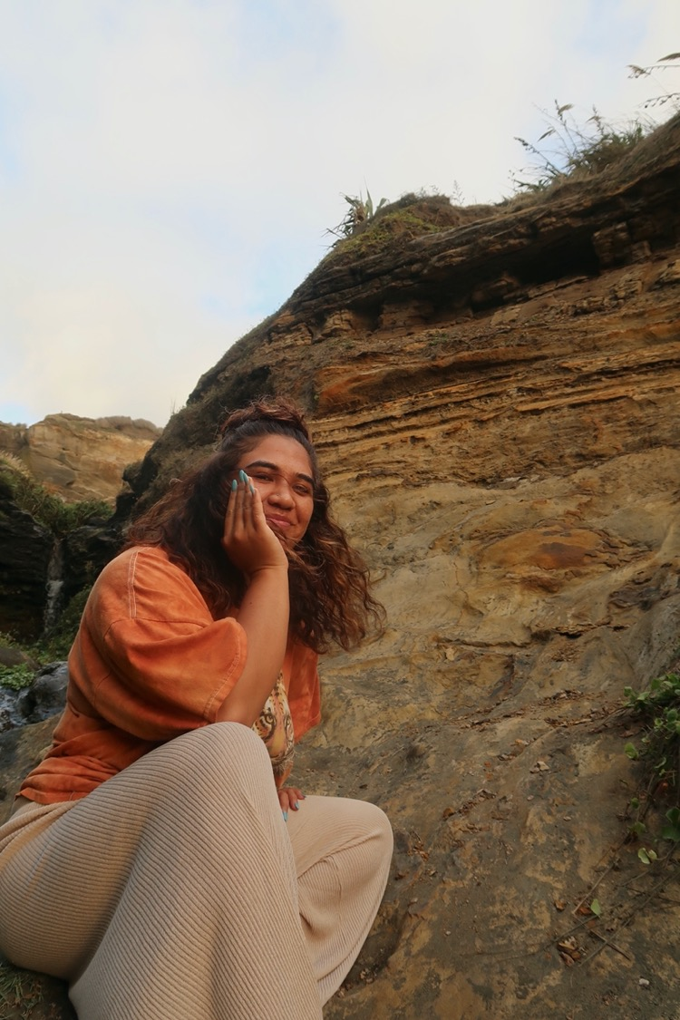
Tōtō [Blood].
Te Ara Minhinnick
Notes:
Tōtō [Blood], Te Ara Minhinnick
Mehemea ka pātai mai koe ki ahau;
“He aha Te Awa o Waikato ki a koe?”
Māku e kī atu, he rite tonu ki te toto o ōku tūpuna.
[If you ask me;
“What does the Waikato River mean to you?”
I will say that it is like the blood of my ancestors.]
—Te Ara Minhinnick

Slide 38
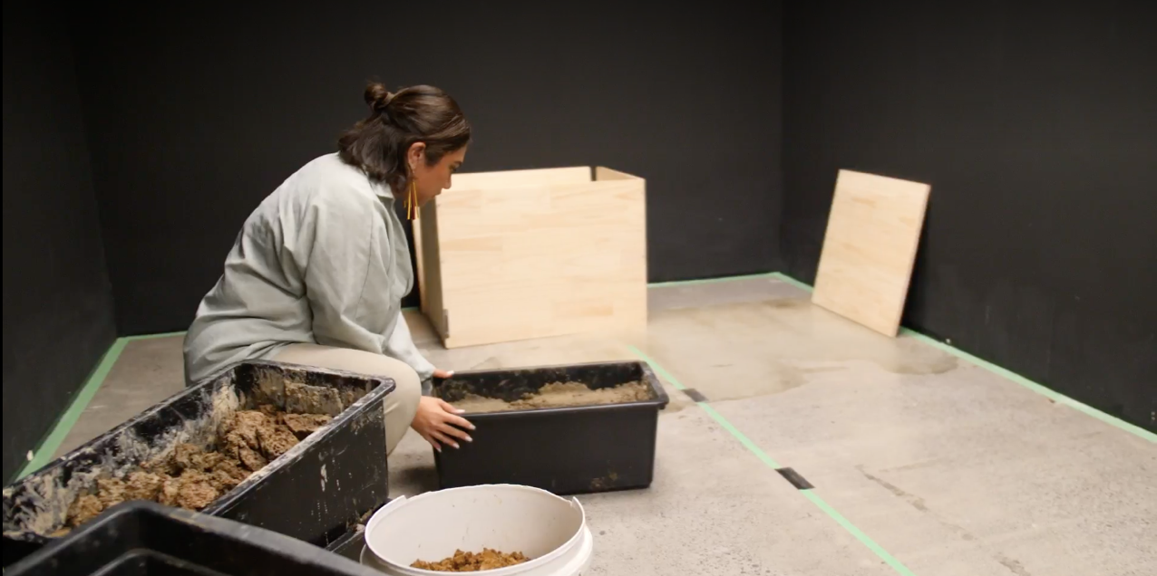
The installation and time-based work of Māori artist Te Ara Minhinnick centres around the alliances of people, space, and place experienced in her ipukarea, her ancestral homeland, and waterways within Waiuku, where her iwi of Ngāti Te Ata (Aotearoa New Zealand) lives.
Notes:
The installation and time-based work of Māori artist Te Ara Minhinnick centres around the alliances of people, space, and place experienced in her ipukarea, her ancestral homeland, and waterways within Waiuku, where her iwi of Ngāti Te Ata (Aotearoa New Zealand) lives. She emphasises a responsibility to her homeland and iwi by employing methods of “wayfinding” through the contemporary realities of Mātauranga Māori (Māori knowledge). The title of Minhinnick’s work in SALTWATER / Interconnectivity, Tōtō, connects the Waiuku waterways with the blood of her ancestors and provides a means for the artist to learn her whakapapa (genealogy), history, and stories of her homeland. The piece consisted of seven stacks of whenua (earth) that she gathered from the shores of Waiuku, the same place her ancestors would have gathered food resources (Fig. 12). The specific time and lunar phase, according to the Māramataka (Māori lunar calendar), during which the earth in each stack was collected was recorded on a flyer that accompanied the work (Fig. 13).

Slide 39
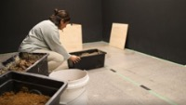
ARTIST SPOTLIGHT – TE ARA MINHINNICK - TOTO –BLOODLINES] 2020. Video by No Six. Tautai Gallery.

Slide 40
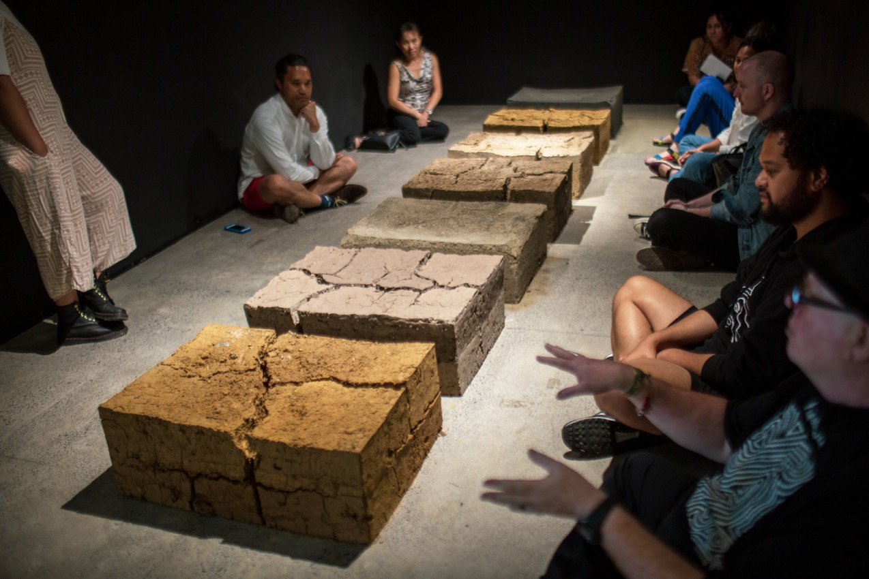
Figure 12. Te Ara Minhinnick, Tōtō, 2020. Blocks of earth gathered near Waiuku. SALTWATER / Interconnectivity, Tautai Gallery, Auckland, Aotearoa New Zealand. Photograph by Ralph Brown. Courtesy of the artist and Tautai Gallery
Notes:
Juxtaposing the concept of the constantly-moving-yet-stable natural cycle of the Māramataka with the solidity and permanence of the earthen blocks, the installation recalled the actions of the artist’s body and of her whānau (family) moving with seasonal rhythms and the push and pull of the tides. Much like Atafu- Mayo’s piece, this installation was a performative, embodied project because of the care and attention paid to the process of bringing the soil to the gallery, pouring water onto the soil in order to shape it into blocks, and letting the dirt dry, crack, and respond to the conditions of the gallery space. Exhibiting Tōtō at Tautai, itself located on a site connected with an ancient waterway, was particularly significant for the artist as a gesture of healing; the blocks of whenua created a sense of home, safety, and whakapapa within the gallery space and allowed her to sync with the temporal cycles connected to places and people.¹⁷

Slide 41
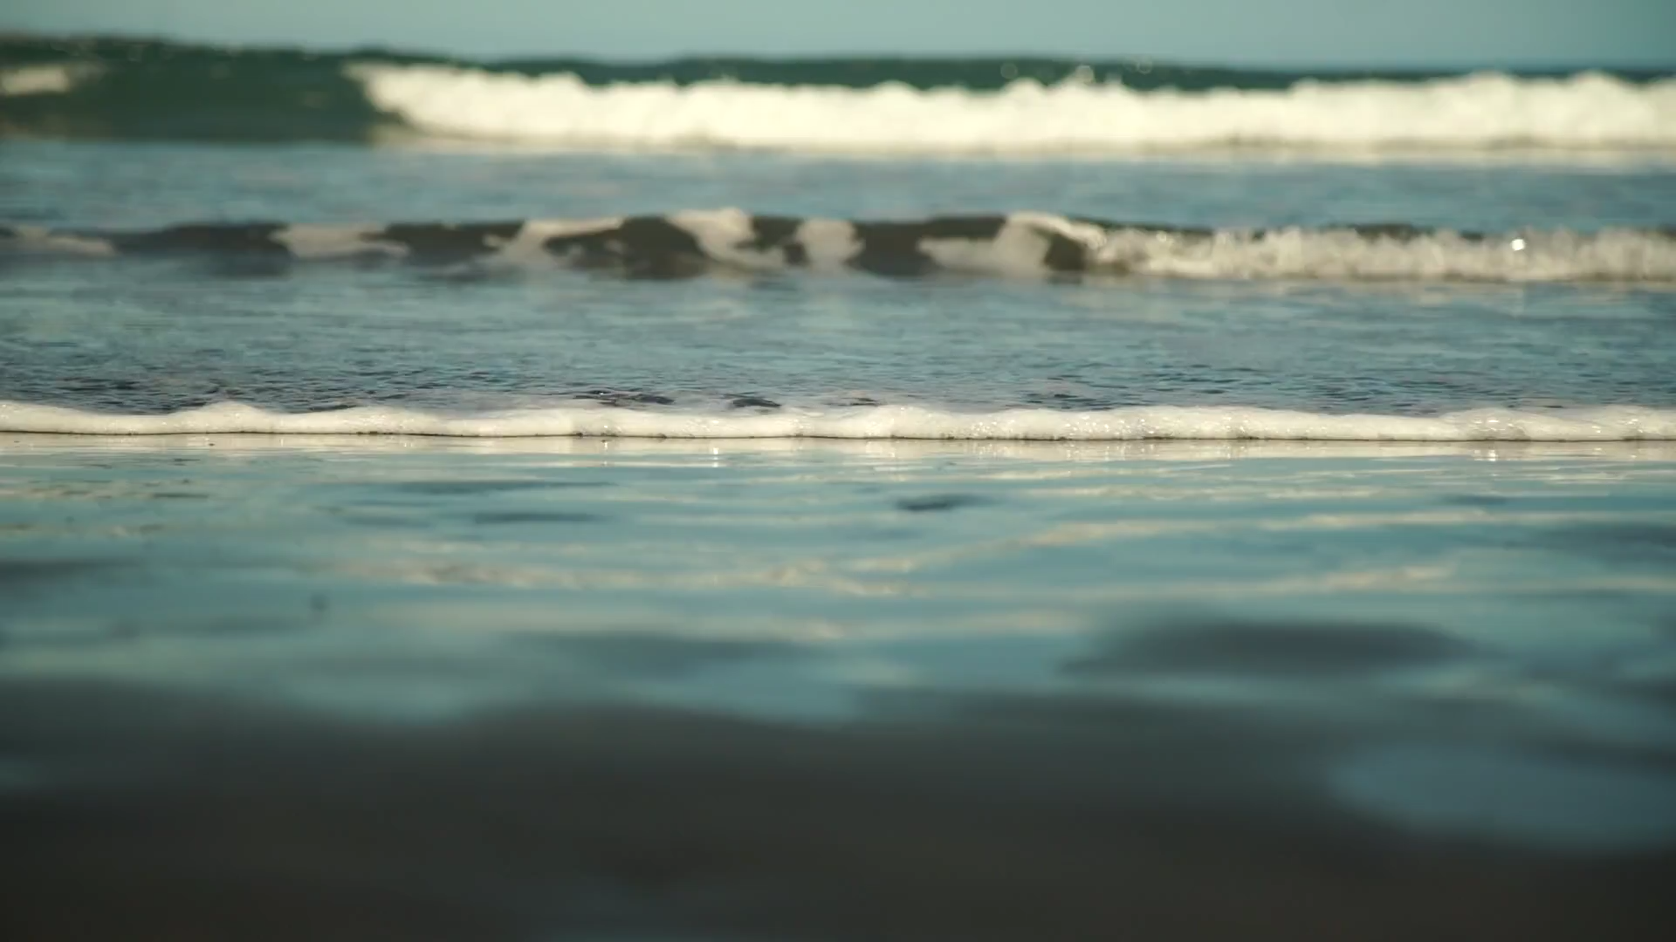

Slide 42
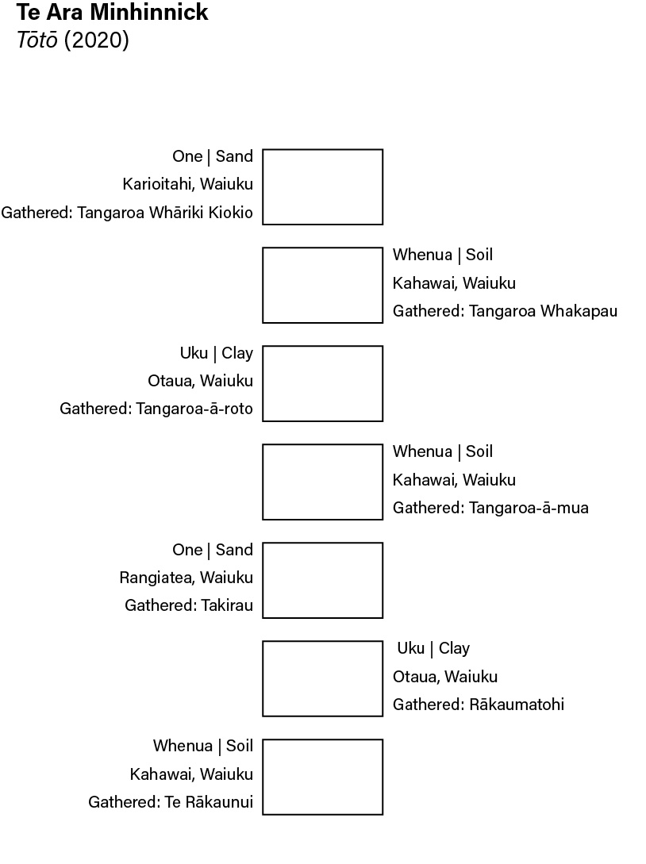
Figure 13. Te Ara Minhinnick, flyer that accompanied Tōtō, 2020. Text and layout by Te Ara Minhinnick. Design by Gloriana Meyers, Tautai Gallery. Courtesy of the artist and Tautai Gallery. SALTWATER /Interconnectivity

Slide 44
Connections
Notes:
Connections
Te Moana Nui a Kiwa (the great ocean of Kiwa, the Pacific Ocean) as giver of life links all the artists in the exhibition. The theme “salt water,” however, is not just about the physical connections between Pasifika peoples and communities—it also embodies shared histories; colonial experiences; ecologies; worldviews and spiritualties; gods and ancestors; blood lines; and current cultural, social, political, and environmental challenges.

Slide 45
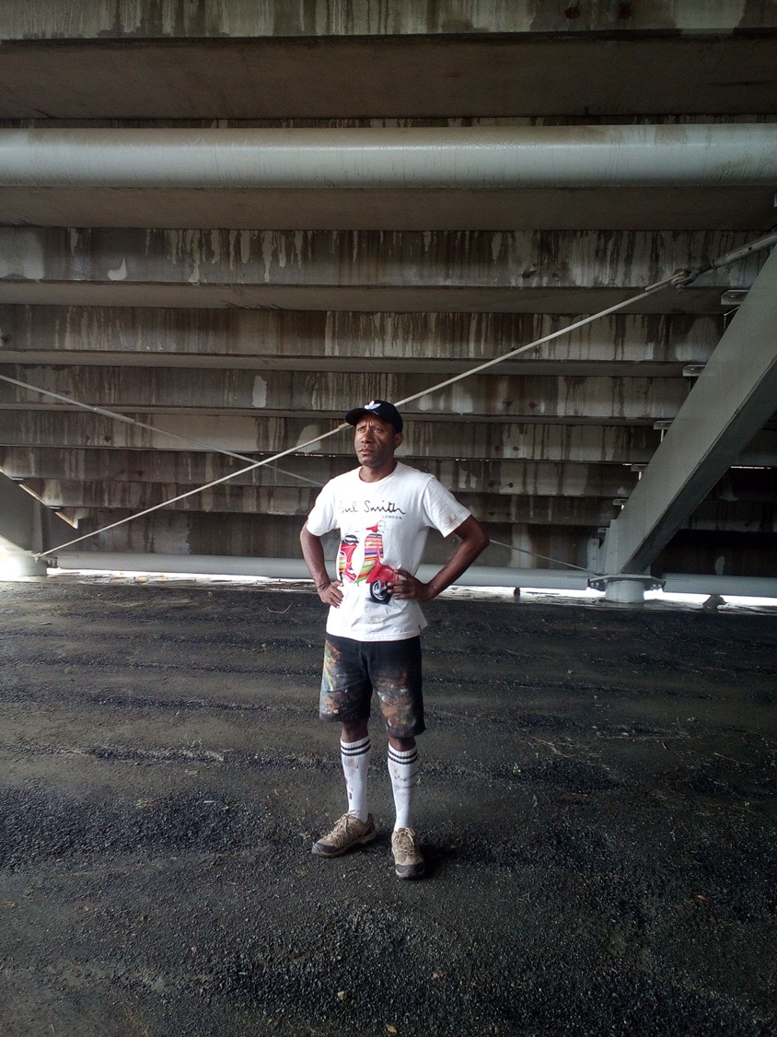
UNITY WALL, PETER ELAVERA
(Port Moresby, PAPUA
NEW GUINEA).
Notes:
Unity Wall, Peter Elavera
Peter Elavera is a Papua New Guinean artist and currently a leader in urban street art in Port Moresby. His artwork incorporates social activism statements on injustice, inequality, and conservation of the natural environment. His interest in harnessing the potency of street art started in 2007. Currently, Peter and his team, known as the Kamilion Art Krew (KAKS), are working on an 800-metre-long seawall-mural project in Port Moresby on the theme “Radioactive Ocean,” which brings awareness to the conservation of ocean and marine life.

Slide 46
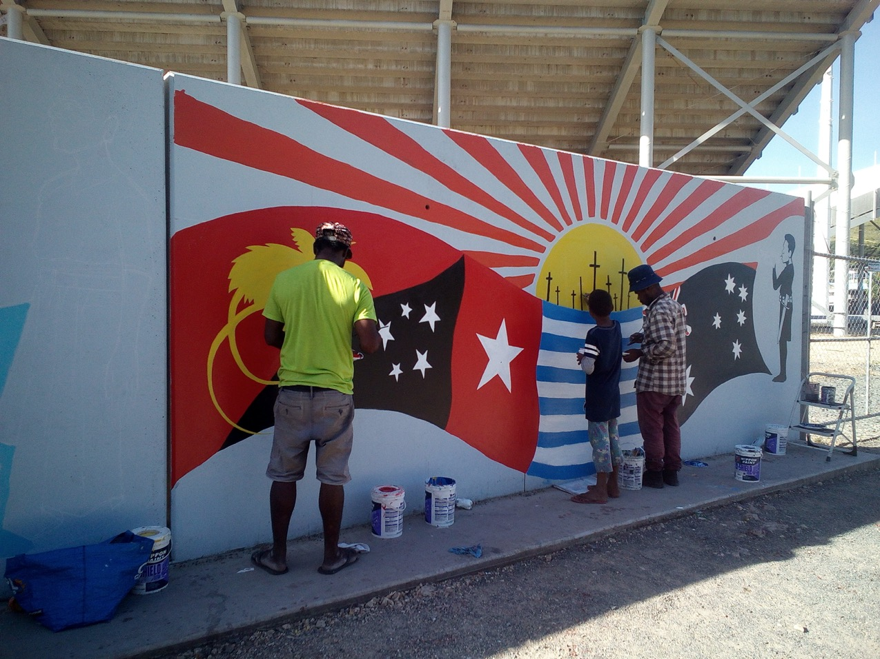
Mural Paintings by Peter Elavera and Kamilion Art Krew (KAKS) – Murals. Unity Wall, Sir Hugh Murry Stadium, Konedobu, Port Moresby, Papua New Guinea, 2019. Photo: Peter Elavera.

Slide 47
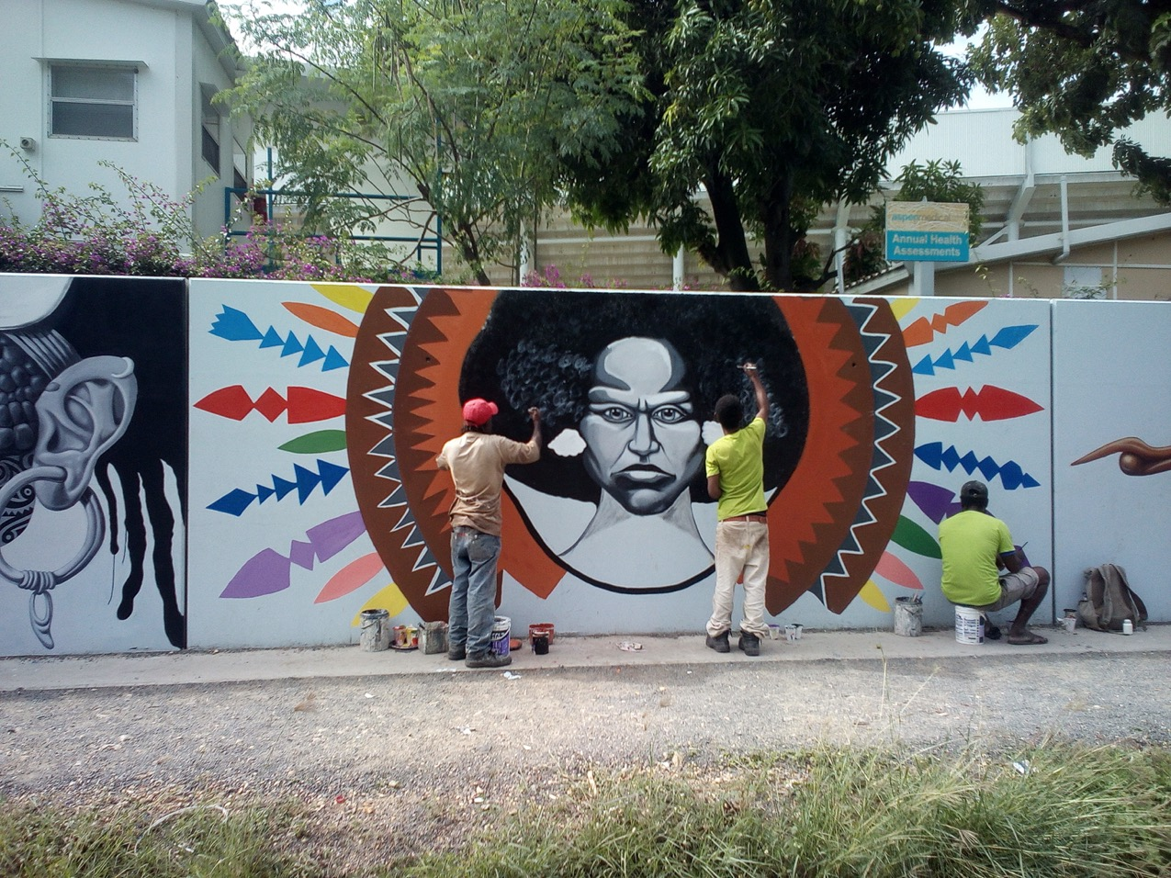
Mural Paintings by Peter Elavera and Kamilion Art Krew (KAKS) – Murals. Unity Wall, Sir Hugh Murry Stadium, Konedobu, Port Moresby, Papua New Guinea, 2019. Photo: Peter Elavera.

Slide 48
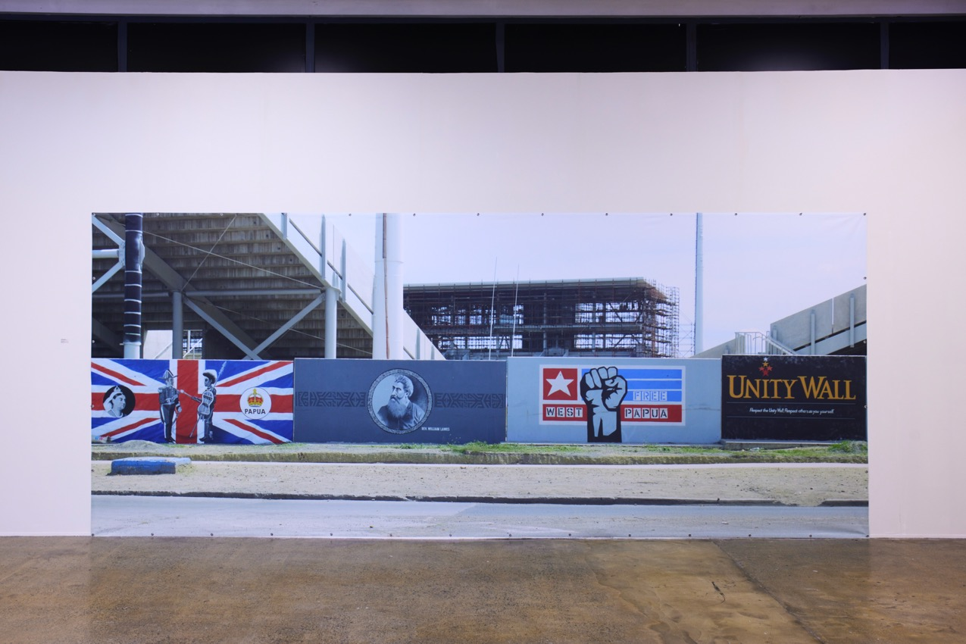
Figure 14. Peter Elavera and Kamilion Art Krew (KAKS), Unity Wall, 2019. Photograph of a portion of the painted mural, each section 6 x 2.5 m, 2020. SALTWATER / Interconnectivity, Tautai Gallery, Auckland, Aotearoa New Zealand. Photograph courtesy of the artist and Tautai Gallery – billboard photograph on canvas, with eyelets - 3 .8 metres high x 6. 8 metres wide: Tautai Gallery, Auckland, Aoteaora – installed SALTWATER /Interconnectivity
Notes:
Unity Wall is a 769-metre-long mural that Elavera painted with KAKS. It surrounds the Sir Hubert Murray Stadium in Port Moresby, the capital of Papua New Guinea (PNG), where the country hoisted its flag of unity on September 16, 1975—the day of its independence from Australia. This was a signficant political event that united about a thousand different Indigenous tribes and cultures. The mural celebrates the diversity of PNG Indigenous cultures and their interconnections through traditional trade and cultural exchange routes, such as Kula in the east and Hiri in the west. For the exhibition, Elavera presented a a six- metre-long photograph of a section of the mural in situ that showed the stadium in the background (Fig. 14). The chosen section of the mural depicts four billboards that chart the colonial history, Indigenous bloodlines, customs, languages, and self-determination movements of PNG, especially those in the southern part of the nation. A painting of the Union Jack, for instance, serves as the backdrop for an encounter between two figures painted in black and white: Commodore James Epstein, captain of the British Navy and Pacific Fleet, on the left, and a Papua treaty chief (most likely from Aroma Coast as indicated by his war shield), on the right. On one side of this encounter is the insignia for the Territory of Papua, annexed by Great Britain in 1883, and on the other side is a portrait of the reigning British monarch at the time, Queen Victoria. Reading left to right, the next segment of the mural depicts a circular portrait of Reverend James Chalmers of the London Missionary Society. Stretching out from either side of the portrait is a banner depicting body tattoo patterns of the Motu people, coastal trade voyagers who originally inhabited, and still inhabit, the PNG coast near Port Moresby. Other scenes in the mural that were not reproduced for the exhibition include historical figures such as Henry M. Chester, the First Magistrate of British Papua in 1883, and Sir Peter Scratchley, the First Administrator of British Papua from 1884 to 1885. Altogether, the mural provides a history of the travels and encounters that continue to shape PNG.

Slide 49
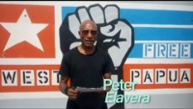
Tautai Arts, “Artist Spotlight: Peter Elavera,” video by No Six for SALTWATER / Interconnectivity, 2020, accessed. Filmed in Port Moresby Papua New Guinea by Peter Elavera and Edited by Niko Meredith – No Six, Auckland, Tautai Gallery August 26, 2021, https://www.youtube.com/watch?v=nY6cB9QFLXA.
Notes:
Tautai Arts, “Artist Spotlight: Peter Elavera,” video by No Six for SALTWATER / Interconnectivity, 2020, accessed. Filmed in Port Moresby Papua New Guinea by Peter Elavera and Edited by Niko Meredith – No Six, Auckland, Tautai Gallery August 26, 2021, https://www.youtube.com/watch?v=nY6cB9QFLXA.

Slide 50
Notes:
In the photograph of the mural displayed in the gallery, Elevara also included more recent images of colonial occupation and the enduring Indigenous cultures of PNG. The third billboard (from the left in Fig. 14) depicts the Morning Star Flag of the Free West Papua movement. Elavera superimposed a raised fist, evoking the Polynesian Panthers and the legacy of the Pasifika freedom fighters, over the flag. He asserts that Unity Wall “calls for a united voice against tyranny and for political independence to the West Papuan determination for freedom. Free West Papua.”¹⁸ In an interview, Elavera connects anticolonial and decolonising movements with Moana-Solwara art and unity:
For me, personally, as an East Papuan, I see the West Papuan struggle for self-determination and human dignity as enshrined under the UN Convention on Human Rights Declaration [and] as the struggle against the old colonial regime under the new “political reform policy” propaganda. The struggle of our brothers and sisters, mothers and fathers, in West Papua is [the] Pacific’s fight against political oppressors and capitalism. The global rhetorical perception of the Pacific as a peaceful, friendly, and timid region has drawn wolves in sheep’s clothing. Government-controlled, mega-conglomerate enterprises [use] the age-old tactic of “divide and control” [to sustain] the pyramid of slavery, world dominance, and economic manipulation

Slide 51
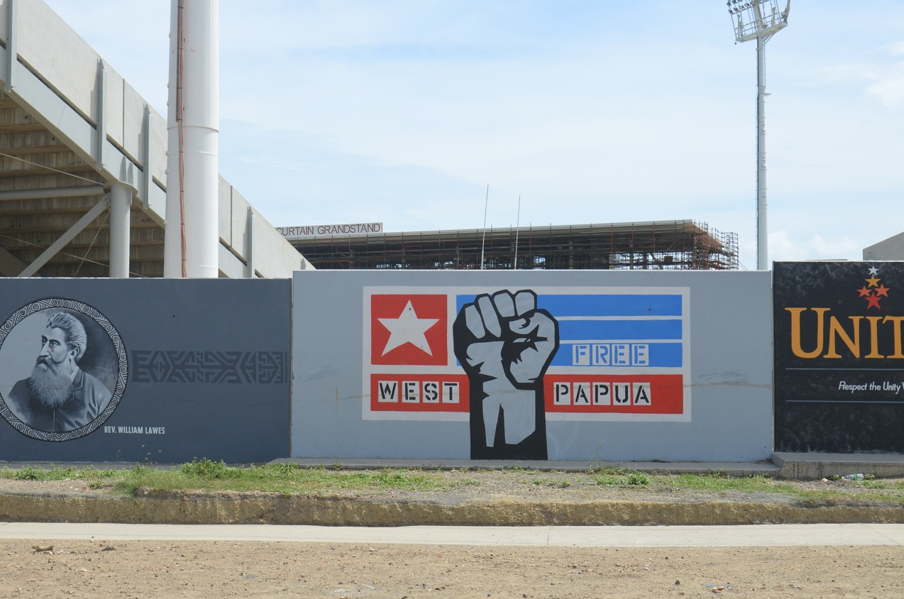
Peter Elavera and Kamilion Art Krew (KAKS), Unity Wall, 2019. Port Moresby, PAPUA NEW GUINEA . A Photograph of a portion of the painted mural, each section 6 x 2.5 m, 2020, [ Sir Hugh Murray Stadium, Konedobu, Port Moresby, Papua New Guinea, 60 running metres.: Photograph by Peter Elevera. [Detail]. Digital photograph billboard skin on canva. SALTWATER / Interconnectivity, Tautai Gallery, Auckland, Aotearoa New Zealand. Photograph courtesy of the artist and Tautai Gallery.
Notes:
Genealogically, we—One Solwara Pacific Family—are all related and connected through our cultural heritage, languages, Indigenous arts, and values. In a nutshell, the Pacific region is one big family. We will not refrain, nor will we cease, from activism for
the freedom of our brothers and sisters, mothers and fathers in West Papua. We the Pacific must stand together in solidarity, undivided nor intimidated. As Pacific Islanders, whether we are Micronesian, Polynesian, or Melanesian, we must sustain unity in social, political, cultural, and economic consciousness and awareness of neocolonialism through global capitalism and global consumerism. Finally, Olgeta Wan Solwara [altogether one Pacific] family, please bear in mind that in the wake of neocolonialism under the pretext of political and economic reforms, the Pacific family now stands on the verge of being pushed over and being pushed under. The West Papuan struggle epitomises Pacific vulnerability. In light of all this, ultimately, West Papua’s freedom will be the Pacific’s freedom.¹⁹

Slide 52
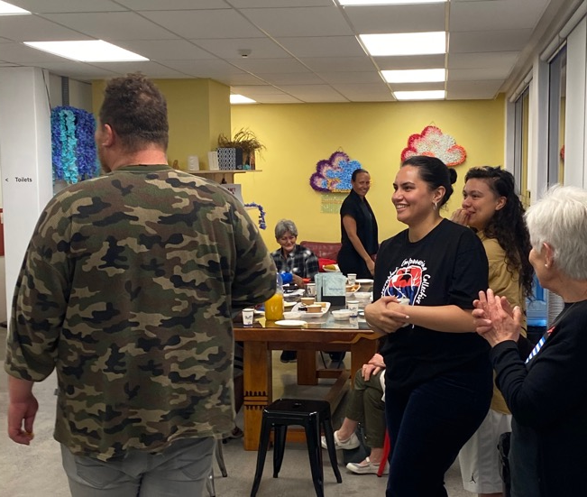
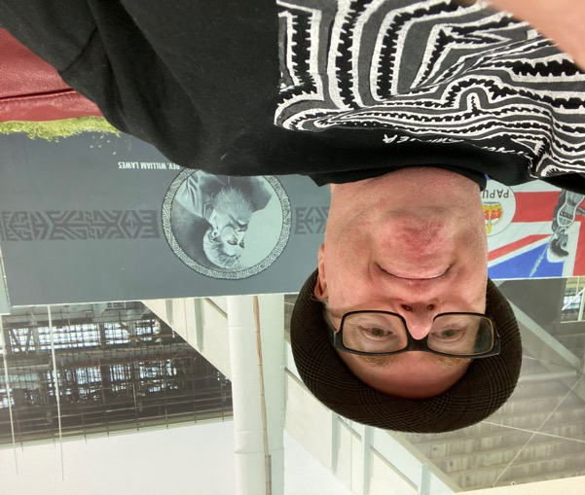
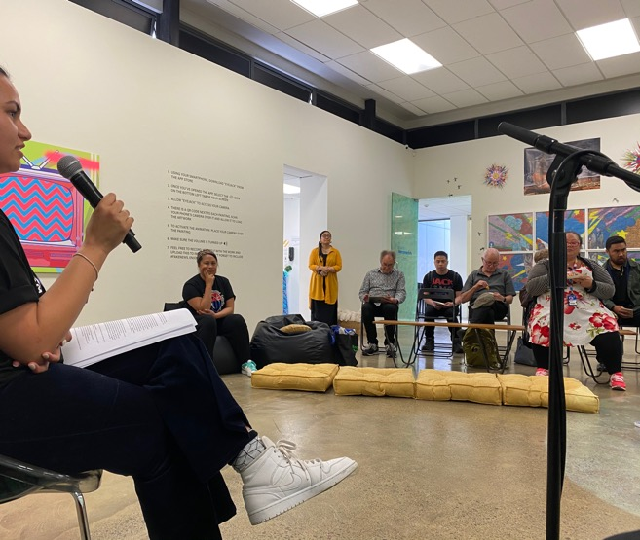
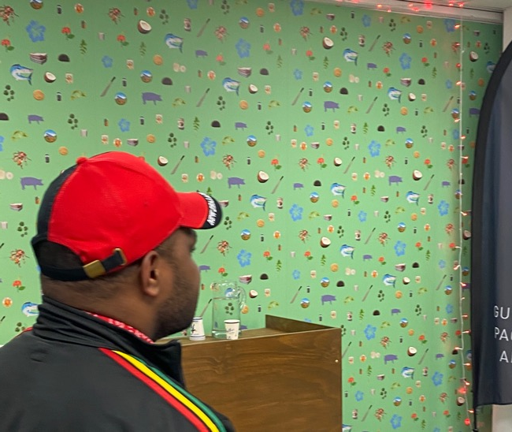
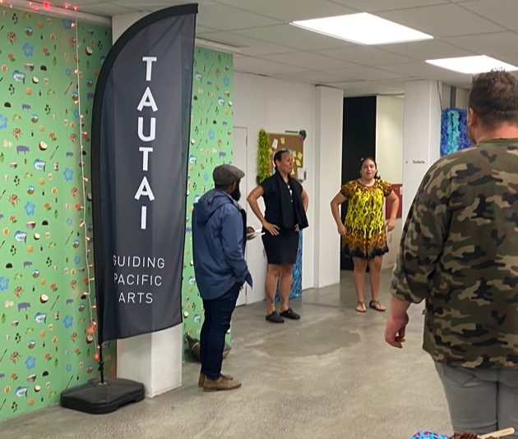
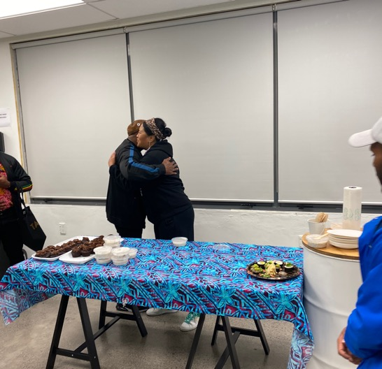
FREE WEST PAPUA – Commemoration of West Papua Independence Day, December 3, 2020: TAUTAI TRUST – SALTWATER /Interconnectivity. Guest speaker: Mairie Leadbetter, Freedom Fighter, and members of the Pacific islander communities - including our Wantok from West Papua community. For our West Papuan Brothers and Sisters this was their first time visit to Tautai Gallery – Ive tried hard not to show you our Wantok’s faces [because their country is still under Indonesian occupation, and as students they and their family face scrutiny from the Indonesian government regime]. Our meet and greet, talk by Maire and hakari (community shared meal) also involved a welcome by Tangata Whenua – Ngati Whatua o Orakei, Tautai Gallery team and board, songs and dances by Papua New Guinean artists, choreographers and dancers Julia Mageu’u Grey and her daughter; plus members of the Oceania Interrupted Collective and Free West Papua Independence Movement . Important community links were made with our Wantok from West Papua and Pacific Media Group and we will be building more projects in the future in collaboration with the West Papua and PNG NESIAN communities in Aotearoa .

Slide 53


Fake News – SHAWNEE TEKII ( Cook Islands)
Tautai Arts, “Artist Spotlight: SHAWNEE TEKII - ” video by No Six for SALTWATER / Interconnectivity, 2020, accessed August 26, 2021, https://www.youtube.com/watch?v=nY6cB9QFLXA. NIKO MEREDITH
Notes:
Fake News, Shawnee Tekii
Cook Islands artist Shawnee Tekii uses art as a tool for social engagement and connecting communities. The digital age plays a large role in underpinning her practice, which is often influenced by mainstream media, digital apps, and interactive art. Her awareness of the ways social media and data configuration have influenced how we react, think, move, and perceive the world is keenly present in her art projects. Through the use of bold graphics that are often focused on urban Pacific imagery, she aims to communicate her political views on local and global issues directly to audiences of her generation. Her work encourages the use of mobile phones to either document or activate deeper conceptual content. She often draws inspiration from graphic design in advertising and branding, resulting in attention-grabbing works. Shawnee like Katharine and Te Ara were former students of mine at Whitecliffe in Fine Arts and Digital media and communication. I was there art and design history teacher . I have been blessed with amazing students, over the 30 years I have taught at Whitecliffe and been curating with young Maori and Pacific islander artists, designers and their families and communities.

Slide 54

Figure 15. Shawnee Tekii, Fake News, 2020. Aerosol paint and acrylic on canvas. 170.8 x 122 cm each. SALTWATER / Interconnectivity, Tautai Gallery, Auckland, Aotearoa New Zealand. Photograph by Ralph Brown. Courtesy of the artist and Tautai Gallery
Notes:
Fake News is a series of urban Pacific paintings that Tekii produced in response to news reports in mainstream media and social media that largely omitted Moana-Solwara peoples (Fig. 15). One painting featured a disembodied hand holding a smartphone horizontally, the way people often do when they are watching a video. On the screen, a hypnotic series of orange and yellow concentric circles appeared to recede into the background. The other painting depicted a bright pink television against an electric-green background with alternating pink and blue squares on the screen evoking televisual static. The bright colours intentionally recall the 1960s and ‘70s and the rise of Aotearoa’s Polynesian Panthers, who led social change and Pasifika activism. They were inspired by the Black Panthers’ revolutionary movement against police brutality and racial injustice, which continues today in the form of Black Lives Matter.

Slide 55

Figure 16. Gallery visitor using an app designed by Shawnee Tekii for Fake News, 2020. SALTWATER / Interconnectivity, Tautai Gallery, Auckland, Aotearoa New Zealand. Photograph by Ralph Brown. Courtesy of the artist and Tautai Gallery
Notes:
Drawing connections between the struggles against racism by Black and Brown communities speaks to the real power and community in shared oppression, which is something Tekii wanted to underscore in Fake News. Viewers could interact with the paintings by using a mobile phone app that played documentary footage of the Polynesian Panthers and the Black Panthers, news broadcasts, and popular media from the 1970s (Fig. 16). The transformation, made possible by the phone screen, of the bright ‘static’ into false and racist news coverage mirrors the misleading nature of popular media. Tekii’s work recentred Aotearoa in political, social, and economic news coverage by focusing on the ongoing fight for social justice and human rights. This work can connect and motivate us to continue fighting systems of oppression and to create a world of our own.

Slide 56

Tautai Gallery: Auckland, Aotearoa: SALTWATER /INTERCONNECTIVITY – ARTISTS SPOTLIGHT Video –
SHAWNEE TEKII – Courtesy Tautai – Championing Pacific Creativity. October 2020. Video: by Niko Meredith, No Six.

Slide 57


COMMUNITY ENGAGEMENT
TAUTAI GALLERY, LEVEL 1: 300 Te KARANGAHAPE ROAD, NEWTON, CBD AUCKLAND, SALTWATER INTERCONNECTIVITY
EXHIBITION OPENING – OCTOBER 20th, 2020
Members of
No Six – Pacific Media group Photo: Niko Meredith.
Tautai Community Supporters and Whanau:
Artists: Tui Emma Gillies and family, Artists - Sione Monu
and artist: Melissa Gilbert: Tautai, SALTWATER /Interconnectivity
Photo: Ralph Brown. Tautai.
Notes:
Through the concepts of resilience, healing, and connection, SALTWATER / Interconnectivity provided an important space where artists from across Oceania could come together and engage in the most pressing issues facing the region today. As Atafu-Mayo stated:
As Moana-Solwara/Saltwater people we are multifaceted, vast, dynamic, and . . . powerful. We stand on the shoulders of giants who have navigated oceans [. . . and . . . ] paved pathways. . . This show [was] more than a response to gobal events and our ever­changing landscape. It [was] a representation of Moana leadership, creativity, and world views. Our understanding of interconnectedness to all living things is embodied throughout Te Moana-nui-a-kiwa. . . [T]hese truths . . . will help heal this capitalist and patriarchal place which houses systems of oppression against us Brown and Black folk. The more we creatively access [our Indigenous worldviews] and see ourselves . . . in spaces . . . we have formed and maintain, the more we are able to imagine and then rebuild a world in which we lead and live with empathy and love.²⁰

Slide 58


Katharine Atafu Mayo and Giles Peterson
C0 – curators of SALTWATER /Interconnectivity,
Tautai Gallery, level 1, 300 Te Karangahape Road, Newton:
Photo: Shawnee Tekii
Te Ara Minhinnick, Shawnee Tekii and Katharine Atafu - Mayo
Exhibiting SALTWATER /Interconnectivity - Artists and co – curator,
Tautai Gallery, Level 1: 300 Te Karangahape Road, Newton, Auckland, Tamaki-makau-rau, Aotearoa, January 30, 2021. Photo: Giles Peterson
Notes:
In many ways, Tautai Gallery and the exhibition operated much like the Moana- Solwara in its capacity to bridge space, time, and culture as well as connect people for centuries. In her closing address for the exhibition, Courtney Sina Meredith, Director of the Tautai Contemporary Pacific Arts Trust, stated, “SALTWATER / Interconnectivity foretells Tautai’s ongoing commitment to artists from Te Moana Nui a Kiwa. Presenting an understanding of reality in the present—within urban, environmental, and sacred realms: the ever-flowing Moana connects us all, keeper of our salt spray stories.”²¹
Giles Peterson was born in Papua New Guinea and is a lecturer at Whitecliffe College of Arts and Design (Auckland), where he teaches courses in New Zealand/Pacific art and design history, contemporary art, fashion theory, and arts management. He was a founding member of the Tautai Contemporary Pacific Arts Trust and has mentored three generations of Tautai artists. He is also an independent curator whose most recent exhibitions include Tīaho: Photography from Oceania (2010) and Garden of Memories: Extending Quilt Making Traditions from around the Pacific (2019).
Katharine Losi Atafu-Mayo (Sāmoa, Aotearoa, Scotland, England) is a devoted daughter, sister, and godmother with a beautiful vessel that houses her resilient soul, powerful heart, and unshakable spirit. She is a multidisciplinary artist, curator, creative and well-being director, and world builder. Her social art practice is an evolving ecosystem of Moana healing methodologies, spirituality, and community engagement grounded in unconditional love to create alternative ways of living in the everyday. Her artworks include installations, workshops, moving image, and poetry. She is best known for ceremonial rituals based on intuitive activation.
Notes
The curators and the director of the Tautai Contemporary Pacific Arts Trust, Courtney Sina Meredith, are grateful to Creative New Zealand, Foundation North, Fetu Taʻi, and the Tautai Board of Trustees for their support of the exhibition. We are also very thankful for the outstanding work of the staff, volunteers, contractors, and suppliers who made the exhibition and programming possible.
The terms Moana-Solwara, Moana, and Pasifika are used in this text interchangeably. With the incredible diversity of languages and cultures in the region, there are numerous terms that people use to identify their place, family, and heritage. By using terms that are more regional than local, we acknowledge the simultaneous diversity and unity that this exhibition celebrates.
Throughout the duration of the exhibition, Atafu-Mayo would activate the gallery space with karakia (prayers), talanoa (dialogue), and ceremony. Rituals, prayers, and thanks were also enacted at the exhibition’s closing in a private ceremony for the artists, curators, Tautai exhibition team, and our whānau (extended family) supporters Rosanna Raymond and Ema Lyon, who have been mentoring Atafu-Mayo.
Tautai Arts, “Artist Spotlight: Katharine Losi Atafu-Mayo,” video by No Six for SALTWATER / Interconnectivity, 2020, accessed September 9, 2021

Slide 59

Artist’s Spotlight – Opening Night – SALTWATER /Interconnectivity October 20th, 2020
TAUTAI GALLERY, Level 1, 300 Te Karangahape Road, Newton, Central Auckland, Auckland Art Week:
ACTIVATIONS. Curator of Activation program: KATHARINE ATAFU – MAYO. Filming: Niko Meredith[Samoa/Aotearoa}
TAUTAI CONTEMPORARY PACIFIC ARTS TRUST, TAUTAI GALLERY

Slide 60


TAUTAI AT AUCKLAND WRITERS FESTIVAL MAY 2021:
SALTWATER PEOPLE, ASB Theatre, Aotea Centre, Friday - May 14, 3.30pm, 2021:
Amber Esau – Poet and Writer; Sistar s’pacific - aka Rosanna Raymond, Visual artist,
poet, curator and writer; Katharine Losi, Visual artist and educator;
James Waititi – visual artist and poet, writer respond to SALTWATER Exhibition themes and
artworks through activation, ceremony, spoken word, poetry, visual and performing arts.
Photo>>>> Giles Peterson
Ryan Dayono, Courtney Sina Meredith,
Giles Peterson, Curator and teacher.
Photo: Danielle Meredith
https://www.pantograph-punch.com/posts/aucklandwf-2-what not - to miss- 2021

Slide 61

Left 2 right: Artist’s and curators- Katharine Losi Atafu – Mayo, Sistar S’pacific aka Rosanna Raymond,
3. Jaimie Waititi, Amber Essau – writers, published poets, visual artists, activists, educators, change agents;
Mihi – by writer and the director of the Auckland Writer’s Festival 2021- Anne O'Brien
Notes:
1- Katharine Losi Atafu – Mayo is a multidisciplinary artist, curator and creative & wellbeing director. Her social art practice is an evolving ecosystem of Moana healing methodologies, spirituality and community engagement grounded in unconditional love to create alternative ways of living in the everyday. AWL 2021 Photo by Hohua Kurene
2 - 2- Sistar S’pacific aka Rosanna Raymond an innovator of the contemporary Pasifika art scene, achieving international renown for her performances, installations, body adornment and spoken word. She is a published writer and poet. Photo by Giles Peterson
3. Jaimie Waititi (Te Whānau a Apanui, Te Rarawa, Ngāpuhi) is a multidisciplinary gender fluid artist and a member of SaVAge K’Lub, issheboys, Arts Laureate group FAFSWAG and Th3 Order. Their work focuses on relationships between people and mea, mea and space, and space and time.
4. Amber Esau is a Sā-māo-rish writer (Ngāpuhi / Manase) born and raised in Tāmaki Makaurau. She is a poet and storyteller,
5., Chief Executive of the Auckland Writers Festival

Slide 62

Sistar s’pacific - aka Rosanna Raymond (Pacific Sisters, SaVAge K’lub ] Visual artist,
poet, curator and writer; SALTWATER PEOPLE, AUCKLAND WRITERS FESTIVAL, May 14, 2021, ASB Theatre, Aotear Centre. Photo: Giles Peterson. 2 - 2- Sistar S’pacific aka Rosanna Raymond an innovator of the contemporary Pasifika art scene, achieving international renown for her performances, installations, body adornment and spoken word. She is a published writer and poet

Slide 63

. Jaimie Waititi (Te Whānau a Apanui, Te Rarawa, Ngāpuhi) is a multidisciplinary gender fluid artist and a member of SaVAge K’Lub, issheboys, Arts Laureate group FAFSWAG and Th3 Order. Their work focuses on relationships between people and mea, mea and space, and space and time.

Slide 64

3. Jaimie Waititi (Te Whānau a Apanui, Te Rarawa, Ngāpuhi) is a multidisciplinary gender fluid artist and a member of SaVAge K’Lub, issheboys, Arts Laureate group FAFSWAG and Th3 Order. Their work focuses on relationships between people and mea, mea and space, and space and time.

Slide 65

4. Amber Esau is a Sā-māo-rish writer (Ngāpuhi / Manase) born and raised in Tāmaki Makaurau. She is a poet and storyteller /writer.

Slide 66

Katharine Losi Atafu – Mayo is a multidisciplinary artist, curator and creative & wellbeing director. Her social art practice is an evolving ecosystem of Moana healing methodologies, spirituality and community engagement grounded in unconditional love to create alternative ways of living in the everyday. AWL 2021 Photo: Giles

Slide 67

Danielle Meredith,
Artist, Designer, Production Manager,
Gallery Manager
Tautai
Auckland Writers Festival
May 14, 2021:
ASB Herald theatre,
Photo: Giles Peterson

Slide 68

Zoe Lewis – Deputy Manager – Operations,
Tautai Gallery 2021
Auckland Writers, Festival, May 14, 2021; Katharine Losi Atafu – Mayo, Auckland Writers Festival, Courtney Sina Meredith, Director – Tautai, May 2021, and Courtney’s aunty – who is also a musician and artist. Its called Mana VAHINE – WOMEN’s POWER and TO REPRESENT – as in ‘ Represent and promote/create/shout out for your community and its visions and dreams for change. We created the table, we were at the table and We did this. Ka Kite.

Slide 69






Slide 70

Acknowledgements
SALTWATER/Interconnectivity foretells Tautai’s ongoing commitment to artists from Te Moana Nui a Kiwa. Presenting an understanding of reality in the present – within urban, environmental, and sacred realms: the ever-flowing Moana connects us all, keeper of our salt spray stories.
I honour the visionary co-curators Katharine Losi Atafu-Mayo and Giles Peterson for creating this important exhibition
with intergenerational awe, and I honour each of the six participating artists for bringing their light. Your ancestors and creative truths are safe here at Tautai Gallery.
I acknowledge our funders and patrons –
Creative New Zealand, Foundation North and Fetu Ta’i, and the passionate community of artists and supporters who give life to the work of Tautai.
Mahalo to the Tautai Board of Trustees and the family of staff, contractors, suppliers and volunteers – for your outstanding mahi.
Alofa shines through all we seek to support, realise and awaken.
atauki
31
po, po, po
Ka mua, ka muri
walking backwards into the future
Courtney Sina Meredith Director – Tautai
2
PO,PO, PO. [Samoan: =literally night, night, night; as in
calling on ancestors, and those that have passed.]
Ka Mua, Ka Muri – Walking Backwards into the Future

Slide 71

‘A mother rock in the ocean the waves will crash against Tautai,
the sun will beat, the birds will circle, and the tide will pull,
she will be found over and over again by new voyagers,
brave enough to cut a path across the deep Moana’
-Courtney Sina Meredith
Tautai Director 2018 - 2022

Slide 72

[ Going Home – Port Moresby, Papua province, Papua New Guinea - 2009 photo: G. Peterson]
Notes:
Flying back home to Port Moresby Papua New Guinea in 2009 after 30 years.

Slide 73

HIRI MOALE CULTURAL ARTS FESTIVAL, United Motu Koitabo National Peoples Assembly: ELA BEACH, Port Moresby, Papua Niu Guinea September 16, 2010. Photo: G. Peterson
Hiri Moale Festival PNG, Ela beach : Port Moresby, Papua New Guinea - Photo : Giles Peterson, born PNG 1969, Papua.

Slide 74



Motuan Pata Pata - sacred –
Motu Koitabu peoples, Port Moresby, Papua New Guinea: home
photo Giles Peterson
Giles, Douglas Llamo – musician and sound engineer
Port Moresby, PNG and childhood best mate., Muliono Family village compound
Port Moresby, 2010
Mums- Ruth Choulai -
and Giles : Spirit of The People – New Melanesian Art. Artwork – Wendi Choulai
(PNG) and Torika Bolatagici (Fiji – Australia]

Slide 75
References and Notes
Atafu- Mayo, Katharine and Giles Peterson. SALTWATER /Interconnectivity. Exhibition Catalogue (30 pages). Published by Tautai: Championing Pacific Creativity. October 2020, Tautai Contemporary Pacific Arts Trust,
Aotearoa. Tautai receives funding from Creative New Zealand Arts Council Toi Aotearoa and Foundation North.
Peterson, Giles and Katharine Losi Atafu – Mayo. Pacific Arts Vol.22, no.1. (2022).pp 131 to 155 with illustrations.
SALTWATER/ Interconnectivity. Pacific Arts: The Journal of the Pacific Arts Association. University of California Press, UC Santa Cruz. Permalink: http://scholarship.org.uc/item/3xq6280g. ISSN: 1018-4252.
DOI: 10.5070/PAC222156845.
Tautai Trust. Meet the Curators of SALTWATER /Interconnectivity – Katharine Atafu – Mayo and Giles Peterson. ^{video by}
Niko Meredith and No Six for SALTWATER / Interconnectivity, 2020, accessed September 9, 2021 https://www.youtube.com/watch?v=c1sp97PhctY.

Slide 76
References and Notes – Continued …
The curators and the director of the Tautai Contemporary Pacific Arts Trust, Courtney Sina Meredith, are grateful to Creative New Zealand, Foundation North, Fetu Taʻi, and the Tautai Board of Trustees for their support of the exhibition. We are also very thankful for the outstanding work of the staff, volunteers, contractors, and suppliers who made the exhibition and programming possible.
The terms Moana-Solwara, Moana, and Pasifika are used in this text interchangeably. With the incredible diversity of languages and cultures in the region, there are numerous terms that people use to identify their place, family, and heritage. By using terms that are more regional than local, we acknowledge the simultaneous diversity and unity that this exhibition celebrates.
Throughout the duration of the exhibition, Atafu-Mayo would activate the gallery space with karakia (prayers), talanoa (dialogue), and ceremony. Rituals, prayers, and thanks were also enacted at the exhibition’s closing in a private ceremony for the artists, curators, Tautai exhibition team, and our whānau (extended family) supporters Rosanna Raymond and Ema Lyon, who have been mentoring Atafu-Mayo.
Tautai Arts, “Artist Spotlight: Katharine Losi Atafu-Mayo,” video by No Six for SALTWATER / Interconnectivity, 2020, accessed September 9, 2021, https://www.youtube.com/watch?v=Emc4nunCcjo.
Katharine Losi Atafu-Mayo, email exchange with Giles Peterson, January 29, 2022.
Tautai Arts, “Opening Night: SALTWATER / Interconnectivity,” video by No Six, 2020, accessed September 9, 2021, https://www.youtube.com/watch?v=rIUFgFEm3lo.
“Acti.VĀ.te” is a term and concept developed by Rosanna Raymond who highlights the vā as a central practice within the word. “Acti.VĀ.te” uses the vā as a methodology to bring the past into the present through an embodied practice. “Acti.VĀ.tor” is the performative agent, or avatar, who uses the vā as an embodied practice. Rosanna Raymond, personal communication, September 10, 2021.

Slide 77
On the ifoga, see Laʻauli A. Filoialiʻi and Lyle Knowles, “The Ifoga: The Samoan Practice of Seeking Forgiveness for Criminal Behaviour,” Oceania 53, no. 4 (1983): 384–8; and Cluny Macpherson and Laʻavasa Macpherson, “The Ifoga: The Exchange Value of Social Honour in Samoa,” Journal of the Polynesian Society 114 (2003): 109–33.
Tautai Arts, “Meet the Curators: Katharine Losi Atafu-Mayo and Giles Peterson,” video by No Six for SALTWATER / Interconnectivity, 2020, accessed September 9, 2021, https://www.youtube.com/watch?v=9GjUKhfHRPo.
Artist Telly Tuita was born in Tonga in 1980, immigrated to Brisbane in 1989, and immigrated to Lyall Bay, Wellington, Aotearoa, in 2017. He has a BFA from Western Sydney University, a bachelor of art education from the University of New South Wales, and a master’s degree in special education from the University of Sydney. Tuita has been a high school art teacher, a special education teacher, and an assistant principal at Green Square School. In 2017, he returned to making art full-time. Tuita’s art practice encompasses painting, printmaking, sculpture, photomedia, and performance. He has contributed to exhibitions in Australia and Aotearoa New Zealand, and his work is included in the collection of the New Zealand Ministry of Foreign Affairs.
William Sharp, after John Webber, Poulaho, King of the Friendly Isles Drinking Kava, 1784. Engraving, 273 x 410 mm, British Museum, 1841,0313.74, https://www.britishmuseum.org/collection/object/P_1841-0313-74.
Tautai Arts, “Artist Spotlight: Telly Tuita,” video by No Six for SALTWATER / Interconnectivity, 2020, accessed September 9, 2021, https://www.youtube.com/watch?v=iD9CcFIgh50.
Telly Tuita, “Telly Tuita: I Left My Heart in Tongpop,” in SALTWATER / Interconnectivity, ed. Katharine Losi Atafu-Mayo and Giles Peterson (Auckland: Tautai, 2019), 11.
See Buku-Larrŋgay Mulka Art Centre, “About the Mulka Project,” accessed August 26, 2021, https://yirrkala.com/about-the-mulka-project/.
Chris Matthews, “Indigenous Perspectives in Maths: Understanding Gurruṯu,” Teacher Magazine, April 27, 2020, Australian Council for Educational Research, accessed August 26, 2021, https://www.teachermagazine.com/au_en/articles/indigenous-perspectives-in- maths-understanding-gurruu. Emphasis in original.
Gutiŋarra Yunupiŋu, “Gutiŋarra Yunupiŋu: Gurruṯu’mi Mala (My Connections),” in SALTWATER / Interconnectivity, ed. Katharine Losi Atafu-Mayo and Giles Peterson (Auckland: Tautai, 2019), 19.
Tautai Arts, “Artist Spotlight: Te Ara Minhinnick,” video by No Six for SALTWATER / Interconnectivity, 2020, accessed September 9, 2021 https://www.youtube.com/watch?v=c1sp97PhctY.
Peter Elavera, “Peter Elavera: Unity Wall,” in SALTWATER / Interconnectivity, ed. Katharine Losi Atafu-Mayo and Giles Peterson (Auckland: Tautai, 2019), 25.
Tautai Arts, “Artist Spotlight: Peter Elavera,” video by No Six for SALTWATER / Interconnectivity, 2020, accessed August 26, 2021, https://www.youtube.com/watch?v=nY6cB9QFLXA.
Katharine Losi Atafu-Mayo (@KattyMayo), Instagram, October 21, 2020, accessed September 12, 2021, https://www.instagram.com/p/CGlcPaBH5uiHMcuw5euP_LtYcr1FfVDmvQx9OM 0/. 14. Courtney Sina Meredith, “Acknowledgements,” in SALTWATER / Inter­connectivity, ed. Katharine Losi Atafu-Mayo and Giles Peterson (Auckland: Tautai, 2019), 29.

Slide 78
SALTWATER / Interconnectivity, ed. Katharine Losi Atafu-Mayo and Giles Peterson (Auckland: Tautai, 2019 - 2021), 33.
We need to protect our taonga which includes our Moana - Solwara. Em Nau.Tenk Yu Tru !.

