Slide 1
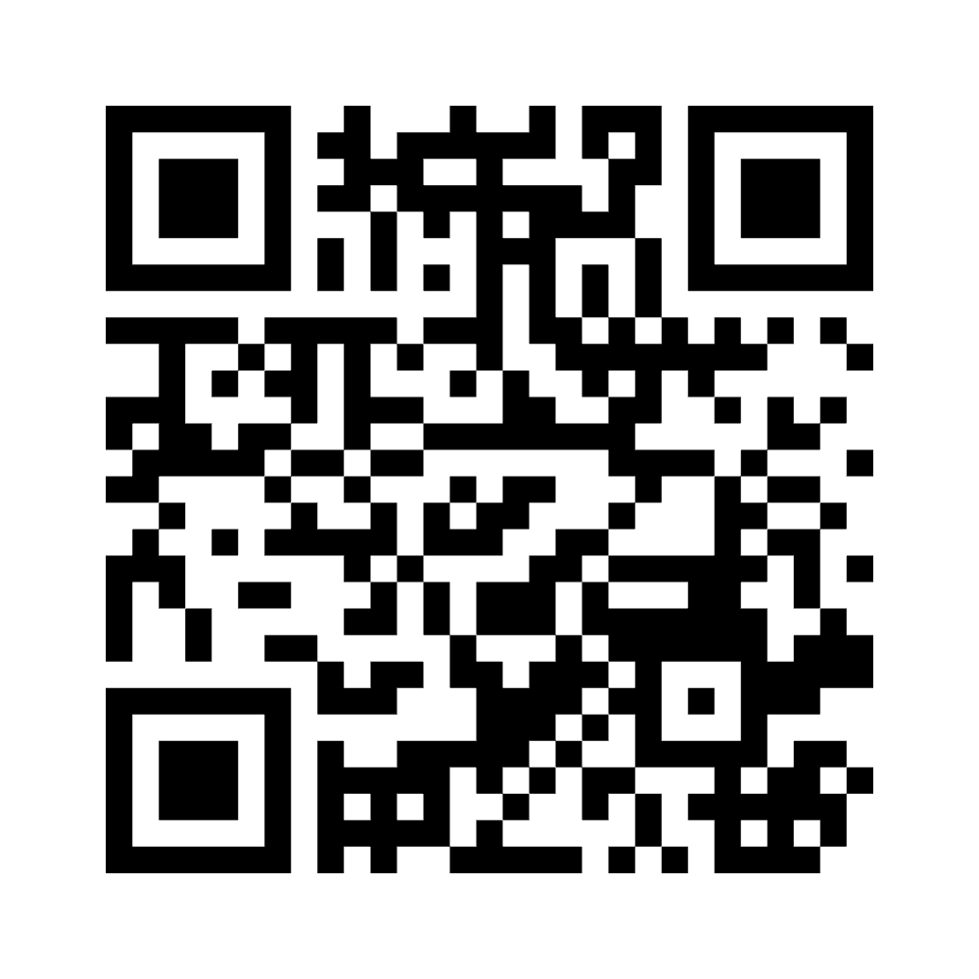
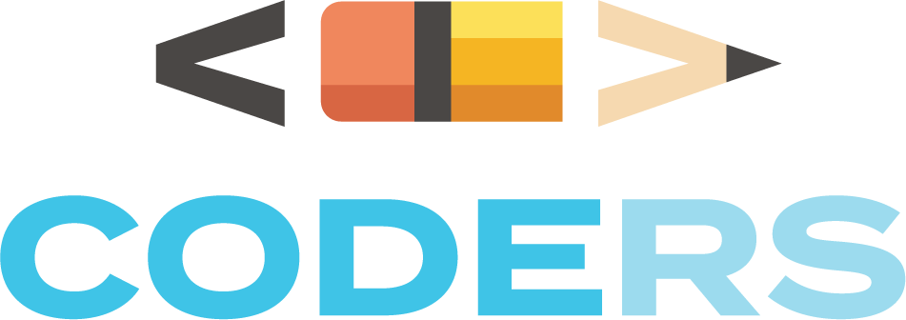
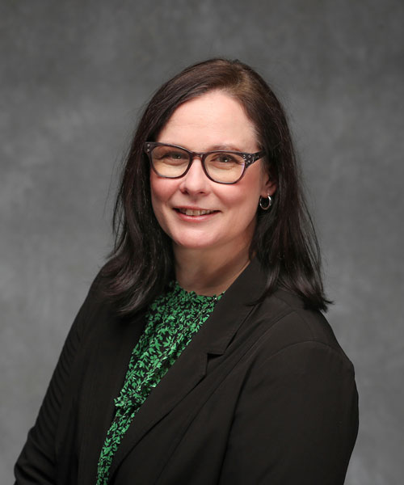

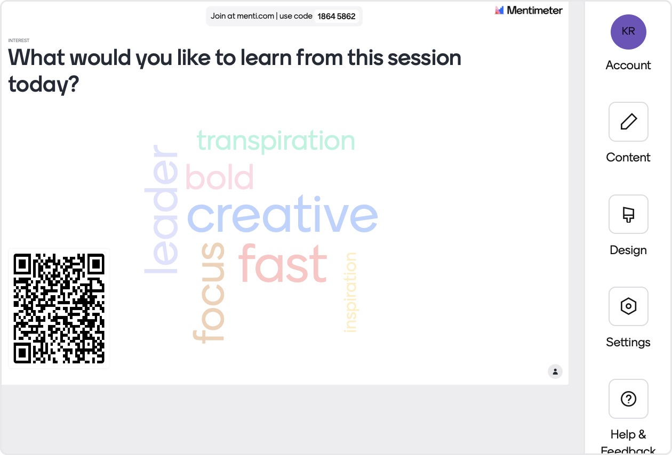
Exploring the Impact of Coding Across the Curriculum Professional Development
Keri R. Franklin, PhD
Missouri State University, USA
kfranklin@missouristate.edu
https://www.instagram.com/msu_coders/
Callie Dean, Evaluation Group
This project is funded by the U.S. Department of Education’s Education, Innovation & Research Program, early phase FY 2021.
Please use the QR code or go to
https://www.menti.com/ali58naremi4
Notes:
I wrote about chat rooms and discussion boards from 1997-1999. I worked as a software trainer, and then I wrote about blogging and reader response theory in literature from 2003-2007.
Comparing 2022-2023 for teachers. 2023-2024 for students…

Slide 2


Slide 3
OVERVIEW
What is this project? Rural students with a significant portion of high-needs students, disadvantaged financially and lacking access to opportunities to improve achievement due to their distance from programming, the financial resources of the school district for transportation, and high poverty.
Who is involved? 56 rural teachers and 2,597 rural students in grades 3-8 in rural elementary and middle schools.
The CODERS Project included a three-year field trial and impact study of teacher and student programming. STEM/Computer Science (STEM/CS) course modules with integrated writing to support learning in STEM, specifically coding by providing High-quality curriculum module with integrated CODERS kits and writing supports; CODERS kits included microbits, cutebots, batteries, sensors, robot dogs, drones, and smart home kits.
The study researches student engagement in school-based STEM and Computer Science experiences to increase student achievement, knowledge of STEM/CS, attitudes, career interest, and efficacy; develop teachers’ content knowledge and efficacy for teaching STEM and CS project-based learning; provide students with academic supports to foster success in schools.
Who is the interdisciplinary team working on this project?
The curriculum modules were developed by a team of faculty in computer science, English Education, Physics, Elementary Literacy, Elementary Mathematics & Language at a large university in Missouri.
Notes:
Think of this as a visual version of your paper. The presentation should include: a short intro, your hypotheses, a brief description of the methods, tables and/or graphs related to your findings, and an interpretation of your data..

Slide 4
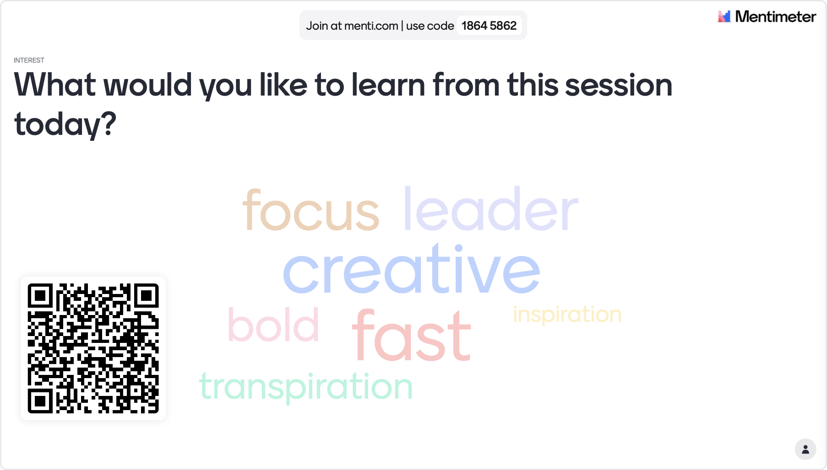

Slide 5
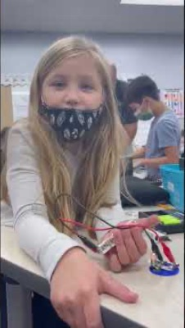
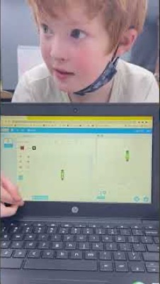

Slide 6
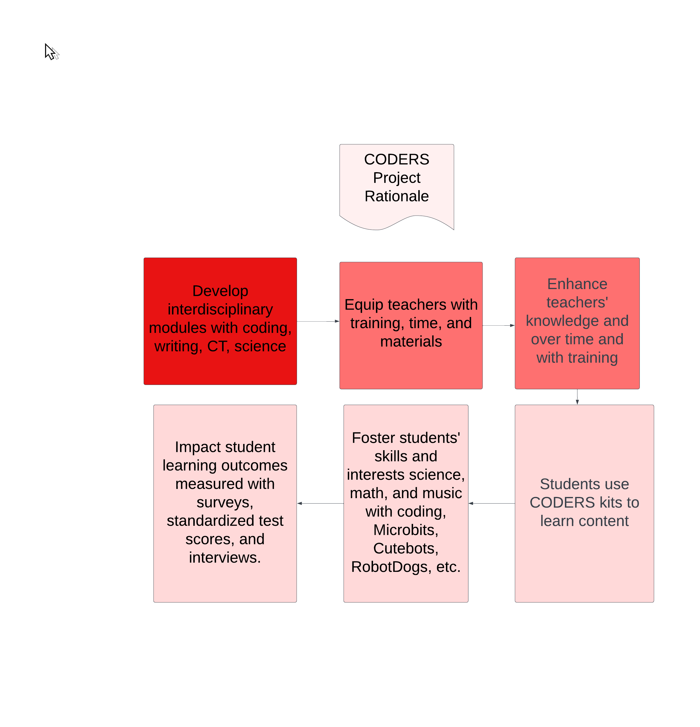
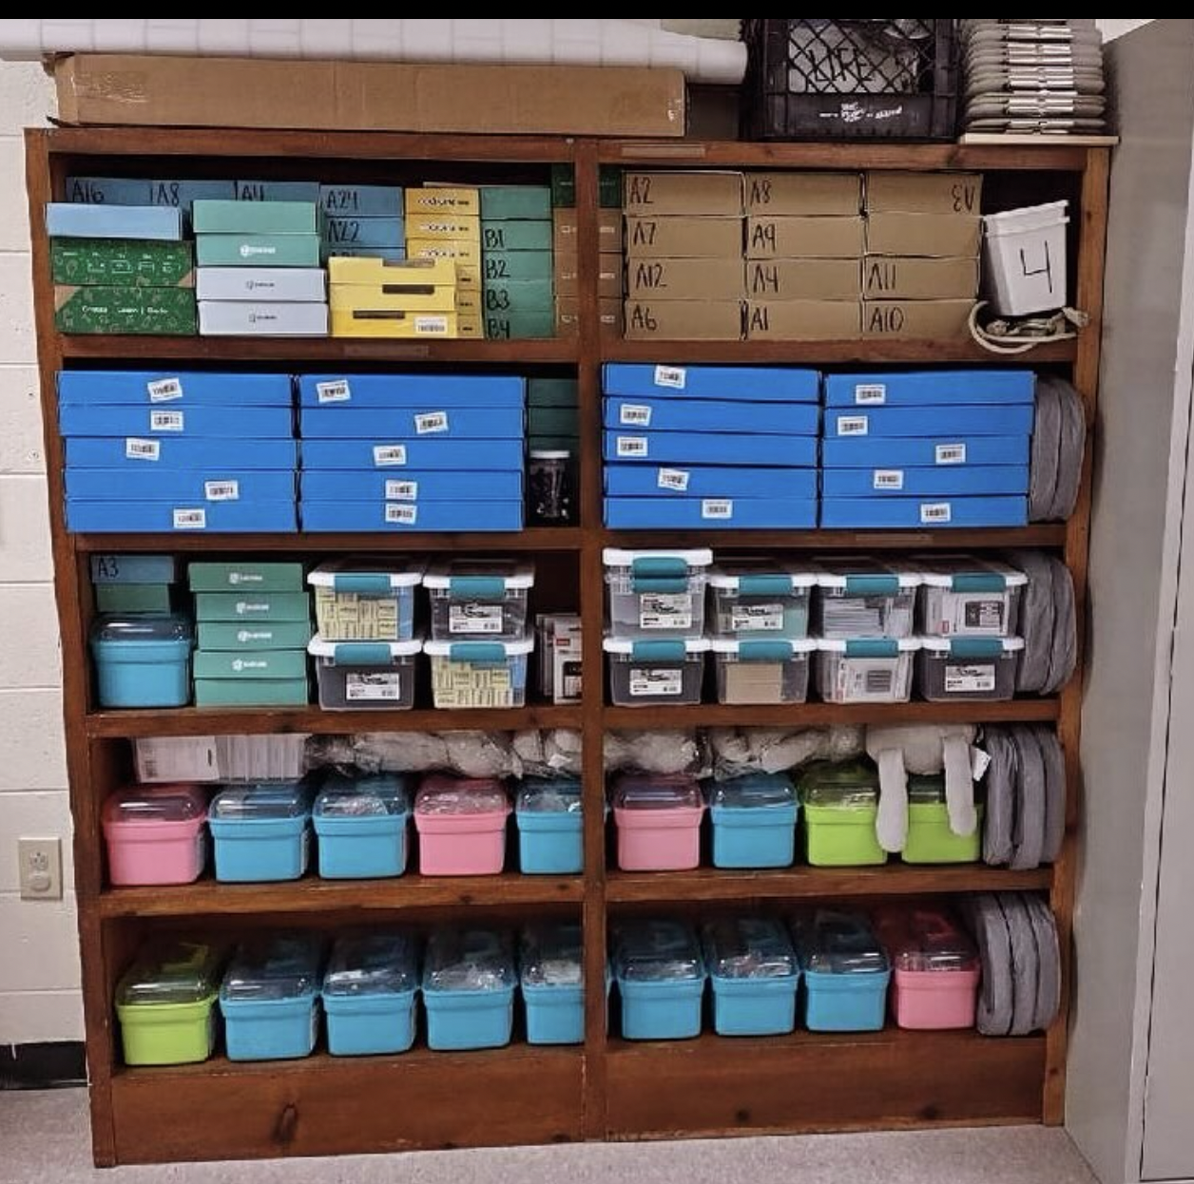

Slide 7
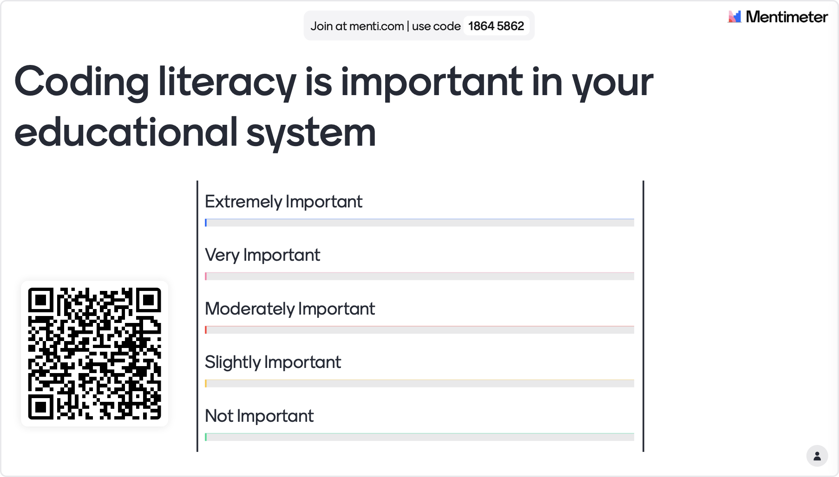

Slide 8

Intermediate Outcomes/Mediators
Increase
Increase teachers’ knowledge of coding
Increase
Increase teachers attitudes toward coding
Increase
Increase amount of time teaching writing
Increase
Increase amount of time spent on teaching coding and STEM
Increase
Increase students’ coding knowledge
Increase
Increase students’ attitudes toward coding
Notes:
Short term wins for long-term impact

Slide 9

Long-Term Impact
Increase teachers’ efficacy in teaching coding
Increase teachers’ use of coding/STEM interdisciplinary lessons
Increase students standardized end-of-year assessments in math, science, and English Language Arts
Increase students’ interest in coding careers

Slide 10
Support Components
CODERS Modules
Summer professional development (30 hours)
Three academic year regroups (3 days x 6 hours=18 hours)
Coding Olympiad (1 day x 6 hours=6 hours)
Coding challenges for students to work on
CODERS Kits
CODERS Kits and Modules
Careers in CS & STEM
Computational Thinking
Writing
Block Coding & Scratch
Cutebots
Microsoft MakeCode & Micro:Bit
Robot Dogs
Bulbs, Batteries, & Wires
Force, Motion, & Friction

Slide 11
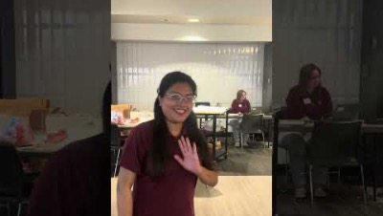
Coding Olympiad Challenge

Slide 12
Teacher Survey Methods
Teacher Attitudes Toward STEM (T-STEM): 20 items measuring teachers’ perceptions and self-efficacy around science and math;
Computer Science Efficacy: 10 items measuring teachers’ perceptions and self-efficacy around coding and computational thinking;
Computer Science Utility: 15 items measuring teachers’ perceptions of the usefulness of coding and computer science; and
STEM Instruction: 11 items measuring teachers’ knowledge of STEM careers, STEM standards, and use of STEM instructional practices.
Notes:
administered in May and June in conjunction with the Of the 33 teachers who took the teacher survey, 19 were returning teachers from Year 1, and 14 were new teachers for Year 2. The teacher survey consisted of the following scales:

Slide 13
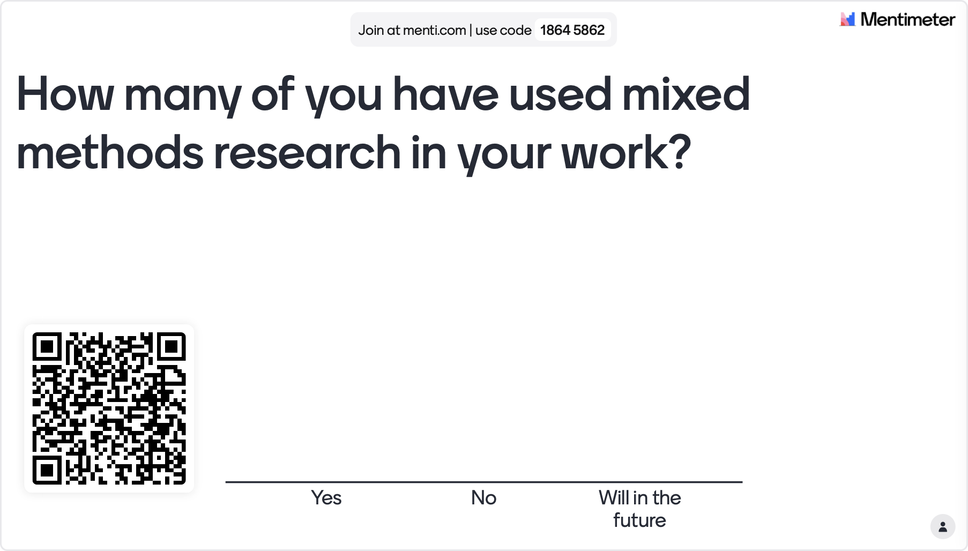

Slide 14
CODERS Teacher Survey Summer 2023
Two-thirds of teachers taught middle school.
* Humanities included ELA, Social Studies, and Music.
Notes:
2023-2024
Of the 30 teachers who completed the survey, 18 were returning teachers from Years 1. 9 had done 2 years. 9 had done 1 year. 12 were new teachers for Year 3.
The returning teachers’ survey responses were matched with pre-survey data from the 2022 CODERS summer institute (and where applicable, the 2021 CODERS summer institute) to measure their growth in targeted areas.

Slide 15
Teachers who participated in two years of CODERS (n=9) increased the amount of time teaching coding, CT, and writing.
The percentages shown above are those who said they spent at least “minimal” class time teaching coding and computational thinking; those who responded “Yes” when asked, “Do you integrate writing into STEM courses?”; and those that said they explicitly teach writing strategies at least “monthly.”

Slide 16
Teachers who participated in 108 hours of PD (n=9) steadily gained in STEM self-efficacy and knowledge.
The graphs at right show subscale scores on a scale of 1 (lowest) to 5 (highest) for the following instruments:
Science Self-Efficacy (T-STEM Science): 10 items
Coding Self-Efficacy: 5 items
STEM Career Knowledge: 4 items
Computer Science Utility: 15 items

Slide 17
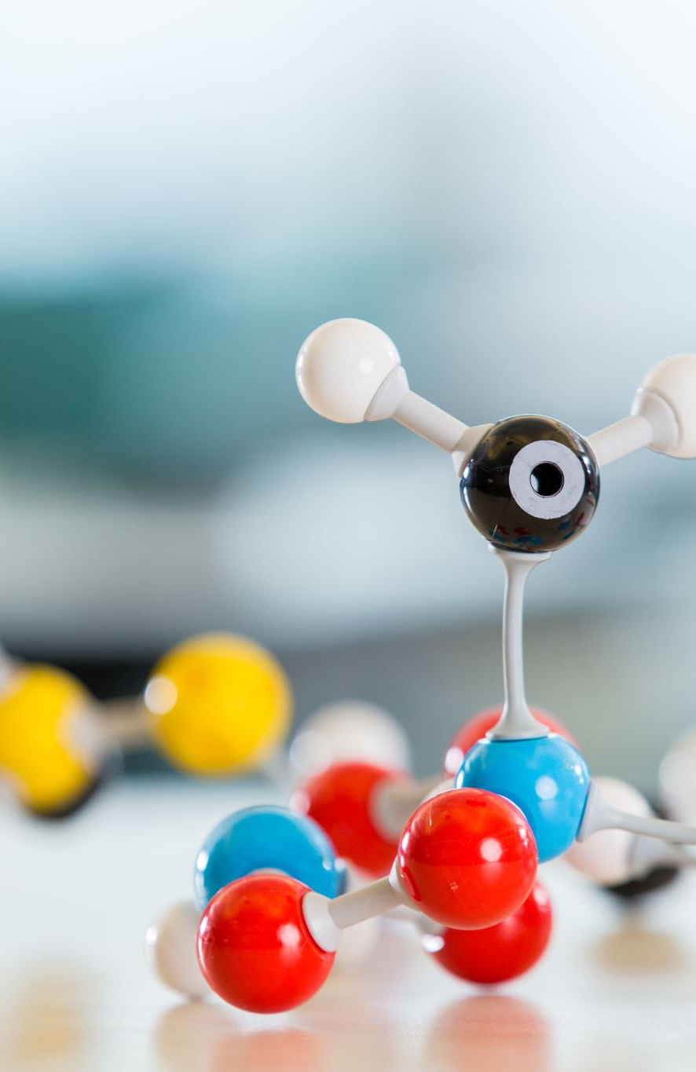
During the first year of CODERS programming, participating teachers experienced statistically significant growth in their computer science efficacy, knowledge of STEM integration and STEM careers, and use of STEM instructional strategies.
During the first year of CODERS programming, elementary students showed small gains in their attitudes and efficacy around both STEM and coding.
During the first year of CODERS programming, middle school students showed small gains in their attitudes and efficacy around STEM, coding, and computational thinking.
2022-2023 data for teachers; 2023-2024 for students

Slide 18
Among the teachers who participated for two years, before attending the CODERS summer institute in 2021, fewer than half (44%) of participating teachers spent class time teaching coding. After the first year, that number had jumped to 100%.
Before participating in CODERS, fewer than half (47%) of teachers said they intentionally integrated writing into their STEM courses. By the end of the first school year, that number had jumped to 56% and continued to climb in the 2nd year to 89%.

Slide 19
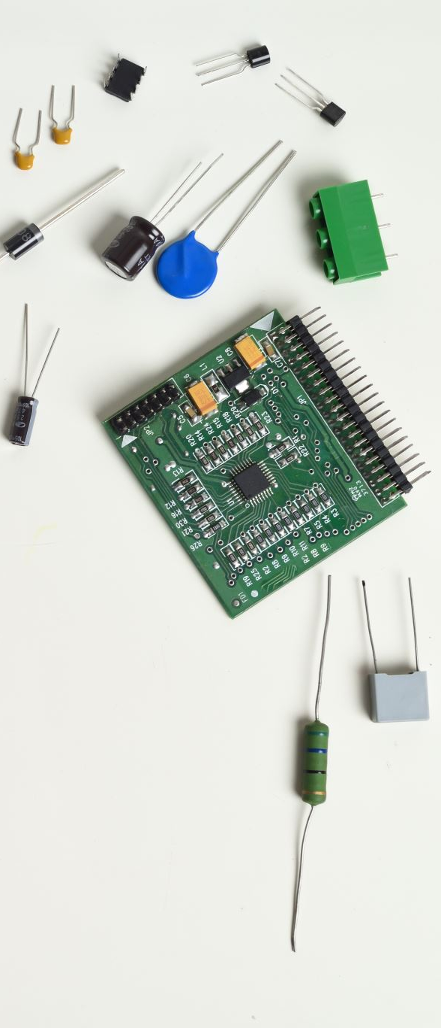
Student Survey Methods
The Student Survey was administered as a pre-survey in September 2023 and a post-survey in April 2024 from 16 schools were represented in the data. The student survey consisted of the following scales:
Coding and Computer Science: 22 items measuring coding confidence, coding interest, utility, social influence, and perceptions of coders;
Student Attitudes Toward STEM (S-STEM): 26 items about math, science, and engineering/technology perceptions;
STEM Career Interest: 11 items representing broad STEM career fields
Programming and Computing Efficacy (3rd – 5th grade only): 15 items measuring programming meaningfulness, impact, creative self-efficacy, and programming self-efficacy;
Computational Thinking (6th – 8th grade only): 22 items measuring computational thinking to solve problems, write computer programs, and create computer programs; and
Science Pre-test (differentiated by grade level: elementary vs. middle school): 7 content-knowledge questions from the CODERS modules.

Slide 20
CODERS Student Survey
In Year 3 of the program (2023-24), teachers administered the student pre- and post-survey to their students at the beginning and end of their relevant CODERS course. A total of 1,222 students completed the pre-survey, and 1,121 students completed the post-survey; 978 sets of student pre and post responses were able to be matched. This year’s match rate (83%) represents a 43% increase from last year’s rate (58%). The results of the matched student surveys are reported in the slides that follow.
More than twice as many middle school students (69%) took the survey as elementary students (31%).
Just over half of students identified as male.
Almost three in four students identified as White.

Slide 21
Academic Achievement
Annual standardized test data in science, math, and English/language arts aims to demonstrate the short and medium-term effects of the CODERS program on students’ academic achievement. For Year 2 of the program, baseline test data was collected from 852 students in Spring 2022, before students received any instruction in CODERS in Spring modules and was compared with Spring 2023 test data from 911 students who had completed a full year of CODERS instruction. CODERS students saw the greatest increases in their science proficiency rates (a 42% increase), followed by math proficiency rates (a 10% increase); however, ELA proficiency rates fell by 7%. Full academic data from Year 3 (2023-24) will be available in Fall 2024.
The Year 2 CODERS cohort exceeded the program target for science proficiency…
…met the target for math proficiency…
…but fell short of the target for English/language arts proficiency.

Slide 22
Students’ attitudes toward coding remained largely the same from the beginning to the end of the school year.
The graph above shows individual subscale scores from the ESCAS (Mason & Rich, 2020). Each subscale ranged from 1 (lowest) to 5 (highest).

Slide 23
Students experienced a small significant increase in math confidence and self-efficacy.
However, their level of confidence in other STEM disciplines did not change.
The graphs at right show individual subscale scores and the total composite scores of the S-STEM (Friday Center for Educational Innovation, 2012). Each scale ranged from 1 (lowest) to 5 (highest).

Slide 24
Younger CODERS students had broader career interests than older students.
When asked to consider 11 different STEM careers, 3rd graders said they were “very interested” in an average of 4.7 careers each, compared with 2.7 for 8th graders.
Computer science and engineering ranked in the top four STEM career choices for all CODERS students.
However, computer science fell in rank from 2nd to 3rd from the beginning to the end of the year.
Pre (Fall)
Post (Spring)
Biology
Veterinary Work
Computer Science
Engineering
Medicine
Energy/Electricity
Environmental
Chemistry
Earth Science
Mathematics
Physics

Slide 25
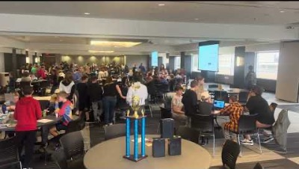

Slide 26
2024 Coding Olympiad
The Coding Olympiad took place on MSU’s campus on February 27, 2024, bringing together 86 select CODERS students from 11 schools to complete four coding challenges. More than half of participating students were male (56%), and two-thirds (67%) were in middle school. Participating students completed a survey about their experiences, the results of which are shown below.
Students enjoyed the Coding Olympiad, giving it an overall rating of 8.37 on a scale of 1 to 10.
said they learned something new about coding at the event.
said at least one teacher had encouraged them to pursue a STEM career.
said the event changed how they think about STEM.

Slide 27
Students found the Coding Olympiad challenges to be challenging but fun.
More than half (53%) of participating students said they felt prepared to complete the challenges. They learned strategies for the challenges primarily from their CODERS teachers and classes. Some students also credited teacher-led after-school programs that helped prepare them for the event, and a few also referenced other life experiences (e.g., team sports) that equipped them with the soft skills needed to succeed.
During the challenges, students felt…
“It was harder than I expected because of the complications and teamwork required, but most of all, it was fun.”
“[My CODERS teacher] is a very special teacher. She helps us with a lot of things. In science she’s always trying to help us. She is the best coder. I can’t thank her enough.”
“My friends were helping and though we made mistakes, it helped us. It was a good thing to problem solve!”
“[My CODERS teacher] is the person who has taught me everything that I know about STEM. I am very grateful to have her as my teacher.”
“[For the] first time I ever felt somewhat smart.”

Slide 28
2022 Teacher Surveys
Returning teachers gave more detailed definitions of coding, using almost twice as many words as they did the year before (an average of 20 words on the post-survey, compared with 11 words on the pre-survey).
What is coding?
Pre Post
“Critical thinking and problem solving”
“Telling a program or computer what to do in different situations. Coding’s purpose is to make things work the way you want them to work."
“It has to do with computer programming, its purposes are varied.”
“A digital creative process to accomplish specific goals or produce specific results in a systematic organized fashion.”
“Writing programs to create computer activities”
“It is the building blocks [sic] of all technology. It is important to understand computational thinking as a way to solve problems.”

Slide 29
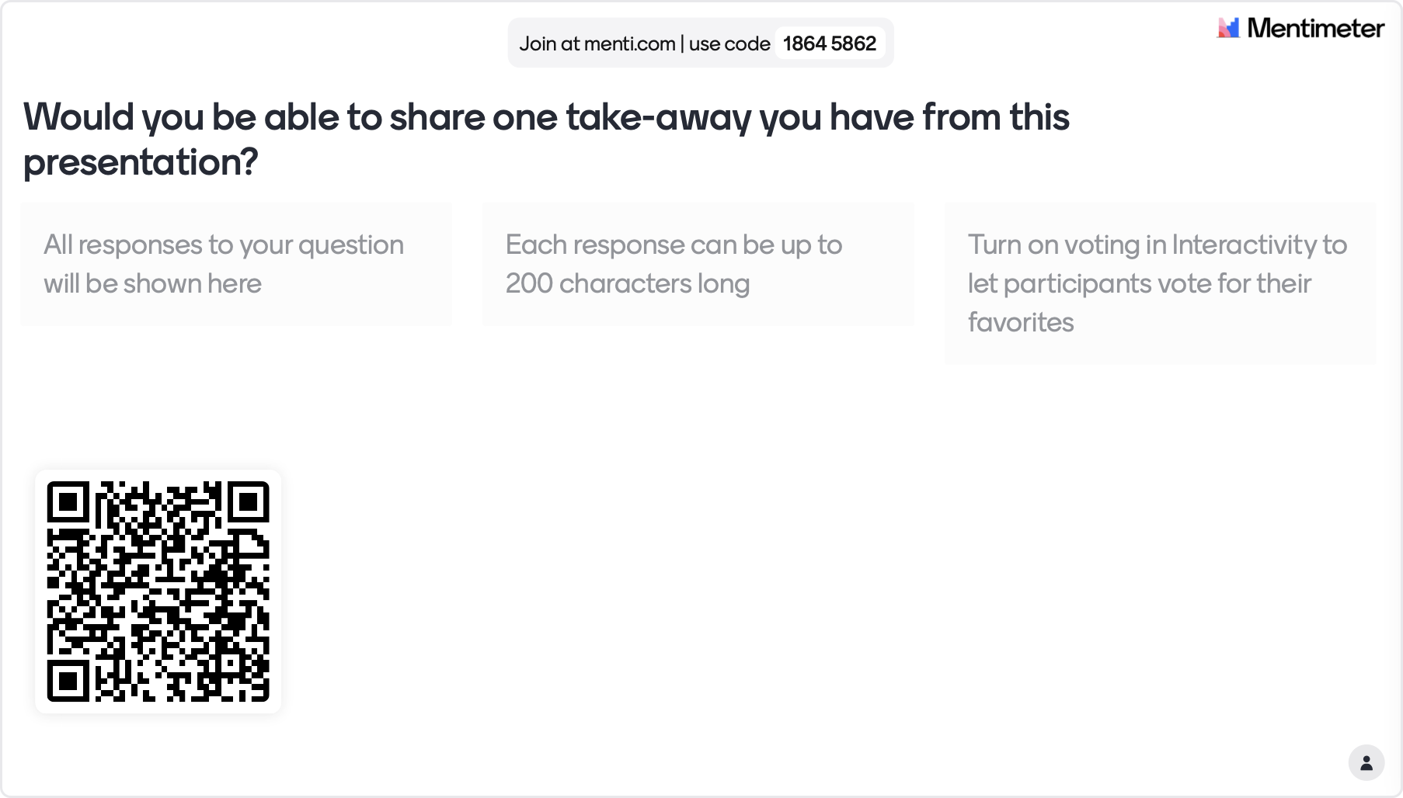

Slide 30
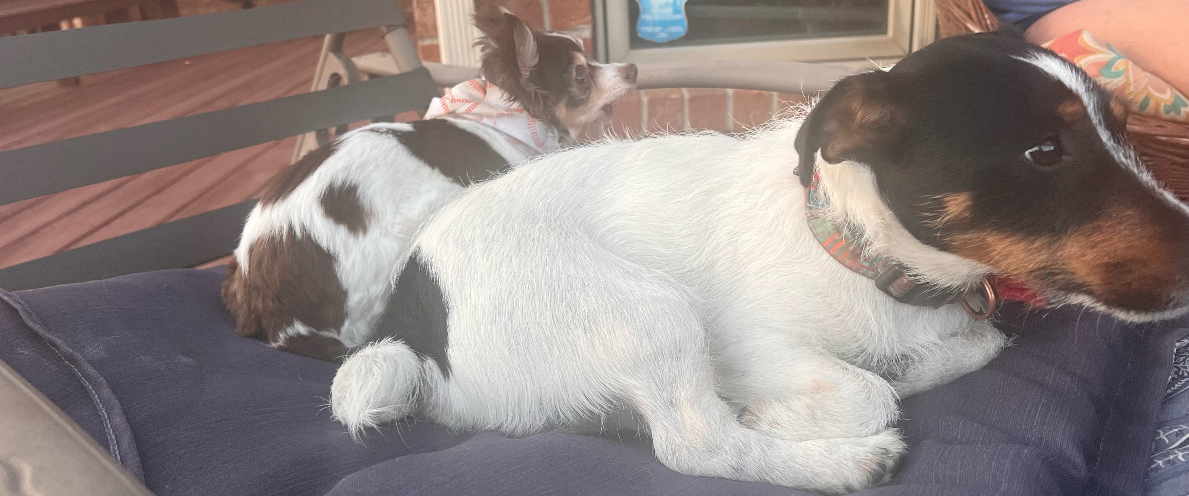
Feel free to contact me for conversation or questions at ‪(417) 501-9977‬ or by email at kfranklin@missouristate.edu.
Feel free to contact Callie Dean at callie@evaluationgroup.com, The Evaluation Group.
Thank you for attending!

Slide 31
Other Links of Interest
Cody the Coder, a third grader, tells his story: https://www.ksmu.org/show/stem-spots/2021-11-18/stem-spots-cody-tells-us-about-coding
https://www.instagram.com/msu_coders/

