Slide 1
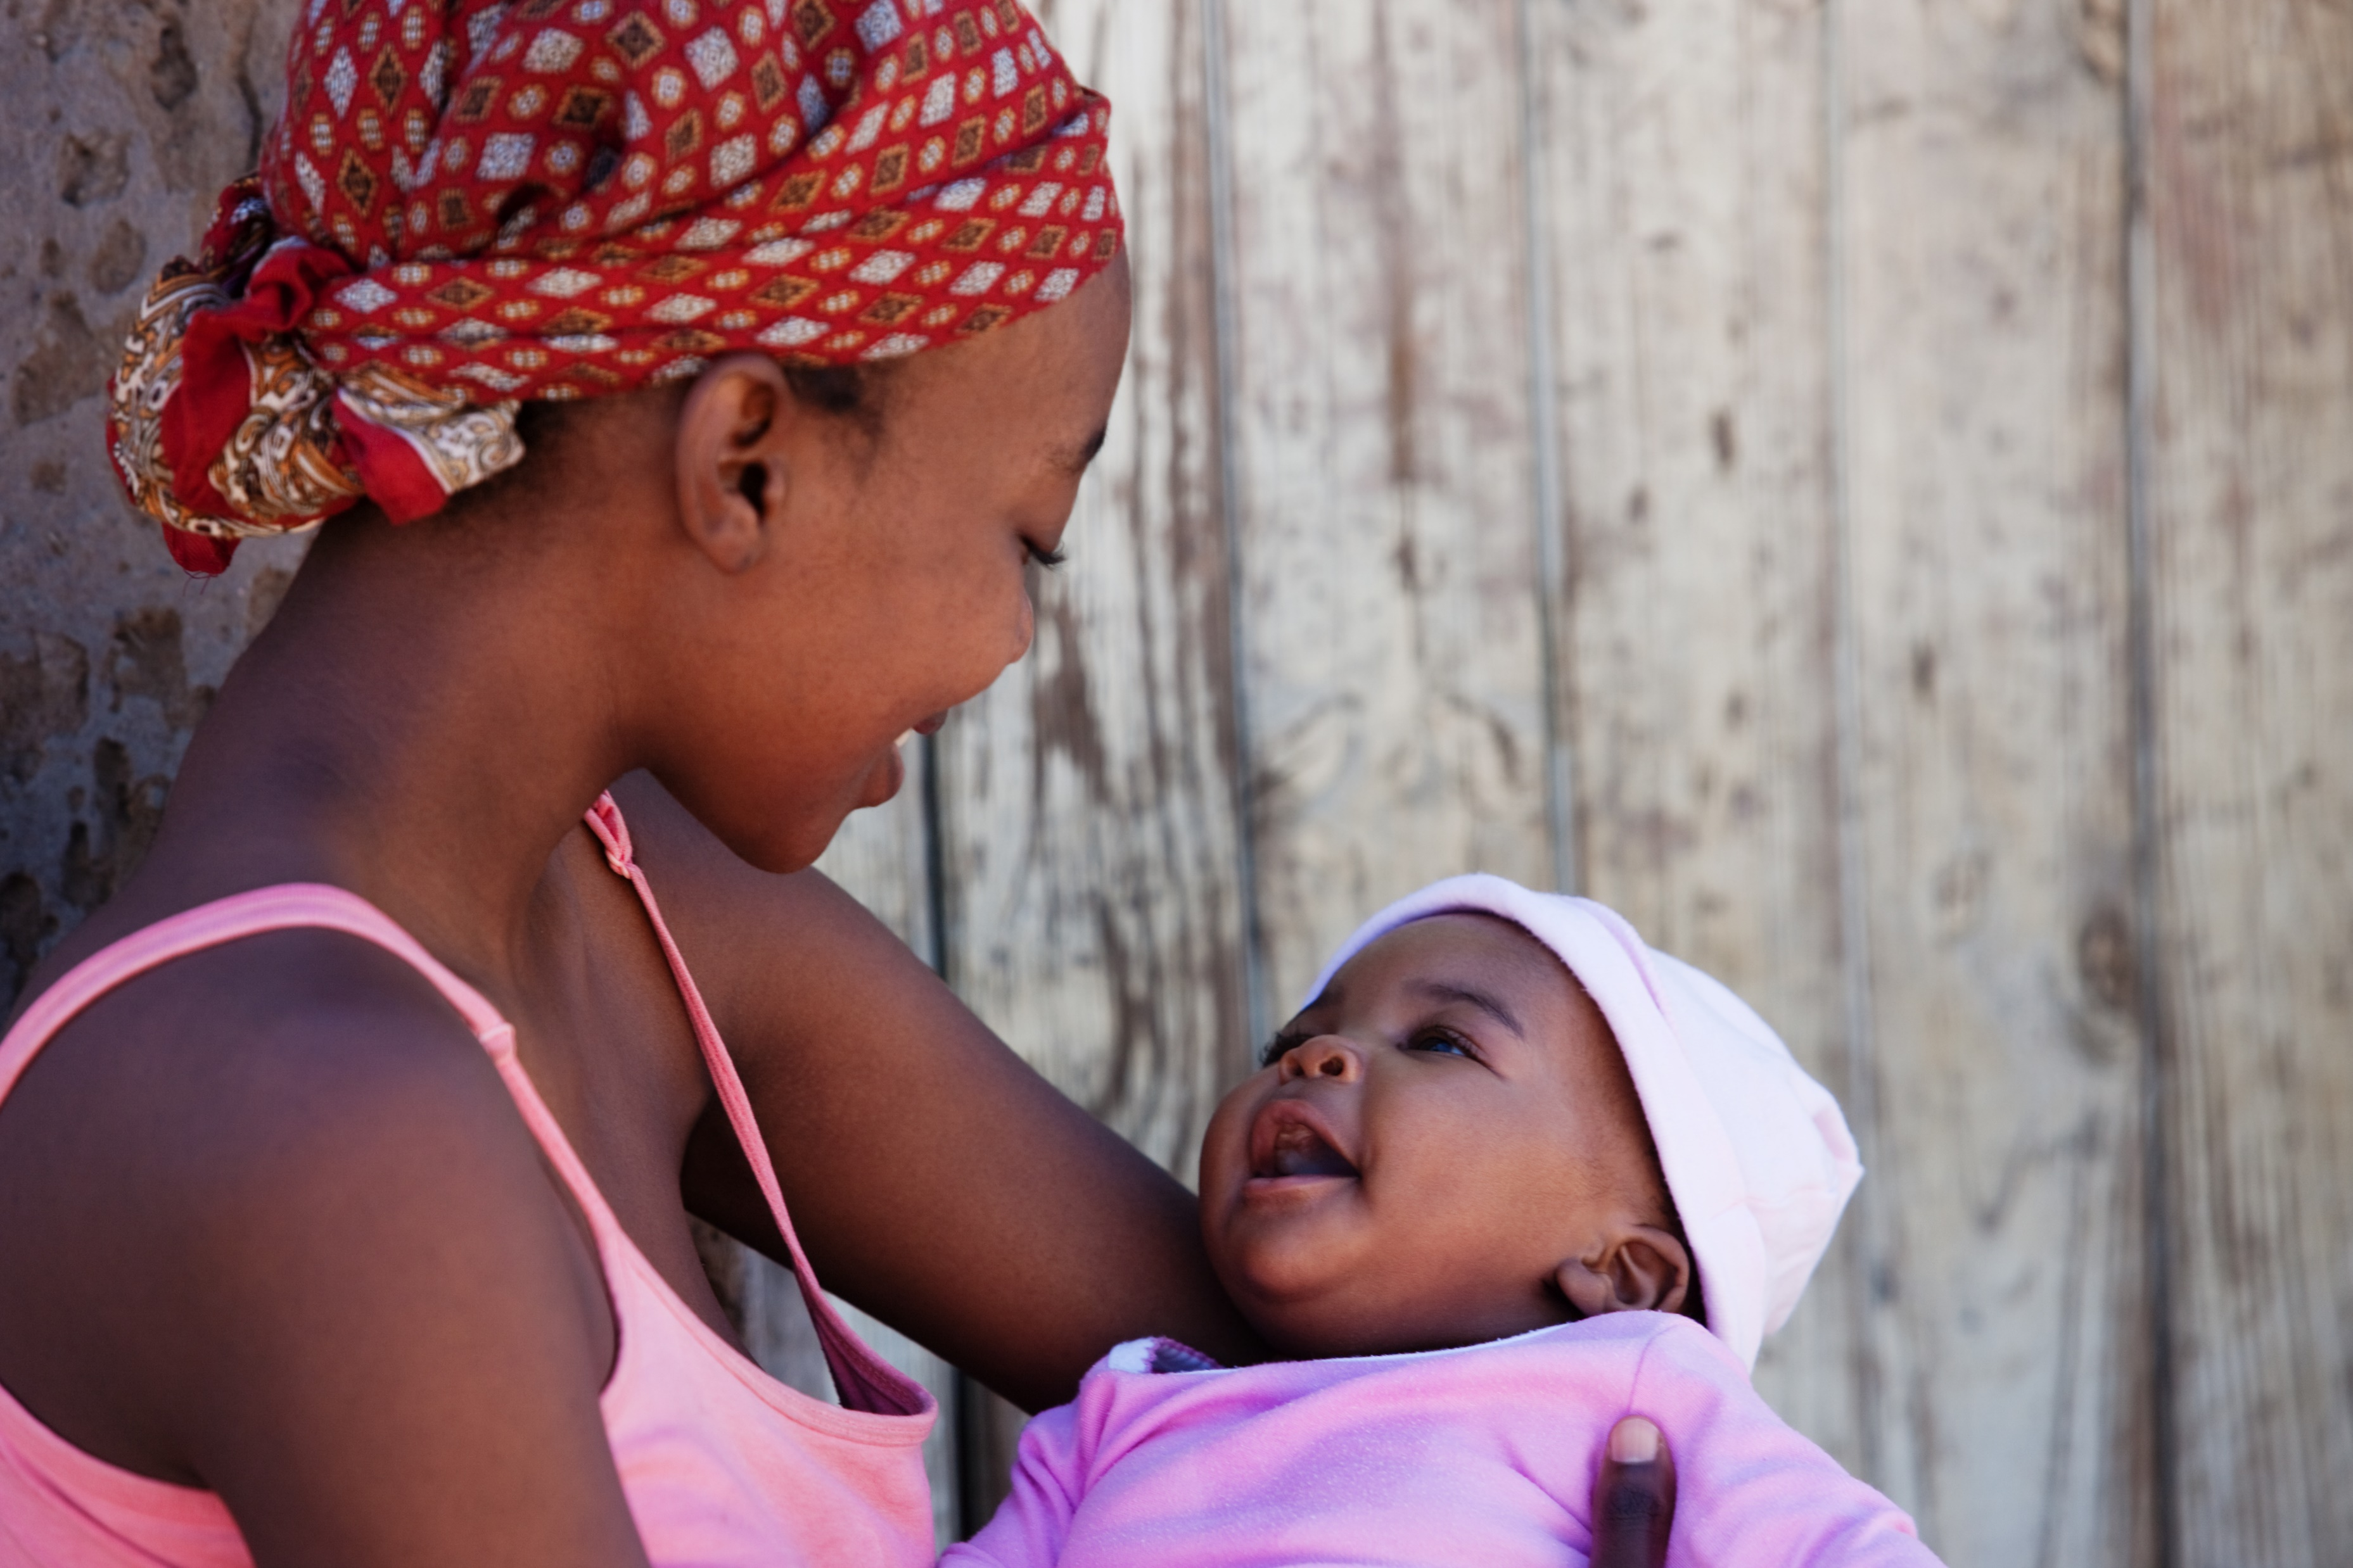


Nigeria MICS-NICS 2016/17
Background

Slide 2





The 2016/17 Nigeria National immunisation Coverage Survey (NICS) was commissioned by implemented by the National Primary Healthcare Development Agency (NPHCDA) and implemented by the National Bureau of Statistics (NBS). Financial support for the survey was provided by the Bill and Melinda Gates Foundation (BMGF). United Nations Children’s Fund (UNICEF) and the World Health Organization (WHO) provided technical assistance.

Slide 3
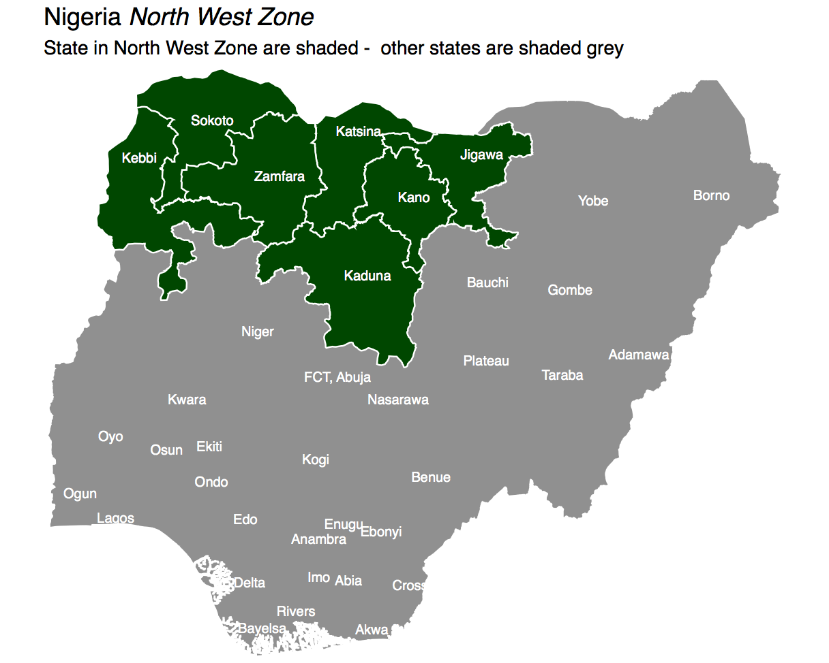

Slide 4
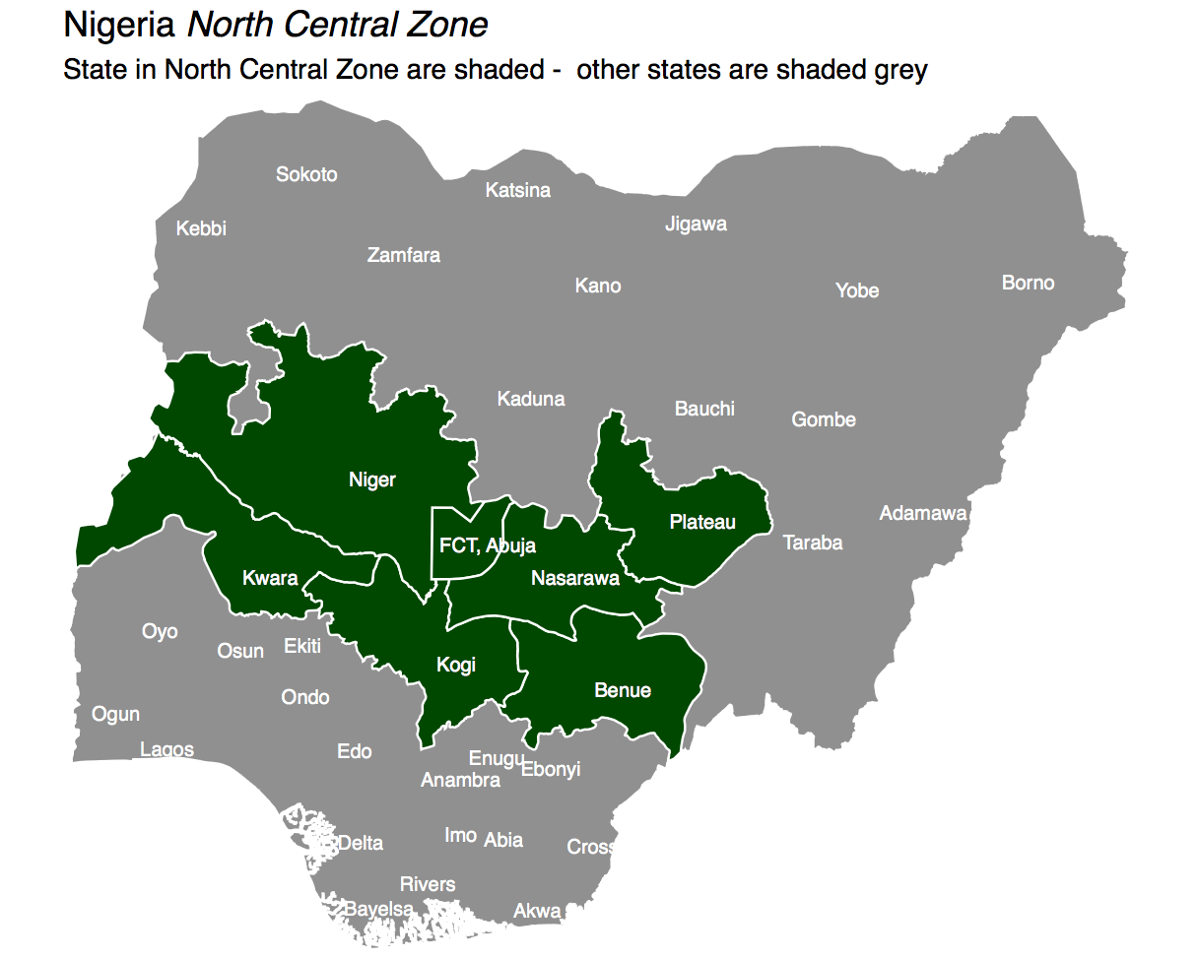

Slide 5
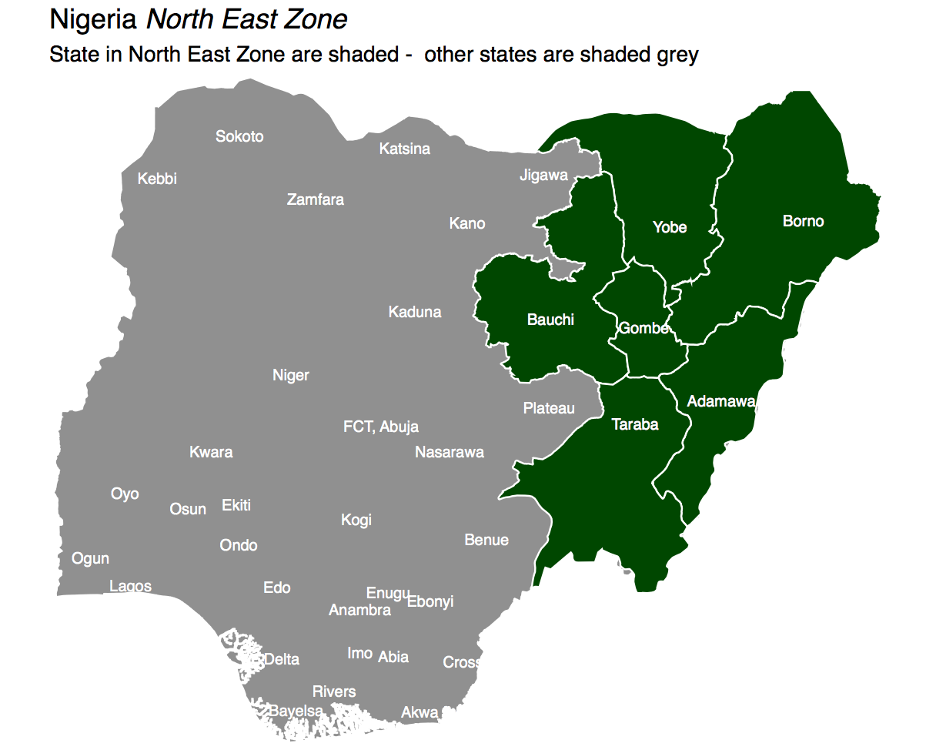

Slide 6
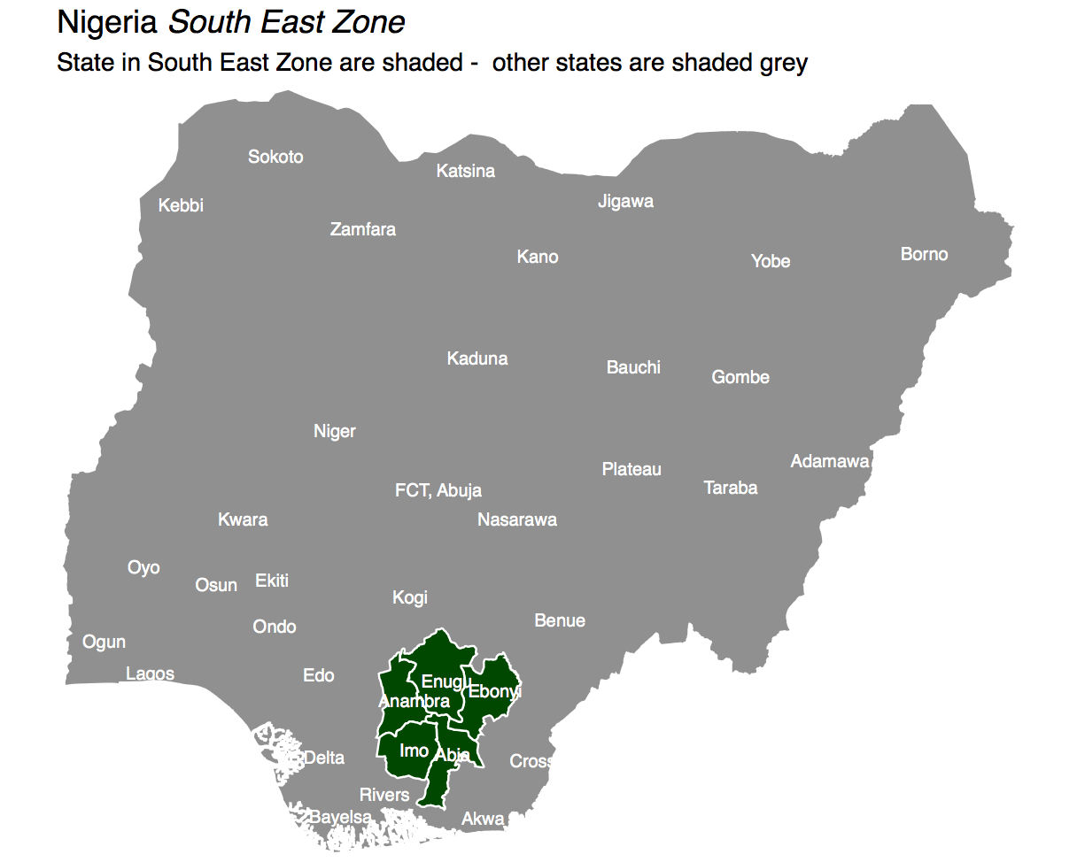

Slide 7
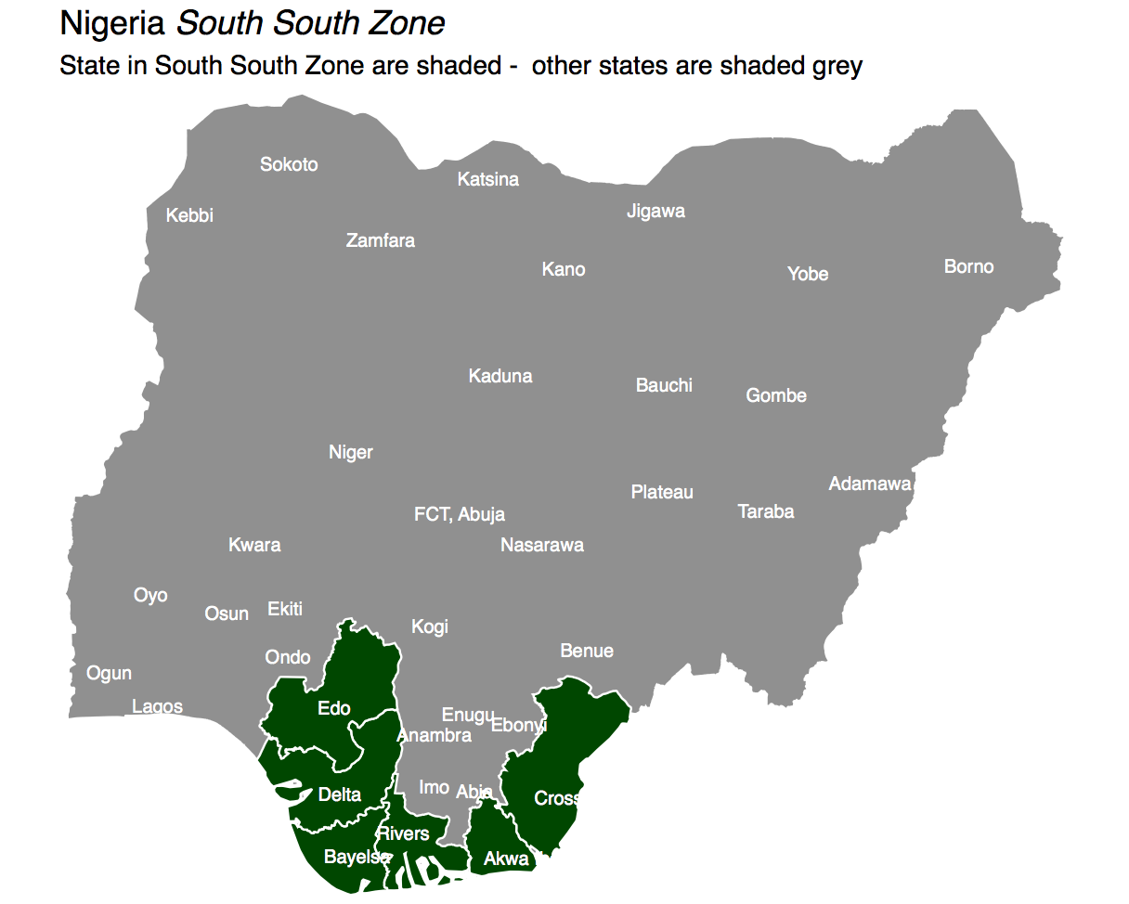

Slide 8
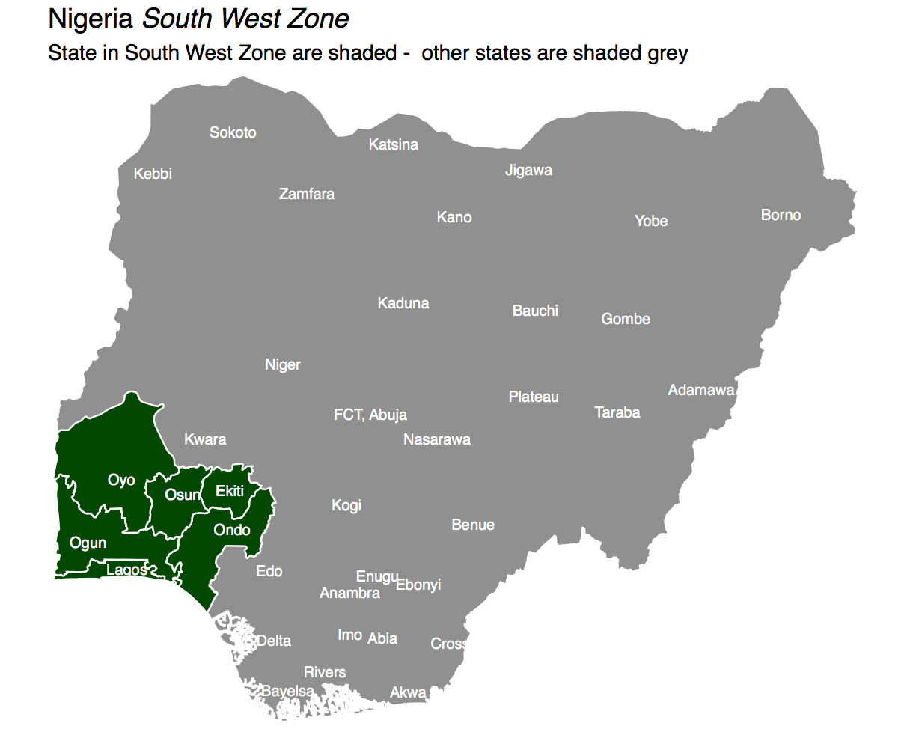

Slide 9
Outline
Previous standalone NICS in Nigeria were conducted in 2000, 2006 and 2010.In 2014, NPHCDA had planned for standalone NICS, however, implementation stalled due to funding constraints.
In 2015, it was decided to incorporate NICS with the Nigeria MICS by inclusion of all NICS related questions into MICS questionnaires.

Slide 10
Outline
Objectives
Background
Overview of Survey tools
Implementation of Joint NICS + MICS
Logistics / Survey monitoring and quality assurance
Key activities
Lessons learnt/ challenges

Slide 11
Objective
The main objective of the 2016/17 NICS was to determine Immunization coverage of children age 12 to 23 months for the basic antigens: BCG, DPT 1-3, OPV 0-3, Measles for each of the 36 states and FCT - Abuja.

Slide 12
Other Objectives
Determine immunization coverage of children age 12 to 23 months for complementary antigens: Yellow fever, Hepatitis B and Vitamin A
Estimate the trend of immunization coverage since 2006
Provide a geographical database on immunization coverage (mapping)
Determine the most frequent obstacles to utilization of immunization services
Provide information on reasons for utilization or non-utilization of immunization services

Slide 13
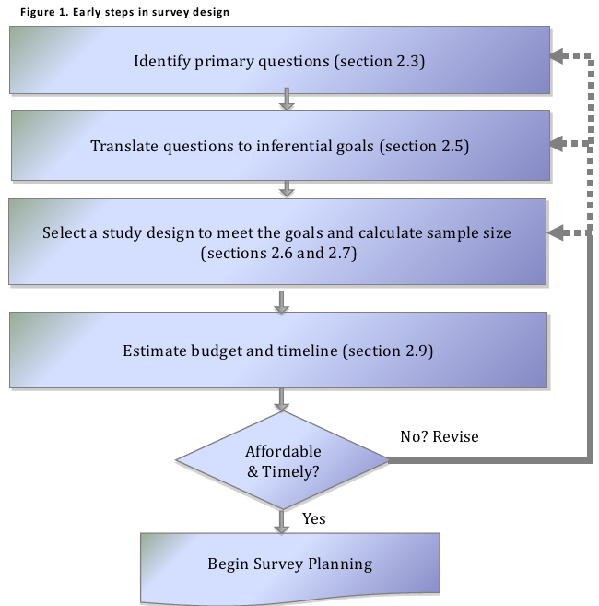
From WHO’s 2015 Vaccination Coverage Cluster Survey Reference Manual revised
Aligned to the processes of MICS
& DHS

Slide 14
Sample Design
Sampling Frame: updated frame from the 2006 Nigeria Population and Housing Census
First Stage: 60 core EAs in every state - Kano & Lagos that had 120 Enumeration areas
Second Stage: 37,440 households selected.

Slide 15
Sample Design
MICS sample calculation was not sufficient to provide precise vaccination coverage estimate in 20 states – shaded
Preliminary analyses indicated that sampling error for Penta3 coverage might be > ± 10% using only the original MICS EAs.

Slide 16
Sample Design
The MICS sample consisted of 60 core EAs in every state except Kano & Lagos that had 120 EAs. = 37,440 households
MICS sample was not sufficient to provide state precise vaccination coverage in 20 states – shaded
MICS sample calculation was based on reported stunting prevalence of 35.8 percent (Nigeria, MICS4 2011).

Slide 17
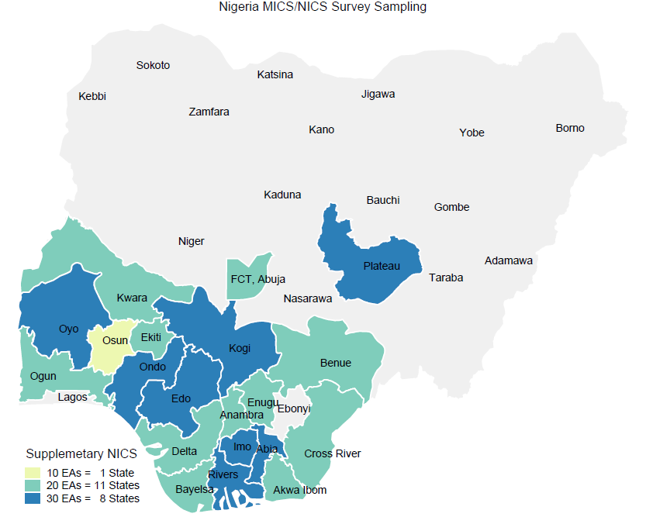
Sample Design
In these 20 states, supplemental sampling was conducted with addition of 10, 20 and 30 EA’s per state as shown

Slide 18
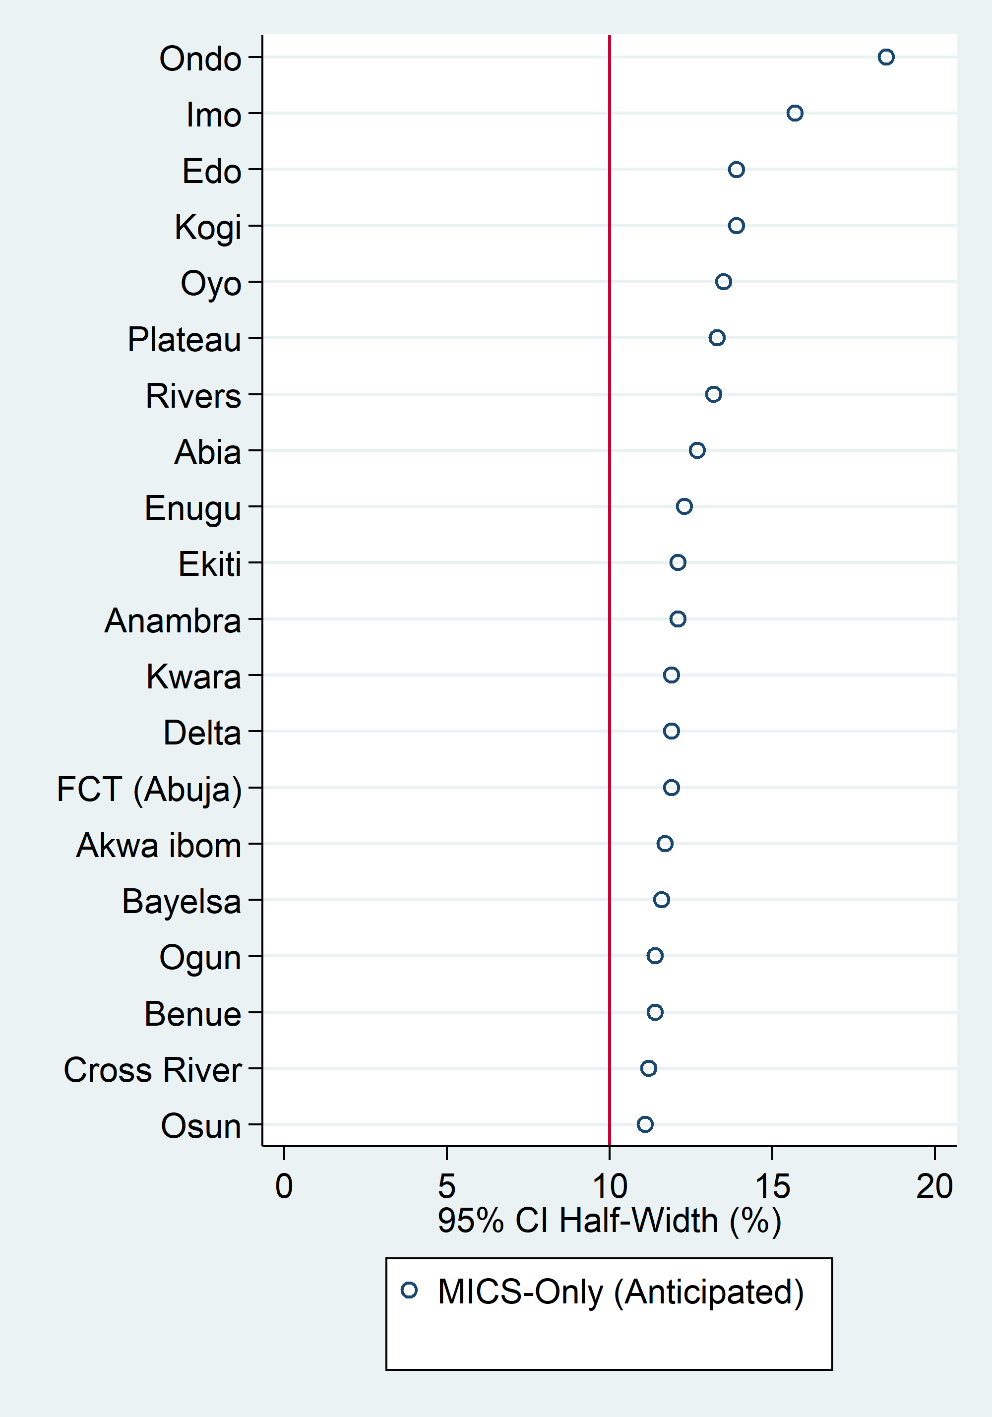
Sample Design
States With Supplemental Sample
Anticipated Conservative Penta3 CI Half-width
Add 30 clusters
Add 20 clusters
Add 10 clusters

Slide 19
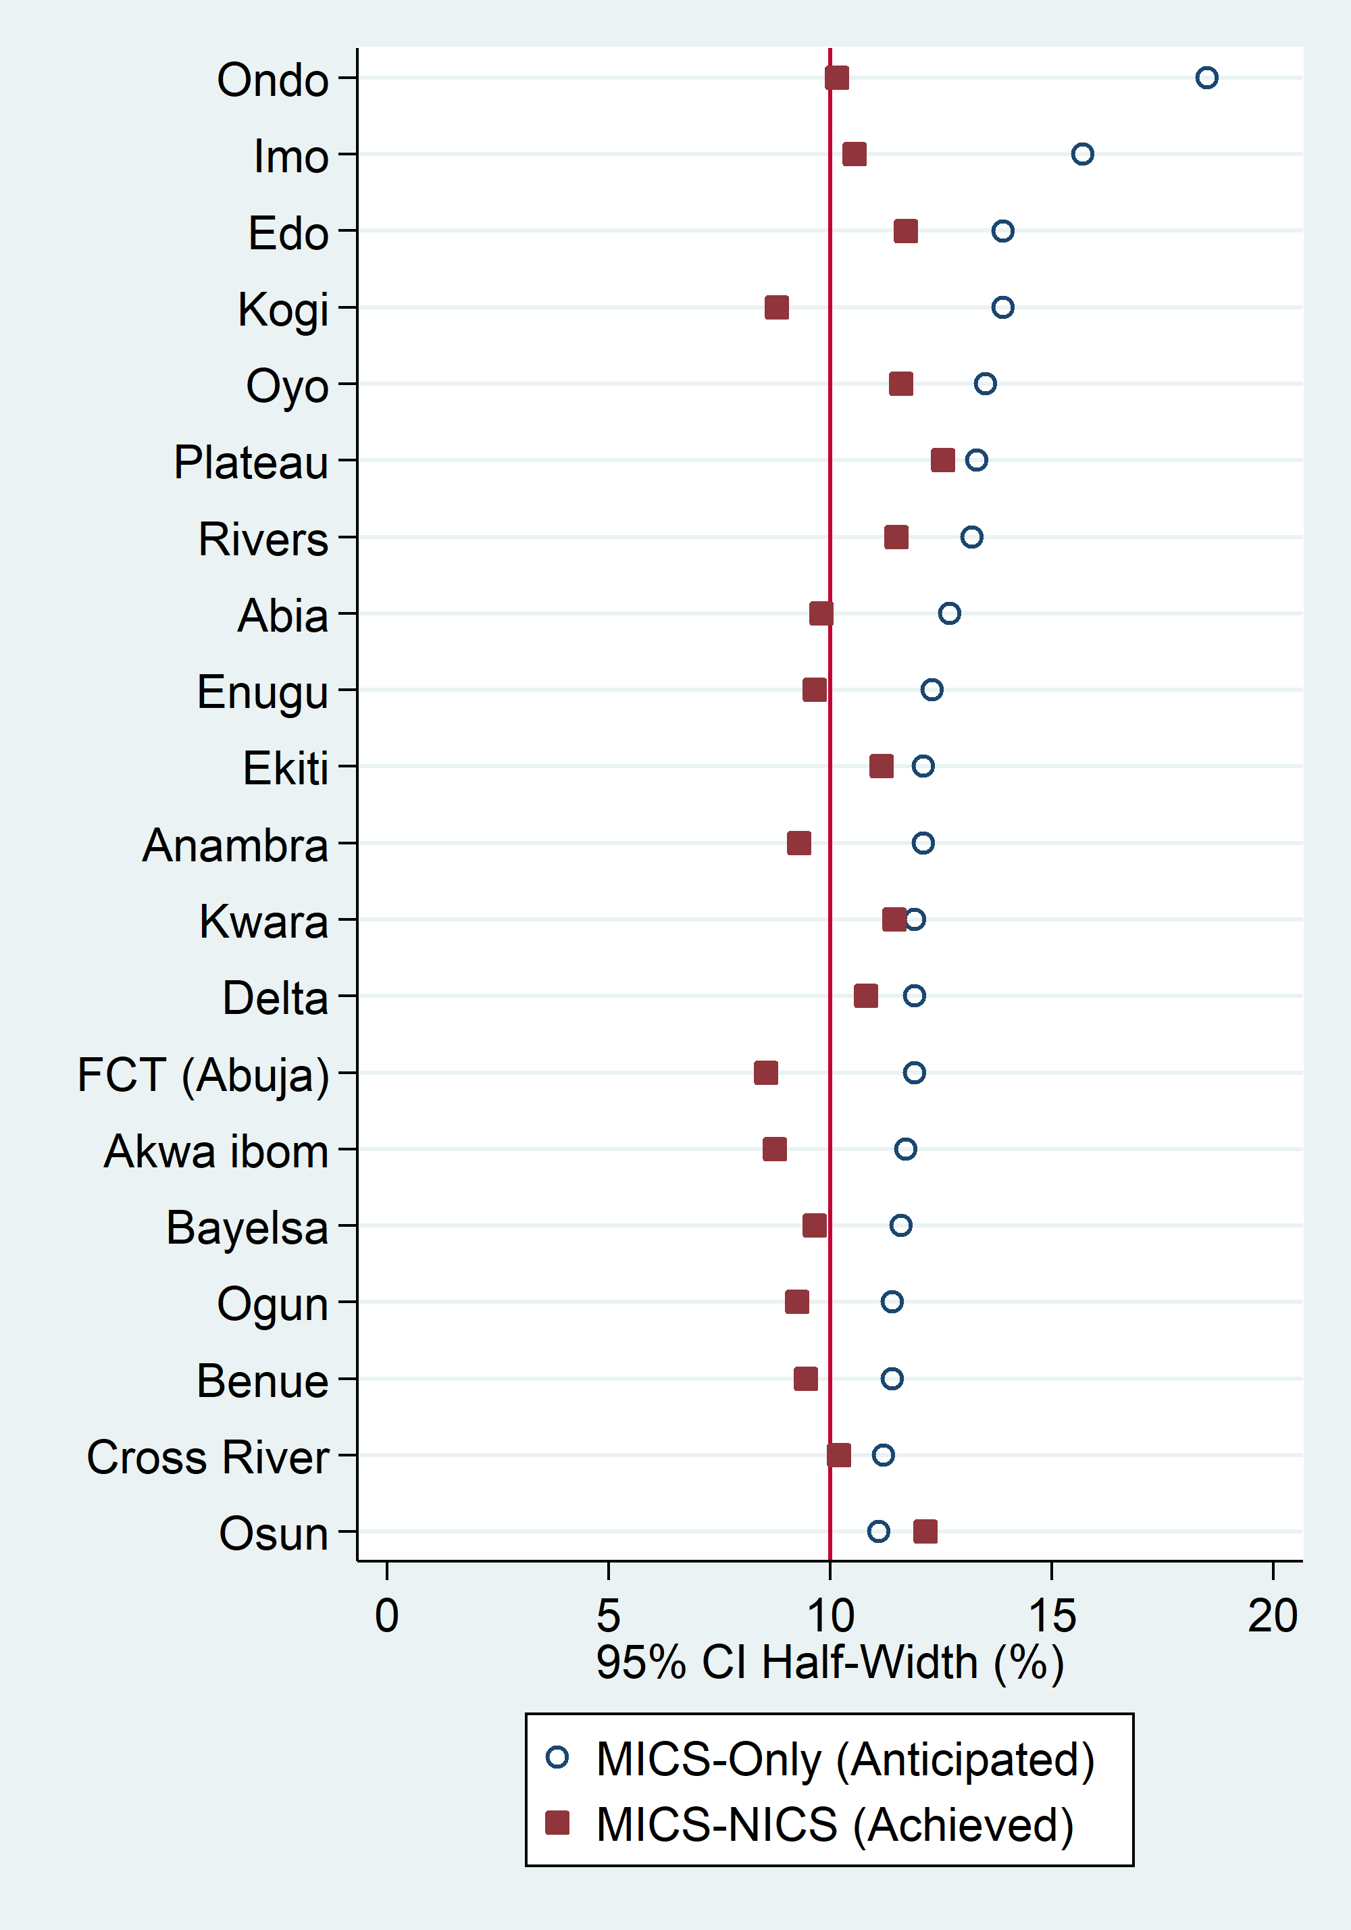
Sample Design
States With Supplemental Sample Anticipated & Achieved Penta3 Half-width
Add 30 clusters
Add 20 clusters
Add 10 clusters

Slide 20
Questionnaires
Household Questionnaire
Child questionnaire
Questions were administered by interviewers recruited from each state and who spoke the language(s) spoken within the state

Slide 21
Questionnaires: Household Questionnaire
Lists usual members to identify eligible individuals
Basic characteristics of each person in the household collected (age, sex, education, etc.)
Housing characteristics (access to drinking water, sanitation facilities, etc.)

Slide 22
Questionnaires: Children’s Questionnaire
Child information panel
Age
Birth registration
Fertility preferences
Immunisation
Reasons for non-vaccination

Slide 23
Questionnaires

Slide 24
Pretest and Main Survey Training
Pretest: Training from January, 2016
Pilot survey: Training from March and April , 2016 covering 80 enumeration areas in 8 states.
Main Survey Training: Training (TOT) conducted for 4 weeks in July 2016
60 facilitators trained
Zonal training conducted in six sites sites in August 2016
125 field teams with a total of 500 members trained

Slide 25
Fieldwork and Data Processing
Total of 125 teams
Core EAS: 78 teams of 1 supervisor, 4 female interviewers, measurer and a driver
Supplementary EAS: 47 teams of supervisor and 2 interviewers and a driver. Fieldwork conducted from early September to mid-December 2016
Data were captured on tablet computers .
NBS central office ran field check tables and data quality checks and feedback provided to individual team

Slide 26
Survey monitoring and quality assurance
NPHCDA participation during training both at national and zonal level
NPHCDA monitoring teams supported survey monitoring both in the MICS only EAs and in the supplemental EAs

Slide 27
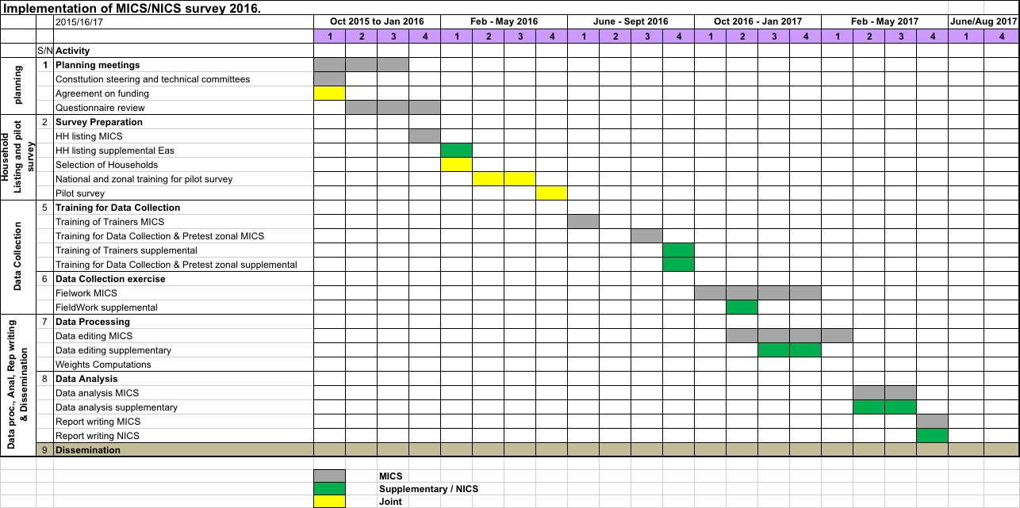
Survey implementation

Slide 28
Data cleaning and analysis
Analysis conducted with custom built software (VCQI)
Calculated additional indictors beyond the standard MICS tables
The software can be customized to compute additional indicators beyond the set of indicators usually calculated during
Last HH interview
Data checks & cleaning (several rounds)
Calculate survey weights
Customize tabulation programs
Compare tables & expectations
Investigate discrepancies
Repeat as necessary

Slide 29
Pooling of MICS and supplemental data
In each supplement state, compare MICS vs NICS are:
% of HH with child 12-23m
% of 12-23m olds with a card with 1+ dates
% of 12-23m olds with any evidence of Penta3
Results: Data from all states deemed poolable

Slide 30
Challenges
National scale – securing funding, constantly increasing budget
Insecurity in certain areas leading to inaccessibility of enumeration areas
Inconsistent/ non-existent power supply requiring purchase of generators to power CAPI tablets
Managing multiplicity of partnerships and agencies especially arising from differences in processes within organizations resulting in delay
WHO offering technical assistance on vaccination while UNICEF offers TA for other components of MICS

Slide 31
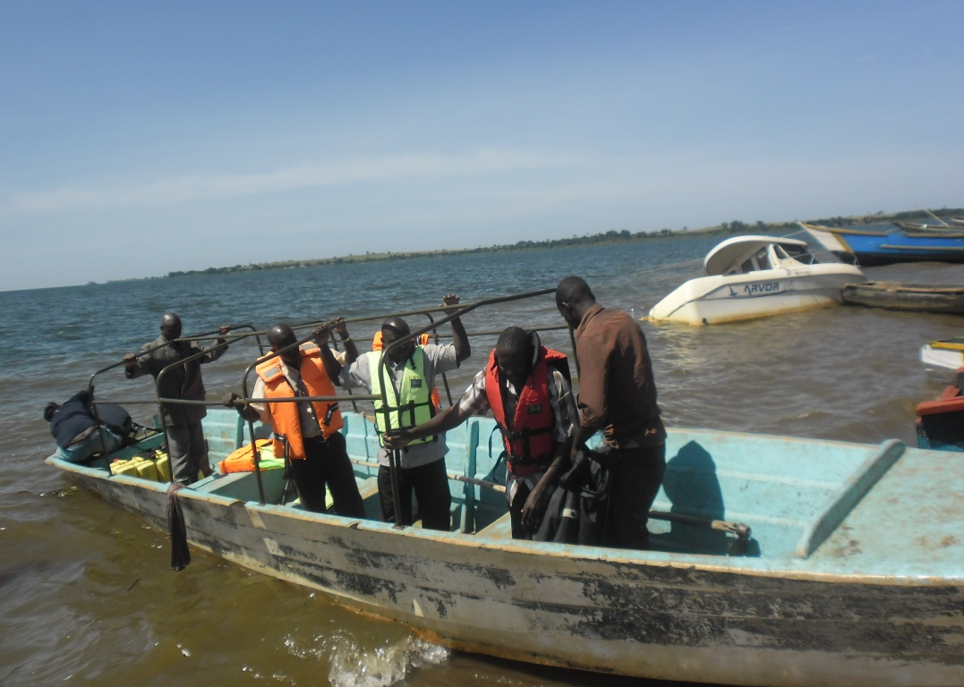
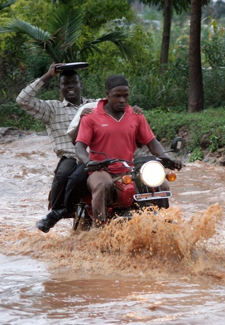

Challenges

Slide 32
Results of the Household and Individual Interviews
Household Interviews
Households selected | 42,981
Households occupied | 41,059
Households interviewed | 40,518
Response rate | 99%
Interviews with children 12 to 23 months
Eligible children | 6,360
Children interviewed* | 6,298
Response rate | 98%

Slide 33
Household and Respondent Characteristics
2016/17 Nigeria National Immunisation Coverage Survey

Slide 34
Household Characteristics
Wealth
Ownership of goods
Urban - rural
Drinking water and sanitation
Electricity
Respondent Characteristics
Education
Age

Slide 35
Nigeria’s Households
13.6% of households are headed by females.
Households have an average of 5.4 members.
46.9% of the population is under 18 years old.
3.4% of the population is 12 to 23 months old.
63.3% of household members live in rural areas.
54.7% of all households have electricity.

Slide 37
Wealth Index
Wealth is determined by scoring households based on a set of characteristics, including access to electricity and ownership of various consumer goods.
Households are then ranked, from lowest score to highest score.
This list is then separated into 5 equal pieces (or quintiles) each representing 20% of the population.
Therefore, those in the highest quintile may not be “rich” but they are of higher socioeconomic status than 80% of Nigeria.

Slide 38
Wealth Index
Poorest 2nd Middle 4th Richest
Urban 2.9% 4.8% 15.1% 31.3% 45.9%
Rural 30.8% 28.9%. 22.4% 12.8% 5.1%
Very few urban households are in the poorest two quintiles, while very few rural households are in the wealthiest two quintiles.
North West zone (33.7%) has the largest proportion of households in the poorest quintile, while South West (53.9%) has the largest proportion of households in the wealthiest quintile.

