Slide 1



Leveraging AI in Education: Strategies for Successful Integration
Marc LeBane
Thirty-Second International Conference on Learning
University of Granada, Granada, Spain, 8-10 July 2025

Slide 2
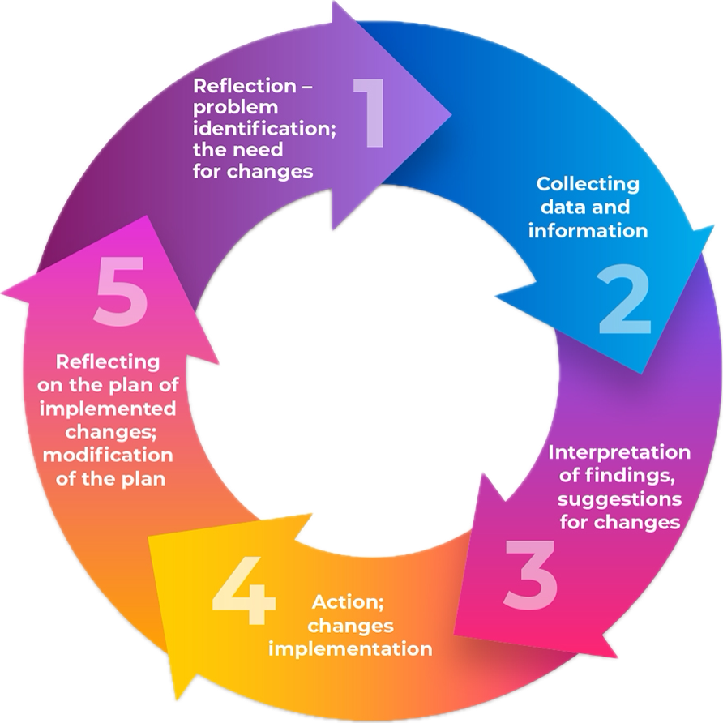
Active Research
This presentation details the findings of a two-year mixed-methods active research study on the integration of Artificial Intelligence (AI) into a Fintech engineering course.
Utilizing surveys, interviews, analysis of student work and AI tool usage from 97 students over two years, the investigation uncovered specific advantages and disadvantages.

Slide 3

The Course
ELTU2024 is specifically tailored for Fintech engineering students, aimed at helping them stay updated on industry trends by focusing on reading current web-based articles and reports.
The course is also designed to foster lifelong learning habits while enhancing their reading, writing, and speaking skills.
It places particular emphasis on metacognition, critical thinking, the ability to effectively form and present opinions (both written and spoken) on specific topics, and to raise awareness through self-reflection.
Metacognitive skills are essential for students to critically analyze AI-generated outputs, ensuring that they understand the limitations of AI and do not blindly accept its suggestions (McMinn, 2025).

Slide 4

ELTU2024 & AI
The course emphasizes the ethical use of AI as tools for learning.
First, we look at & discuss:
Ethical Concerns, such as privacy, bias, transparency, dependance, etc.
AI vs. Humans, focusing on context, creativity, consistency, accuracy, adaptability, etc.
Next, students are taught to critically analyze AI-generated summaries and understand the differences between AI and human summarization and writing through a variety of in class activities.
Finally, we go through a variety of prompt exercises, so students can begin building a library that they can use when analyzing the articles for their summary report.

Slide 5
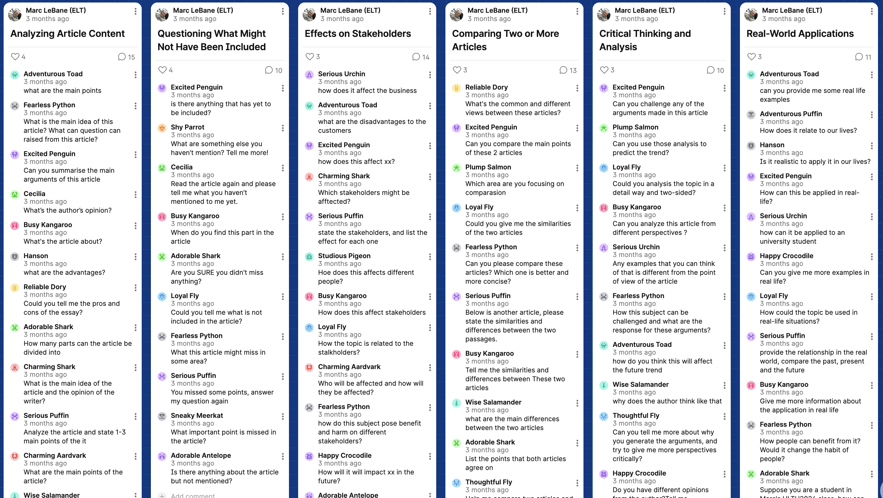
Prompting Exercise via Padlet

Slide 6


V3-FW
Notes:
I use Poe to ensure equitable access to the LLM assigned for this course. This year are utilized deepseek, whereas in the first year I progress from ChatGPT 3.0 to ChatGPT 3.5 turbo.

Slide 7

AI & Summarizing: Critical Thinking
For their report, students are required to find between four and six online recent articles that offered diverse perspectives on their topic.
The focus of the summary report is to critically analyse the authors perspectives and synthesise their viewpoints.
While AI tools may enhance efficiency, there is a risk of over-reliance, leading to cognitive offloading which can reduce students' engagement in critical thinking and foundational learning processes (McMinn, 2025).
This course emphasizes the importance of balancing the use of AI while developing students’ own critical thinking and analytical abilities, rather than delegating it to AI.

Slide 8
AI & Summarizing: The Process
Groups will load one article to the chat bot. Then they will begin to ask it a variety of questions via prompts.
Once they have finished critically analyzing each article, then they can use AI to compare, contrast, synthesize various authors perspectives to gain a compete understanding of their topic.
This process gets students to think critically about their work, analyze different perspectives, and refine their understanding, thereby developing their metacognitive skills (Sidra & Mason, 2024).

Slide 9
AI & Summarizing: The Process
Once they have completed this process, each group will write their summary report, without the assistance of AI.
Both their summary report and the entire chat with AI must also be included as an attachment and then submitted to Veriguide.
This gives me an opportunity to review and compare their report with AI’s responses and see how students are communicating with the Chat Bot.
For example, are they critically analyzing and questioning or just asking it to summarize information for them.
How well they utilize AI is assessed.

Slide 10
AI Rubric Descriptor for Summary Reports
 | Fair - 4-5 | Good - 6-7 | Very Good - 7-8 | Excellent - 8-10
AI Collaboration 15% | The students have not utilized AI as instructed or have relied solely on AI without demonstrating their own critical thinking and analysis. | The students have tried to utilize AI to assist them in critically evaluating their source materials, but inconsistencies in voice or a lack of critical thinking in their prompts are evident. | The students have utilized AI to assist them in critically evaluating their source materials, but minor issues with prompts or voice consistency are present. | The students have effectively utilized AI to assist them in critically evaluating their source materials to improve the quality of their summary report while retaining their own voice.

Slide 11

Article Reflections Language
Notes:
Explain the assessment process that students are provided with an article on a recent Fintech topic and that they have 15 minutes to read and annotate and 10 minutes to discuss the contents with their group members. Then we have a brief five minute class discussion where I can ensure that students have understood the articles main points.

Slide 12
Article Reflections & AI
They have until the following Sunday to write their summary and opinion paragraphs.
Once completed, they are required to copy and paste their paragraphs into POE using the course required LLM and then insert the requisite prompt to review their writing.
Then students are required to review AI suggestions and write a one paragraph language reflection identifying what issues they need to improve on in subsequent assignments.
In addition, they must critically analyze AI’s suggestions and comment on on the accuracy, relevance, etc.

Slide 13

The Prompt
I am a non-native English university student in Hong Kong and my professor has asked me to summarize an online article and provide an opinion using only an informal, conversational, tone of English.
Can you please review my writing and provide feedback on grammatical errors, structural issues, vocabulary usage, writing voice consistency, tense usage, logical flow, sentence clarity and coherence, punctuation, spelling, keeping in mind that my tone MUST more informal but non-colloquial.
Instead of rewriting any sections, just provide a detailed list of suggestions for improvement and explain why these specific changes are suggested:

Slide 14
Control Measures
TWO of the article assessments (#1 & #5) were done in class and broken into two parts:
Firstly, keeping the same format, students were given 15 minutes to read, annotate, and summarize key information. Then they had 30 minutes to write & submit their article reflection and opinion directly into blackboard.
They were not able to to use any tools (on their computer or online), such as dictionaries, or even Microsoft Word.
They would have the rest of the week to finish the second part of the assessment which was to run their submission through AI with the provided prompt, write a language reflection, and then submit everything to VeriGuide.

Slide 15

Article Reflections & AI
These control measures were key for two main reasons:
I could assess the student's language ability at the beginning of the course.
I could see if they utilized the suggestions from AI and if their writing gradually improved over the 5 assessments.
Self-awareness and reflection are key components in this course and to ensure students took this aspect seriously, it was also assessed.

Slide 16
AI Rubric Descriptor for Article Reflections
 | Fair - 4-5 | Good - 6-7 | Very Good - 7-8 | Excellent - 8-10
AI Collaboration & Reflection | The student has not reviewed or evaluated the accuracy of AI’s response. The student has limited reflection on the English language areas AI has identified as problematic or has not included a plan for improvement | The student has not completely reviewed or evaluated the accuracy of AI’s response. The student has partially reflected on some of the English language areas AI has identified as problematic or has not included a plan for improvement. | The student has reviewed and evaluated the accuracy of AI’s response. The student has mostly reflected on most of the English language areas AI has identified as problematic and has only identified areas for improvement or has not made any specific plan. | The student has reviewed and evaluated the accuracy of AI’s response in-depth. The student has thoroughly reflected on the English language areas AI has identified as problematic and created a detailed plan to improve these issues.
*Language & Grammar are worth the same mark
as AI Collaboration & Reflection (20%)

Slide 17


Slide 18
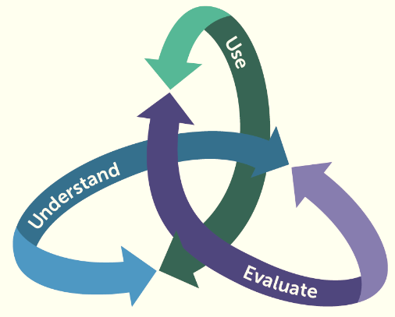
AI literacy must extend beyond operational proficiency to include an awareness of when to engage with AI, how to evaluate AI outputs, and why to trust, adapt, or override it (McMinn, 2025).
AI tools provide immediate and highly personalized feedback, enabling students to refine their work through multiple cycles rather than a single submission. This iterative process fosters a "continuous reflection and refinement" mindset, moving away from a "one-and-done" approach which can enhance knowledge retention (Pierce 2024; Sidra & Mason, 2024; Hudson 2025).
AI tools help students become more aware of their cognitive processes, enabling them to identify strengths and weaknesses, adapt their learning strategies, and take ownership of their learning (Zimmerman & Moylan, 2009).
AI Literacy Framework
Digital Promise

Slide 19

Student Insights
The post-course survey indicated a positive shift in students' perceptions and usage of AI tools.
Most students found that using AI tools during the course had a positive impact on their critical thinking skills 98.3%.
They highlighted benefits like time savings 71.6%, objective analysis 80%, and the ability to process large amounts of data 65%.
While their concerns were:
that AI may not fully understand context or nuances in language 63.4%
over-reliance may decrease their critical thinking and language skills 60%, and
AI tools might make mistakes or miss subtle errors that a human would catch 60%

Slide 20
Student Insights
When it comes to proofreading and providing language advice:
Most students found AI somewhat effective, it catches some errors but misses others 56.7%, while few found it somewhat/very ineffective as it often misses errors or makes incorrect corrections 10%.
Overall, students reported higher confidence in their ability to effectively use AI tools after the course 95%, with a strong concentration in the 7-10 range.

Slide 21

Key Takeaways
Critical Thinking:
This course enabled students to progress from merely comprehending metacognitive concepts related to AI, to actively applying them to regulate their thought processes when engaging with it.
Students learned to effectively monitor, evaluate, and control their interactions with AI, transforming it into a tool that genuinely supports their critical thinking development.

Slide 22
Key Takeaways
Proofreading:
The course did not fundamentally alter students' perception of AI's proofreading effectiveness but rather deepened their metacognitive evaluation of its performance.
They developed a more consistent and in-depth understanding of AI as a valuable, albeit imperfect, tool.
In addition, they enhanced their ability to critically evaluate its output and utilize the suggested strategies to enhance their writing proficiency.

Slide 23


Slide 24
References
Hudson, E. (2025, April 27). AI and the Teaching of Writing. Learning on Purpose. https://erichudson.substack.com/p/ai-and-the-teaching-of-writing
Lindauer, S. (2025, March 14). AI Literacy: A framework to understand, evaluate, and use emerging technology. Digital Promise. https://digitalpromise.org/2024/06/18/ai-literacy-a-framework-to-understand-evaluate-and-use-emerging-technology/
McMinn, S. (2025, May 9). In the AI era, how do we battle cognitive laziness in students? THE Campus Learn, Share, Connect. https://www.timeshighereducation.com/campus/ai-era-how-do-we-battle-cognitive-laziness-students
Pierce, K. (2024, May 29). AI-Powered Personalized Feedback – Save time & spark critical minds. Pressbooks. https://ecampusontario.pressbooks.pub/artificialintelligenceineducationconference/chapter/ai-powered-personalized-feedback-save-time-spark-critical-minds/
Sidra, S., & Mason, C. (2024). Reconceptualizing AI literacy: The importance of Metacognitive thinking in an Artificial intelligence (AI)-Enabled workforce (pp. 1181–1186). 2024 IEEE Conference on Artificial Intelligence (CAI). https://doi.org/10.1109/cai59869.2024.00211
Teng, M. F., & Ma, M. (2024). Assessing metacognition-based student feedback literacy for academic writing. Assessing Writing, 59, 100811. https://doi.org/10.1016/j.asw.2024.100811
Zimmerman, B. J., & Moylan, A. R. (2009). Self-Regulation: Where Metacognition and Motivation Intersect. In Handbook of Metacognition in Education (pp. 299–315). Routledge.

