Slide 1
Unknown Victims: Exploring Race and Sex Differences in Missing Persons Post-Flood
Anneliese Schenk-Day & Taylor June
The Ohio State University

Slide 2
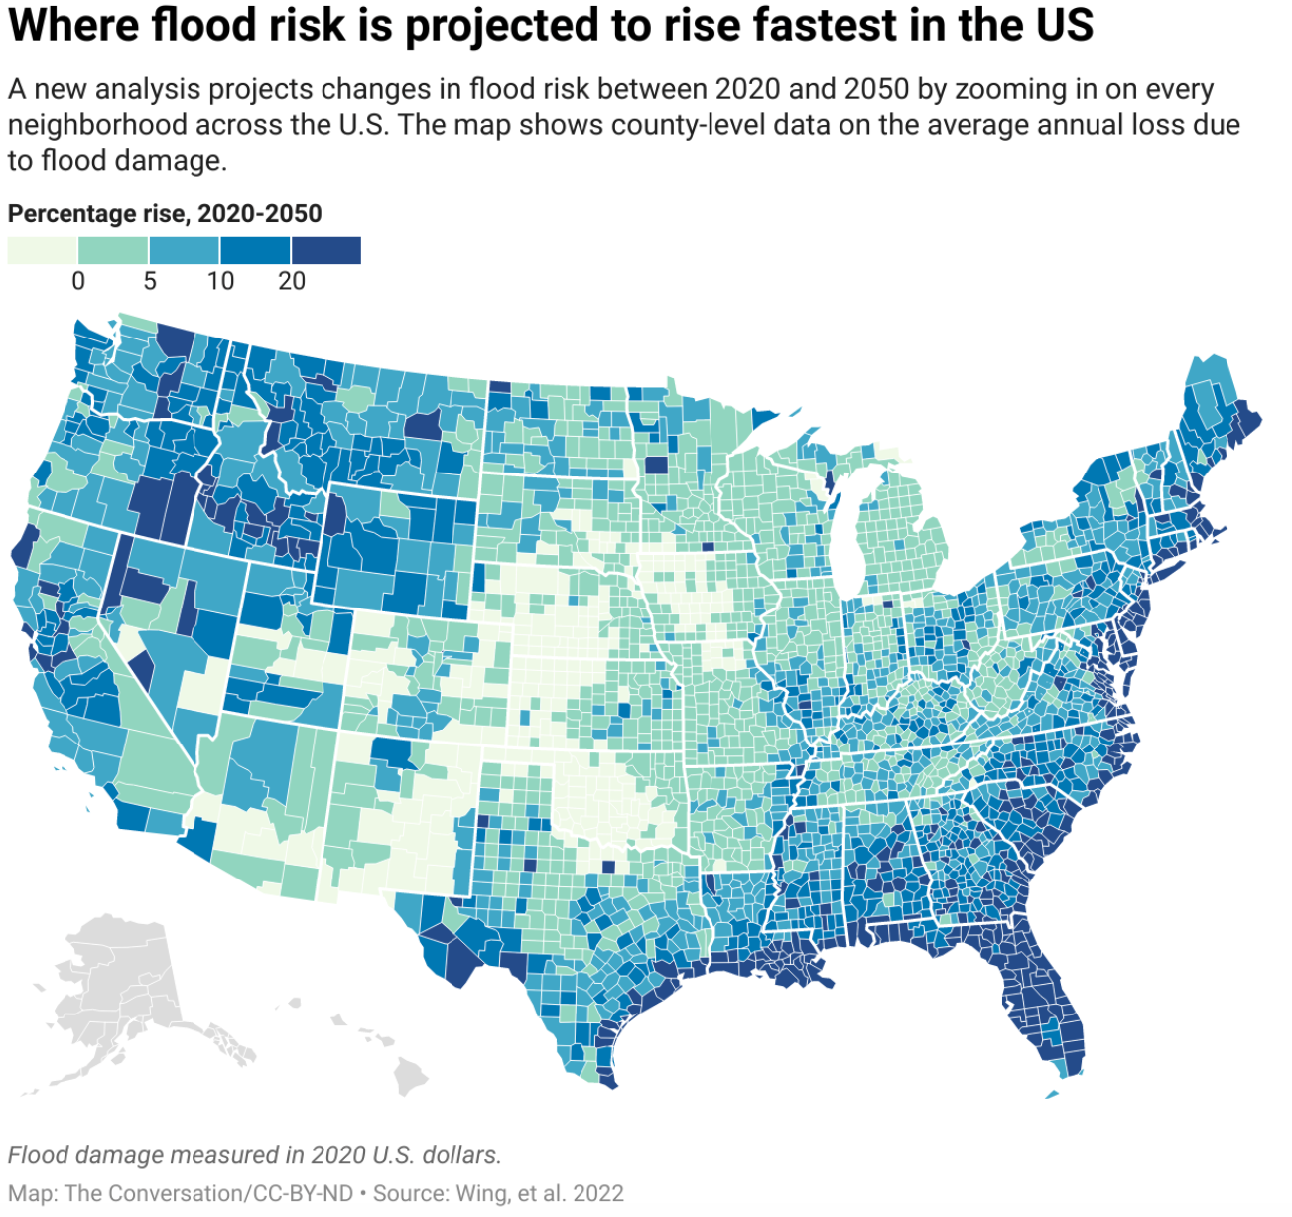
Flooding
Definitions:
Floods: The overflow of water onto dry land
Flash Floods: Rapid flooding within six hours, with a quick rise in water levels and strong currents (Petersen, 2001).
Impact:
Loss of life and property (Špitalar et al., 2014).
Notes:
Definitions:
Floods: Overflow of water onto normally dry land, typically due to prolonged heavy rainfall, snowmelt, or dam breaks. These are longer duration events that cause extensive damage to property and longer-term displacement of populations (Calianno et al., 2013).
Flash Floods: Rapid flooding, typically within six hours of intense rainfall or other events like dam breaks, characterized by a rapid rise in water levels and strong currents (Petersen, 2001).
These are more sudden and unpredictable, leading to higher immediate risk to human life and infrastructure (Gaume et al., 2009).
Impact: Both types of floods cause extensive socio-economic damage, including loss of life, property damage, and disruption of infrastructure (Špitalar et al., 2014).

Slide 3

Societal Impacts
Differences in Societal Impact:
Flash Floods: Sudden and unpredictable, higher immediate risk (Gaume et al., 2009).
Floods: Longer duration, extensive property damage, and displacement (Calianno et al., 2013).
Disparate Impact on Vulnerable Populations:
Vulnerable Groups: Greater risks for low-income communities and minorities (Terti et al., 2015).
Differences Based on Race and Gender:
Disparities: Higher impacts and slower recovery for minorities and women (Bhuiyan et al., 2021).
Notes:
Likewise, both floods and flashfloods have been shown to have disparate Impacts on Vulnerable Populations such as, Low-income communities, racial minorities, and other marginalized groups often face greater risks and have fewer resources to recover from disasters (Terti et al., 2015).
Relatedly, In terms of race and gender-based disparities, minority groups and women often experience higher impacts and slower recovery rates due to socio-economic disparities and access to resources (Bhuiyan et al., 2021).

Slide 4

Missing Persons
Missing Persons:​
Causes: Displacement and rescue challenges from flash floods and floods.​
Disparities:
  Higher unresolved cases among minority groups (Calianno et al., 2013).​
  Women are more vulnerable to natural disasters due to socio-economic disparities, responsibilities, and lack of resources (Neumayer & Plümper, 2007).
Indigenous woman are especially vulnerable to trafficking and violence
Research Gaps:​
Limited research on flood-related missing persons by race and gender (Knocke & Kolivras, 2007).​
Notes:
One of the other impacts floods my have are an increase in missing persons
Some literature has also pointed to disparities among race and gender in Missing Persons cases
- research has found that minority women have higher rates of unresolved missing person cases than their white counterparts
- Activist groups in the US and Canada have also draw attention to extremely high rates of unsolved cases among missing and murdered indigenous women
Indigenous woman are especially vulnerable to trafficking and violence due to:
Reporting policies on tribal vs federal lands
Inter-agency coordination
Media coverage failures
Low SES
Transient in lifestyle
Research Gaps: Limited research specifically linking floods to patterns in missing persons, especially when considering racial and gender disparities (Knocke & Kolivras, 2007).

Slide 5
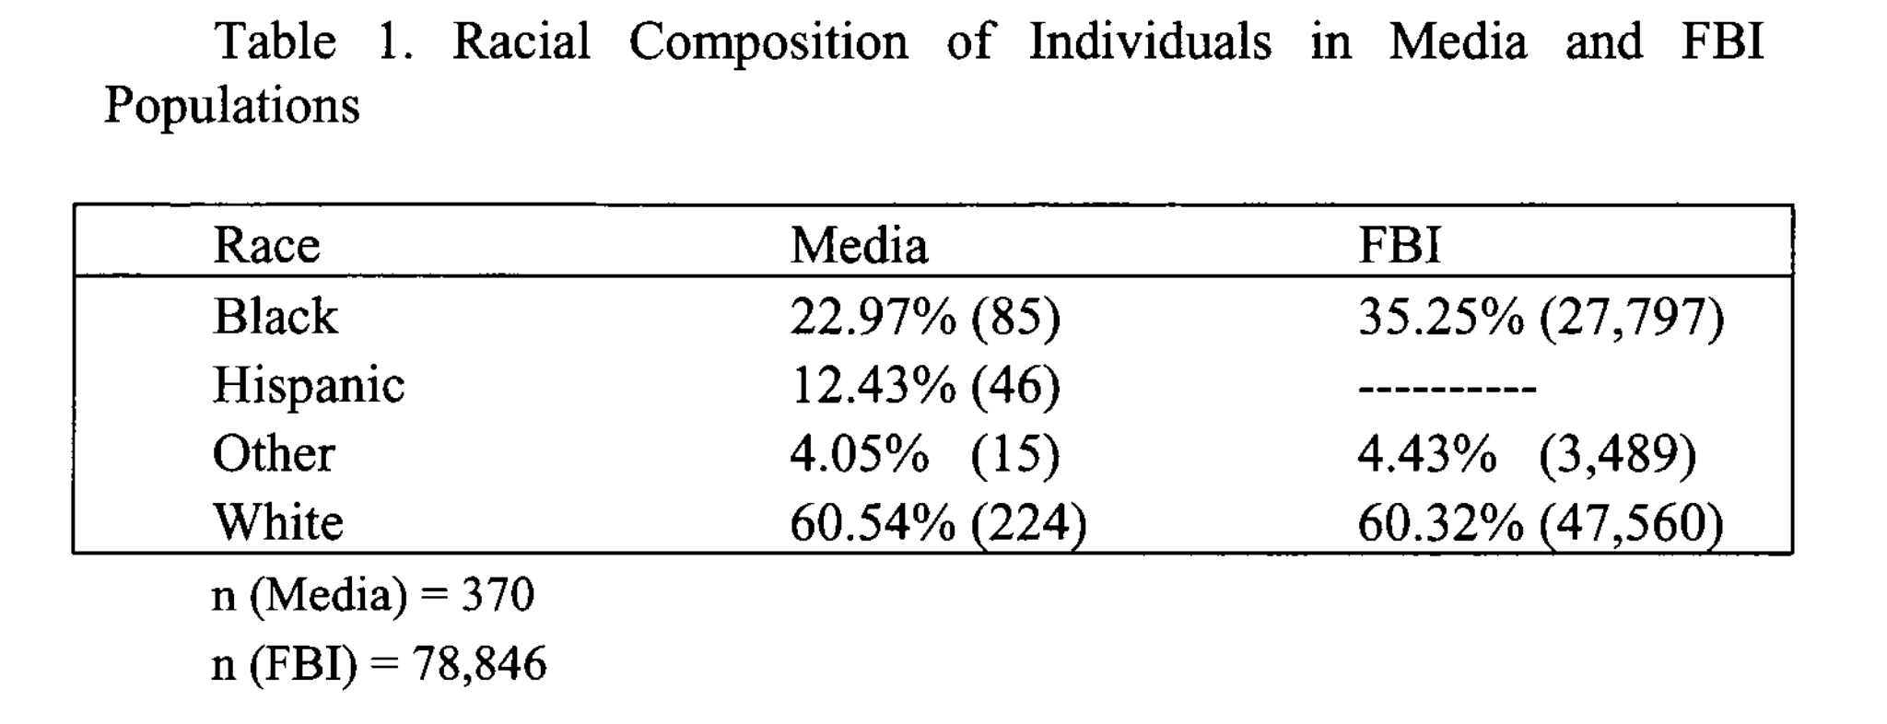
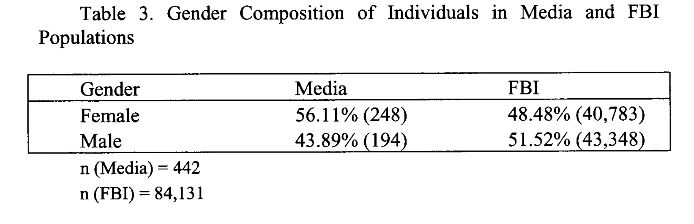
Missing White Women Syndrome
Source Sommers 2017
Notes:
Missing white women syndrome puts a name to the disparity between how often cases of missing white women are reported in the media, seen here as nearly proportional, compared to cases of men and women of color, which often go uncovered by the media.
Some scholars such as Jeanis et al have hypothesized that social media may heighten this further, with cases of missing white women often being ”liked” and “viewed” more often by social media users
This is important as media coverage is correlated with community involvement and places pressure on law enforcement to find the missing individual. In these cases, police reporting has been significantly associated with successful case outcomes (finding the missing person and/or arrests being made)
Relatedly, it is important to note that minority communities may be less likely to trust police, which could also subsequently effect case outcomes Miethe et al 2023

Slide 6

How do the impacts of floods and flash floods on missing persons in the United States differ based on race/ethnicity and Sex?
Research Question
Notes:
This leads us to our research question: How do the impacts of floods and flash floods on missing persons in the United States differ based on race/ethnicity and sex?

Slide 7

Data
NamUs: Database on missing persons in the U.S.
NOAA: Storm event database - Floods and Flash Floods
Unit of Analysis: County-month-years in the United States from 1997-2023.
Sample Size: 3144 counties, 1,018,656 observations
Notes:
Namus= National Missing and unidentified persons system

Slide 8
Methods
Outcomes:
Missing men and women from the racial categories of White, Indigenous, Black, Hispanic/Latino (Latinx), and Asian
Key Predictors:
Floods, flash floods, direct flood deaths, direct flood injuries, direct flash flood deaths, direct flash flood injuries
Analytic Strategy:
Mixed effect multilevel negative binomial regression models
Notes:
FIPS codes are included as random effects in the model. This means that the model accounts for variability within each FIPS code (geographic area), allowing for random intercepts that can vary across these areas.
By including FIPS as a random effect, the model already accounts for unobserved heterogeneity across different counties. This includes variations in baseline rates of events due to factors that are not explicitly measured. The random effect captures county-specific effects, making it unnecessary to include every potential county-level control variable.

Slide 9
Sample overview
Category | Frequency
Flash Floods | 1,589,478
Floods | 164,056
Missing Persons (all groups) | 25,240
Missing Black People | 3,952
Missing White People | 13,644
Missing Indigenous People | 788
Missing Latinx People | 3,356
Missing Asian People | 563
Notes:
(other races/ethnicities excluded due to small sample)

Slide 10
Descriptives by race and sex
Race | Female Frequency | Male Frequency
White | 5,140 | 8,503
Black | 1,661 | 2,288
Latinx | 1,121 | 2,235
Asian | 238 | 325
Indigenous | 225 | 562
Notes:
check for sex vs gender
and which states require resporting by the FBI

Slide 11
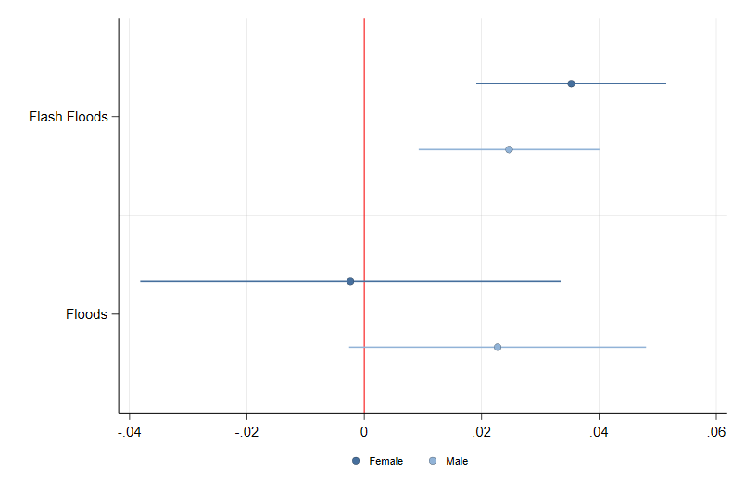
Preliminary Results
Coefficient Plot of Mixed Effect Negative Binomial Regression Models for Missing woman and men During Floods
Notes:
Key Elements of the Plot: Male and female disagregated
X-Axis (Coefficient Values):
The horizontal axis represents the coefficient values, ranging approximately from -0.04 to 0.06.
The red vertical line at zero indicates the point of no effect.
Y-Axis (Flood Types):
The vertical axis lists the two types of flood events: "Flash Floods" and "Floods".
Data Points and Error Bars:
The plot includes separate points for female and male coefficients, represented by dots.
Error bars around the points indicate the confidence intervals of the coefficients, illustrating the uncertainty or variability around these estimates.
Coefficient Interpretation:
Flash Floods:
For females, the coefficient is positive, suggesting that flash floods have a higher association with missing women.
For males, the coefficient is also positive and slightly lower than for females, indicating a similar but slightly weaker association.
Floods:
The coefficients for both females and males are close to zero, with wider confidence intervals. This suggests that the association between floods (not flash floods) and missing individuals is weaker and less certain for both genders.
Interpretation:
Gender Differences: The plot indicates that both men and women are affected by flash floods, with men possibly having a slightly stronger association. However, for general floods, the effect is less pronounced and more uncertain.
Confidence Intervals: The wider error bars for floods compared to flash floods imply greater uncertainty in the estimates for floods, possibly due to lower incidence rates or greater variability in the data.

Slide 12
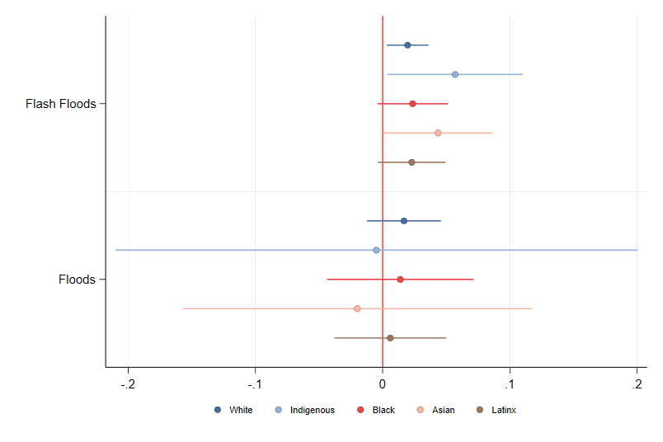
Preliminary Results
Coefficient Plot of mixed Effect Negative Binomial Regression models of missing Persons by race
Notes:
Interpretation: All missing persons by race
Flash Floods:
White: The coefficient is positive, suggesting a significant association between flash floods and an increased number of missing White people
Indigenous: The coefficient is positive and slightly higher than for White individuals, with wider confidence intervals.
Black: The coefficient is positive with the confidence interval crossing zero, suggesting a positive but uncertain association between flash floods and missing Black people
Asian: The coefficient is positive but closer to zero, indicating a minor positive association.
Latinx: The coefficient is positive with the confidence interval crossing zero, indicating a minor and uncertain association.
Floods:
All confidence intervals cross zero, indicating a non-significant association for floods.

Slide 13
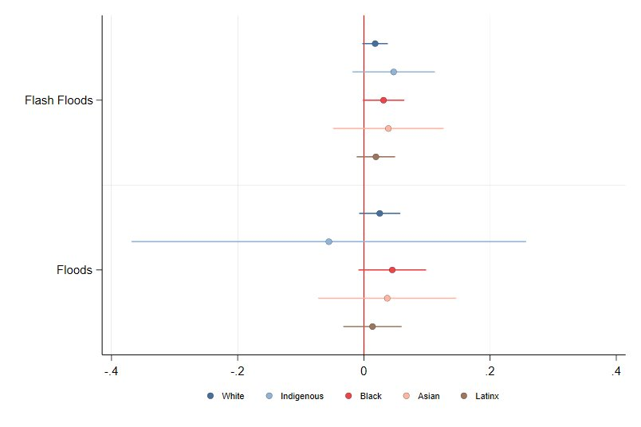
Preliminary Results
Coefficient Plot of mixed Effect Negative Binomial Regression model of missing Men by race
Notes:
Interpretation: Men by race
Flash Floods:
White: The coefficient is slightly positive but close to zero, indicating little to no significant association between flash floods and missing White men.
Indigenous: The coefficient is slightly negative with a relatively wide confidence interval and crosses zero.
Black: The coefficient is positive, suggesting a significant association between flash floods and an increased number of missing Black men.
Asian: The coefficient is positive with the confidence interval crossing zero, indicating a minor and uncertain association.
Latinx: The coefficient is positive with the confidence interval crossing zero, indicating a minor and uncertain association.
Floods:
All confidence intervals cross zero, indicating a non-significant association for floods.

Slide 14
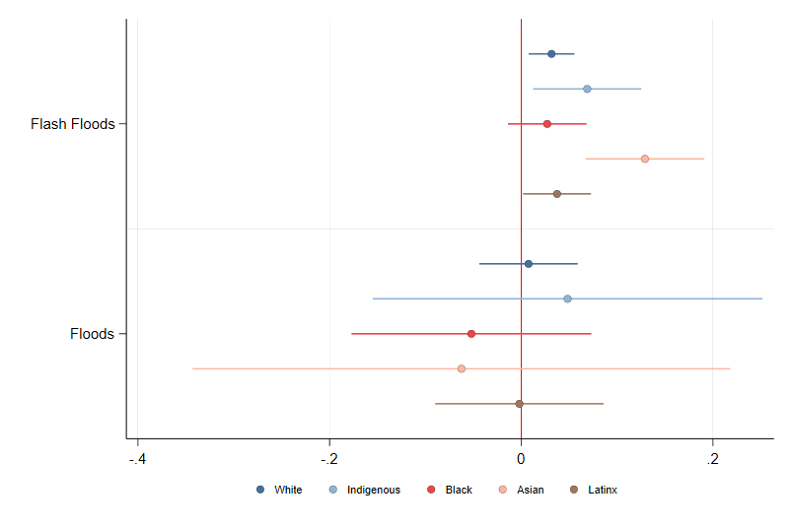
Preliminary Results
Coefficient Plot of mixed Effect Negative Binomial Regression model of missing woman by race
Notes:
Interpretation: Women by Race
Flash Floods:
White: The coefficient is positive and relatively small, indicating a positive association between flash floods and missing White women.
Indigenous: The coefficient is positive and slightly higher than for White women, with wider confidence intervals.
Black: The coefficient is positive with the confidence interval crossing zero, suggesting a positive but uncertain association between flash floods and missing Black women.
Asian: The coefficient is positive but with a wider confidence interval, indicating some uncertainty.
Latinx: The coefficient is slightly positive with a wide confidence interval, indicating uncertainty in the association.
Floods:
All confidence intervals cross zero, indicating a non-significant association for floods.

Slide 15
Discussion and Results
Flash Floods:
Have a more significant association with missing persons compared to general floods.
Gender Differences:
Both men and women are affected by flash floods, with woman showing a slightly stronger association.
Racial Differences in Flash Floods
Women: varied positive associations across all racial groups, . Indigenous and Asian women have higher coefficients, but with uncertainty
Men: positive associations, marginally significant for Black and White men
Implications:
Targeted interventions are needed for flash floods, especially for vulnerable groups.
Further research is necessary to understand and address the disparities in flood impacts.
Notes:
Read slide

Slide 16
Future Directions
Include more key predictors, controls and context variables
Control for spatial autocorrelation
Center key predictors
Add population exposure to the models.
Notes:
Future Directions
Include More Key Predictors, Controls, and Context Variables:
Expand Predictors: Identify and include additional variables that may influence the likelihood of missing persons during floods, such as socioeconomic status, housing quality, and access to emergency services.
Contextual Variables: Incorporate contextual factors like local climate conditions, flood severity, and historical flood data to better understand the broader environmental context.
Control Variables: Include control variables to account for potential confounders, such as age, health status, and employment type.
Control for Spatial Autocorrelation:
Spatial Dependence: Ensure that the model accounts for spatial autocorrelation, which occurs when observations in close geographical proximity are more likely to be similar.
Techniques: Utilize spatial econometric techniques such as spatial lag models or spatial error models to properly control for spatial dependence and ensure robust estimates.
Software Tools: Employ GIS (Geographic Information System) software or spatial statistics packages in statistical software (e.g., R, Stata) to address spatial autocorrelation.
Center Key Predictors:
Normalization: Center the key predictors by subtracting the mean value of each predictor from its individual values. This normalization helps in interpreting the effects of predictors and reduces multicollinearity.
Interpretability: Centering allows for more straightforward interpretation of interaction terms and main effects in the model.
Add Population Exposure to the Models
These are the exposure models
Exposure Metrics: Incorporate measures of population exposure to floods, such as population density, number of people living in flood-prone areas, and the proportion of vulnerable populations.
Impact Assessment: By including population exposure, the model can better assess the risk and impact of floods on different population groups.
Data Sources: Utilize census data, demographic surveys, and other reliable sources to accurately quantify population exposure.

Slide 17

Questions?
Email: Schenk.67@buckeyemail.osu.edu
Twitter/X: @Schenkday

